Slide 1
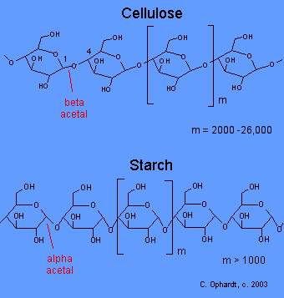
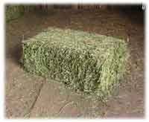
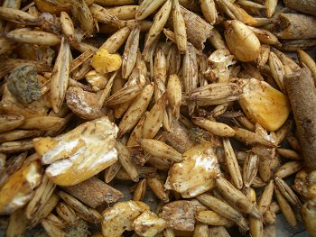
Carbohydrates
Equine Nutrition

Slide 2
Carbohydrates
Principles sources of energy
Originate from?
Forages
Grains
Grain By-Products
All CHO’s contain similar amounts of GE
But different amounts of DE, ME, and NE
CHO’s digested and absorbed in the S.I. yield
More energy than when digested by microbial action

Slide 3
Carbohydrates
Categorized as?
Mono-saccharides
Di-saccharides
Oligo-saccharides
Poly-saccharides

Slide 4
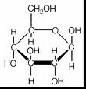
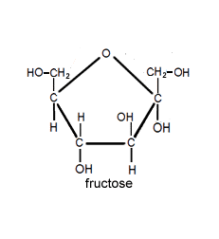
Carbohydrates
Mono-saccharides of nutritional importance include:
Glucose Fructose Galactose
Mannose Arabinose Xylose

Slide 5
Monosaccharides
Free mono-saccharides occur in
Low concentrations in plants
Important constituents of
Oligo-saccharides
Poly-saccharides

Slide 6
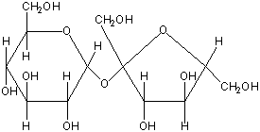
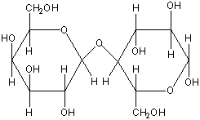
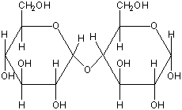
Di-saccharides
Few of importance in equine diet
Exception: Lactose for foals
Include:
Sucrose
Glucose + Fructose
Lactose
Glucose + Galactose
Maltose
Glucose + Glucose

Slide 7
Oligosaccharides
Composed of short chain monosaccharides
3 – 10 monosaccharide units
Most common:
Raffinose
Stachyose
Fructooligosacharide aka fructan
Mannoligosacharides

Slide 8
Polysaccharides
Contain > 10 monosaccharide units
Largest and most complex CHO’s
Most common?
Starch and Cellulose
Pectin and Hemicellulose (not as common)
Type of linkage between monosaccharide residues in oligo- and polysaccharides has a great influence on what?
Site of digestion

Slide 9
Carbohydrates

Slide 10
Carbohydrates
Hydrolysis of the α 1-4 linkage of starch can occur where?
Small Intestine
Hydrolysis of the β 1-4 linkage of cellulose and hemi-cellulose must occur where?
Cecum or colon
Microbial Fermentation

Slide 11
Carbohydrates
Classification on Plant CHO’s
Neutral Detergent Fiber (NDF)
Cellulose, Hemi-cellulose, and Lignin
Non-fibrous CHO’s
Aka Nonstructural CHO
Comprised of all CHO’s not found in NDF
Includes?
Mono- and disaccharides
Oligosaccharides
Starch

Slide 12
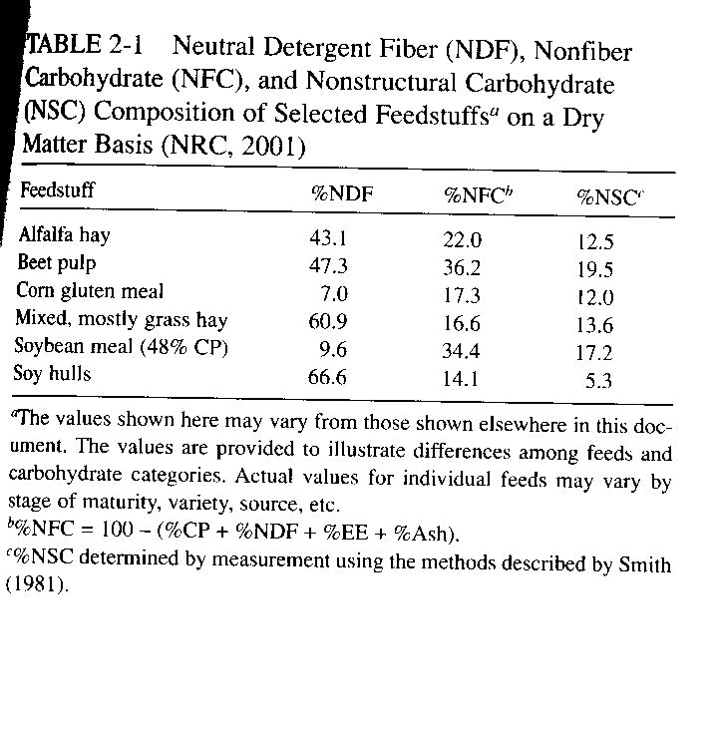
Carbohydrates
CHO composition of feed can vary greatly
Especially for forages and bi-products

Slide 13
Carbohydrates
Structural CHO’s are important energy sources
Microbial production of VFA’s in cecum
Up to 30% of maintenance
Additional VFA’s produced in
Colon
Principle VFA produced from fiber
Acetate
Propionate and butyrate also significant

Slide 14
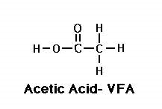
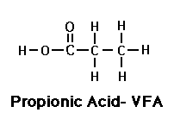
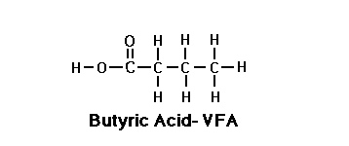
Carbohydrates
Acetate
Propionate
Butyrate

Slide 15
Carbohydrates
Acetate may be used directly for energy
If not used immediately probably used for the synthesis of
Long-chain fatty acids
May be stored
May be secreted in milk
Research has shown that mares consuming high-forage rations have
Higher milk fat percentages

Slide 16
Carbohydrates
Propionate may be used for
Hepatic glucose synthesis
Important in forage fed horses
Butyrate not well studied

Slide 17
Carbohydrates
What may affect microbial populations in the L.I.?
Diet composition
Particularly CHO composition
Proportions of VFA’s produced
What VFA is produced more in a high forage diet?
Acetate
What VFA is produced more in a high concen diet?
Propionate

Slide 18
Carbohydrates
Are structural CHO’s necessary in the diet?
Does the amount of fiber in the diet affect the weight of the GIT?
Why?
High fiber diets tend to hold more water
Mass of GIT may also be increased

Slide 19
Carbohydrates
Are non-structural CHO’s necessary in the diet?
When energy needs cannot be met by forage alone
What are non-structural CHO’s primarily made of?
Starch
Where should the majority of digestion take place?
Small Intestine

Slide 20
Carbohydrates
Are their differences in starch digestibilities?
Why?
Structural variation dependants on feed type
Two main components of starch
Amylose
Amylopectin

Slide 21
Carbohydrates
How do amylose and amylopectin differ?
Amylose
Straight chain structure of glucose units
Amylopectin
Branched chain of glucose units
Proportions in starch vary by
Cereal grain
Maturity
Variety

Slide 22
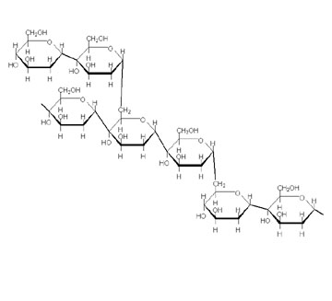
Amylose
Amylopectin

Slide 23
Carbohydrates
What may reduce pre-cecal digestion of amylose and amylopectin?
Type and amount of forage
Abundance of amylase in digestive secretions
What may ↑ pre-cecal digestion of these?
Type and amount of forage
Grain Processing
Decreasing particle size
Increasing surface area

Slide 24
Carbohydrates
What are other factors that affect pre-cecal digestion?
Grain type
Oat starch more digestible than corn or barley
Amount of starch consumed at one time
What happens if starch is not digested in the S.I.?
Enters into L.I. and is fermented
Is this a good thing?

Slide 25
Carbohydrates
Starch digestion in L.I.
Lowers net energy value
No longer will be broken down to glucose
May alter microbial environment
May be good only on very poor quality forage diet
Generally bad
Could decrease concentration of cellulolytic bacteria
Decrease pH
Should avoid high starch diets

Slide 26
CHO Metabolism and Storage
What happens when a meal high in starch is consumed?
Blood glucose concentrations ↑
Insulin levels ↑
Glucose uptake to muscle and adipose
Glycemic Index
↑ in blood glucose levels associated with substrate consumed

Slide 27
CHO Metabolism and Storage
What happens to glucose once it is absorbed?
May be used for immediate energy
Stored for later use
Fat synthesis
What is stored glucose referred to as?
Glycogen
Where are the main store sites?
Muscle
Liver

Slide 28
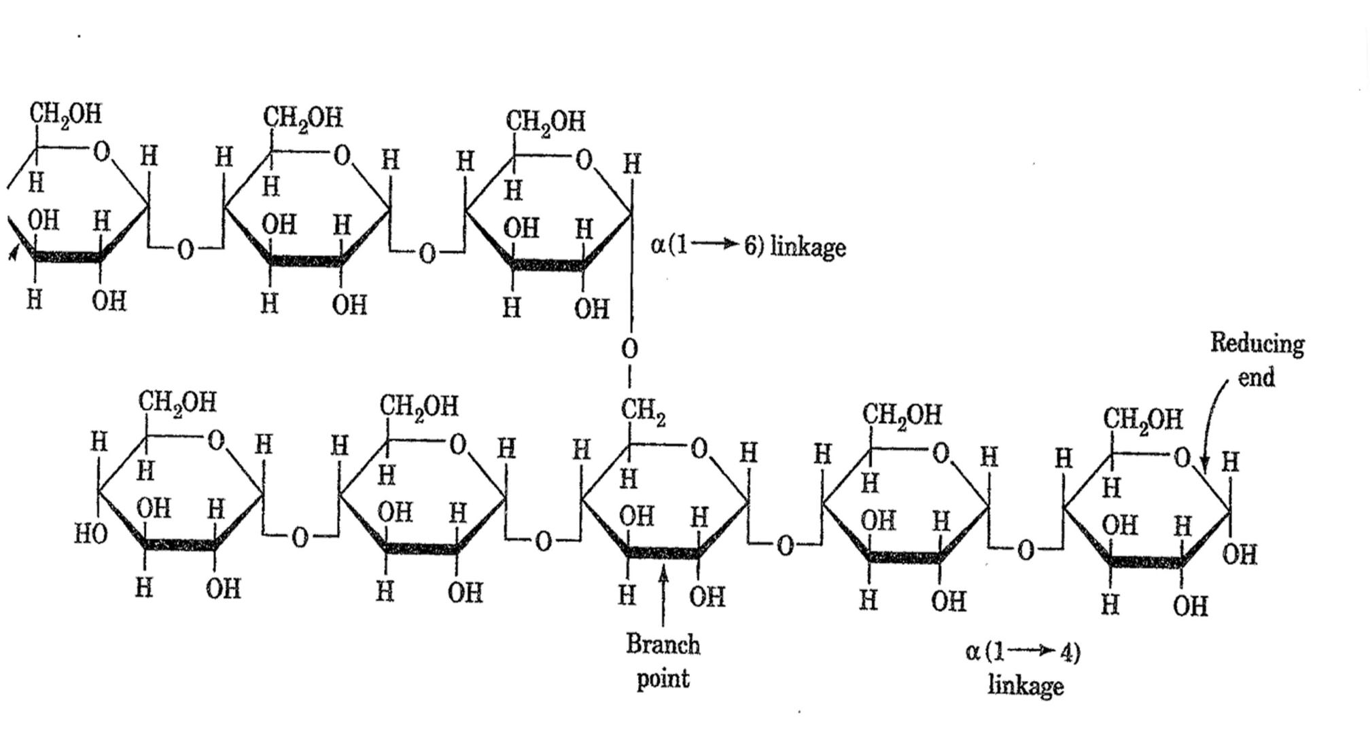
Glycogen

Slide 29
CHO Metabolism and Storage
Muscle glycogen can only be used for
Muscle energy
Glycogen stored in liver can be used for
Maintaining blood glucose levels
Provide glucose for other tissue
CHO’s very important in the exercising horse
Requirements ↑ as work intensity ↑

