Slide 1
Selection and Evaluation of Horses
Introduction to Conformation

Slide 2
Conformation
What is conformation?
Physical appearance due to the arrangement of:
Muscle
Bone
Other body tissue
Is there a perfectly conformed horse?
Each breed organization has it’s ideal

Slide 3
Conformation
Before comparing horses, what is essential?
A mental picture of the ideal
What is the purpose of judging?
To find within a group of horses, the horse most typical of the ideal of that breed, the second closest, etc.

Slide 4
Conformation
Will the ideal horse of the class always possess the optimal conformation for all performance events?
It is essential to judge horses in a conformation class based on their merit that day.
Do not attempt to predict the riding ability of an individual being shown in a conformation class

Slide 5
Conformation
What defines conformation?
Skeleton
Geometry of the horse
A really competent judge must have:
A sound understanding of all parts
Also, the function of those parts

Slide 6
The Ideal?
AQHA States:
Horse should possess eye appeal that is the result of:
Head
Harmonious blending and attractive
Throatlatch
Refined, well-proportioned with a trim neck
Shoulder
Long and sloping

Slide 7
The Ideal?
AQHA States:
Horse should possess eye appeal that is the result of:
Heart girth
Deep
Back
Short with strong loin and coupling
Hip and croup
Long and flat
Stifle, gaskin, forearm, and chest
Well defined and muscular

Slide 8
The Ideal?
Characteristics should be coupled with:
Straight and structurally correct legs
Feet that are free of blemishes
Should also be a balanced athlete
Muscled uniformly throughout

Slide 9
AQHA Purpose
To Preserve AQH Type by selecting:
Well-mannered individuals in the order of their resemblance to the breed ideal and that are the most positive combination of
Balance
Structural correctness
Movement
With appropriate breed and sex characteristics
Adequate muscling

Slide 10
APHA Purpose
Ideal standard should include
but not limited to a positive combination of:
Balance
Breed and sex character
Soundness and correctness of conformation
Particularly feet and legs
Emphasis on correct manner of travel
Muscling

Slide 11
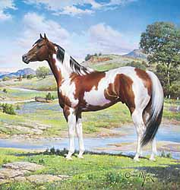
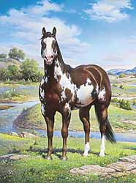
Ideal Paint Horse

Slide 12
Priorities of Judging
What are the eight priorities?
Balance
Breed Type
Sex Character
Quality
Structural Correctness
Movement
Size
Muscling

Slide 13
Priorities of Judging
Rating conformation depends on objective evaluation of four traits:
Balance
Structural Correctness
Breed and Sex Character
Degree of Muscling

Slide 16
Parts of the Horse
What is the ideal head?
Length of head
Ears
Eyes
Nostrils
Jaw
Mouth
Muzzle

Slide 17
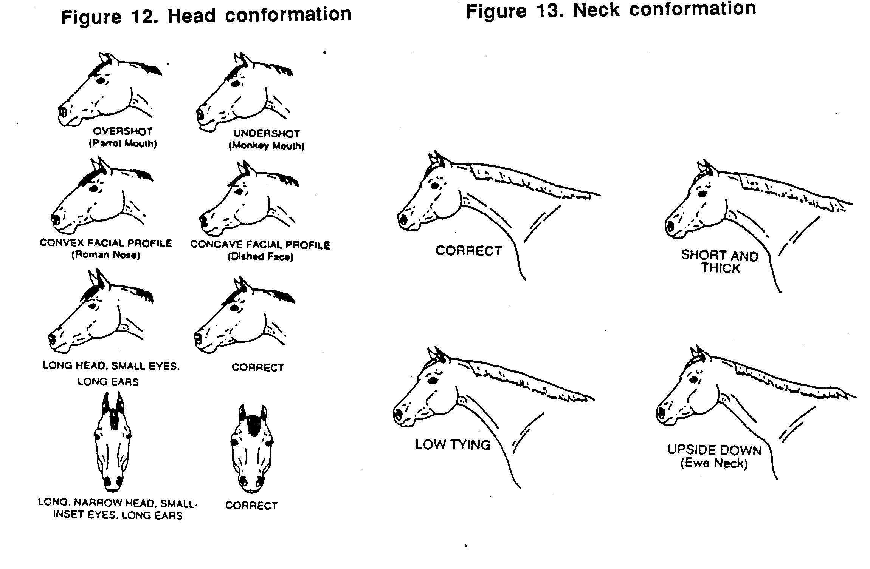

Slide 18
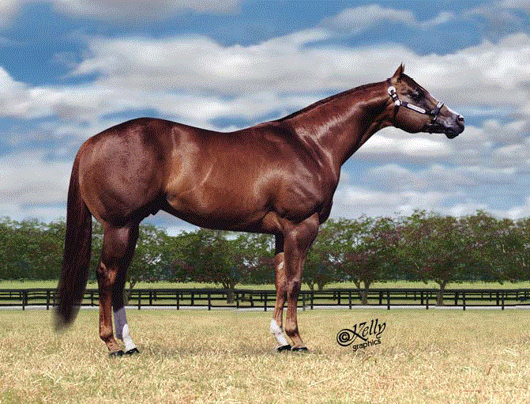
Head

Slide 19
Parts of the Horse
What is the ideal neck? Throatlatch?
Ideal neck would ~ be a 2 to 1 ratio top to bottom
A horse that is short and heavily muscled will have
Shorter, thicker neck than taller horse with less muscle
Neck is proportional to the horse’s what?
Overall length and height

Slide 20
Neck
Neck Length
2x
1x
Neck Refinement
Neck set

Slide 21
Parts of the Horse
What is the determining factor in the ratio of the top to bottom line of the neck?
Slope of shoulder. Why?
As shoulder becomes more sloping what happens?
Top line becomes longer in relation to the bottom line
As the shoulder becomes straighter
Ratio of the top to bottom line smaller

Slide 22
Parts of the Horse
All horses are basically proportional
But not necessarily balanced
What is the single most important characteristic in equine selection?
Balance
What is balance determined by?
Skeletal structure

Slide 23
Determining Balance
1/3
1/3
1/3

Slide 24
Parts of the Horse
Nothing is more critical to balance than what?
Slope of shoulder
What happens when the slope of the shoulder changes?
Top to bottom line ratio of the neck changes
Ratio of the length of the back to length of the underline changes

Slide 25
Parts of the Horse
What happens when shoulder becomes straighter?
Withers move forward, resulting in what?
Longer back
Length of underline is not affected
Thus the appearance of a tube
So what is the ideal top line to underline ratio?

Slide 26
Top Line

Slide 27
Parts of the Horse
When the shoulder is straight, the other angles of the horse’s body will be straight too.
Short, steep croup
Straight stifle
Straight pasterns
In general:
Angle of pasterns will correspond with
Angle of the shoulder

Slide 28
What is the ideal slope to the shoulder?
Angle
Length
Angle

Slide 29
Parts of the Horse
What else besides overall balance does the slope of the shoulder influence?
Length of stride
Angle of shoulder and pasterns serve to absorb shock when the horse moves
Therefore, what will occur with a straight shouldered horse?

Slide 30
Parts of the Horse
What are ideal withers?
Sharp, prominent, and slightly higher than the croup
Properly balanced horse will appear to be
Sloping downhill from front to back
When withers are higher than the croup
Hindquarters are positioned under the body more

Slide 31
Parts of the Horse
Hindquarters should appear square when viewed from the side
The croup should remain flat
The hip should be long
Stifles should be powerful

Slide 32
Parts of the Horse
Feet and Legs:
Should be free of
Blemishes and unsoundnesses
Should be straight from profile as well as front and hind
Should be able to track freely and easily while maintaining a straight line

Slide 33
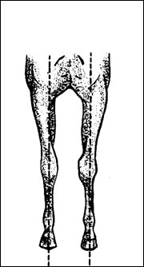
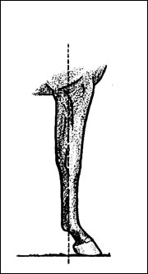
Forelegs, viewed from the front, should be centered under the points of the shoulders.
From the side, knees should be flat and pastern should slope at about 45 degrees.

Slide 34
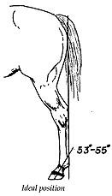
Ideal Leg Conformation

Slide 35
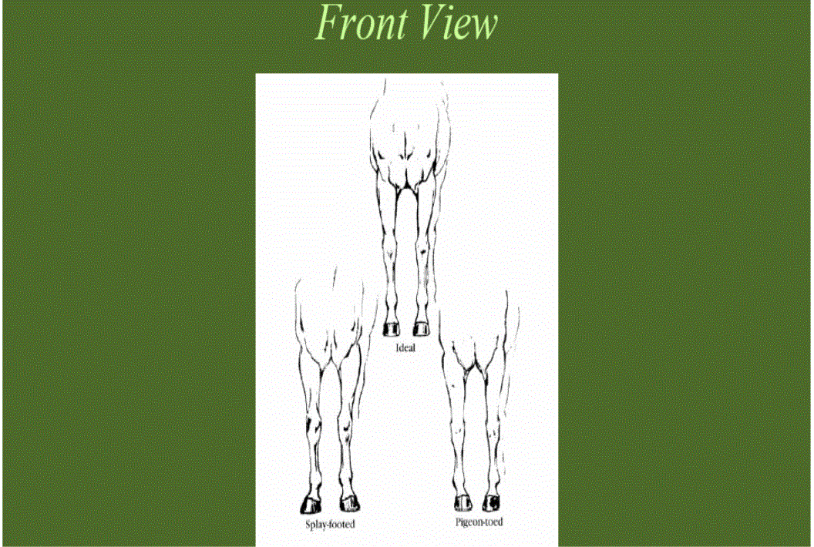
Ideal
Pigeon-toed
Splay-footed

Slide 36
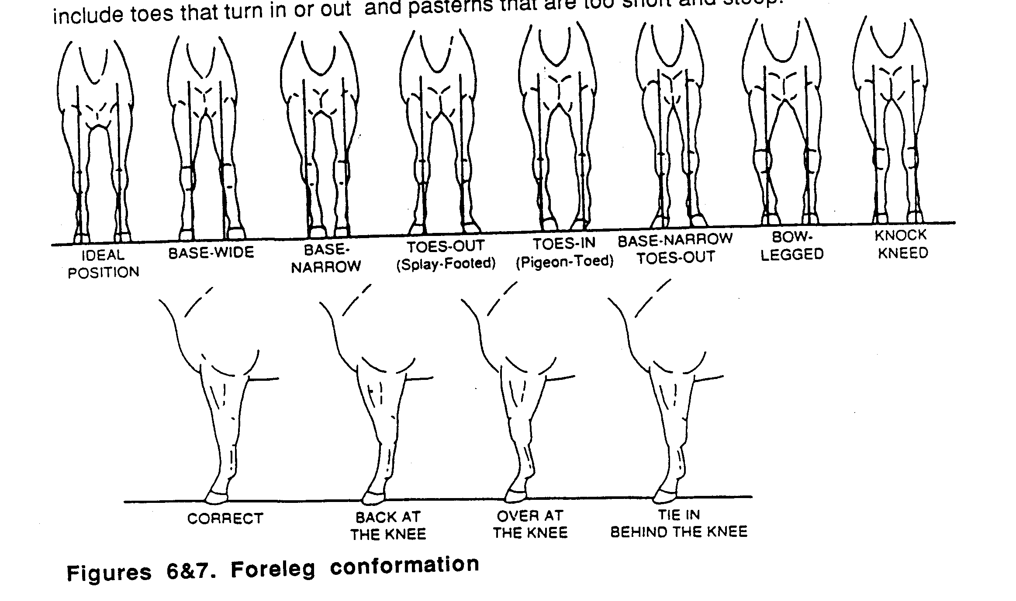
Foreleg Conformation

Slide 37
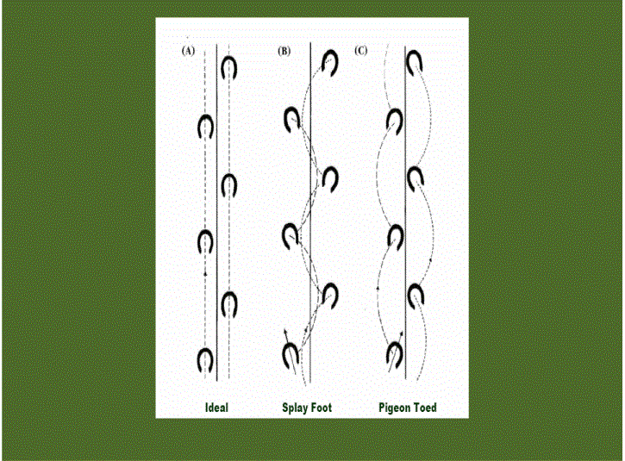

Slide 38
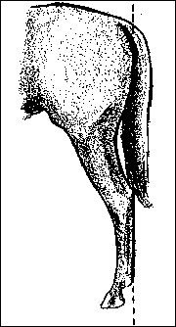
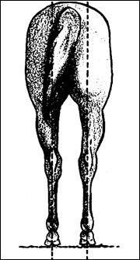
Hind legs, viewed from the rear, should be centered under the points of the buttocks;
From the side, hock, cannon and fetlock should align with the back of the buttock.

Slide 39
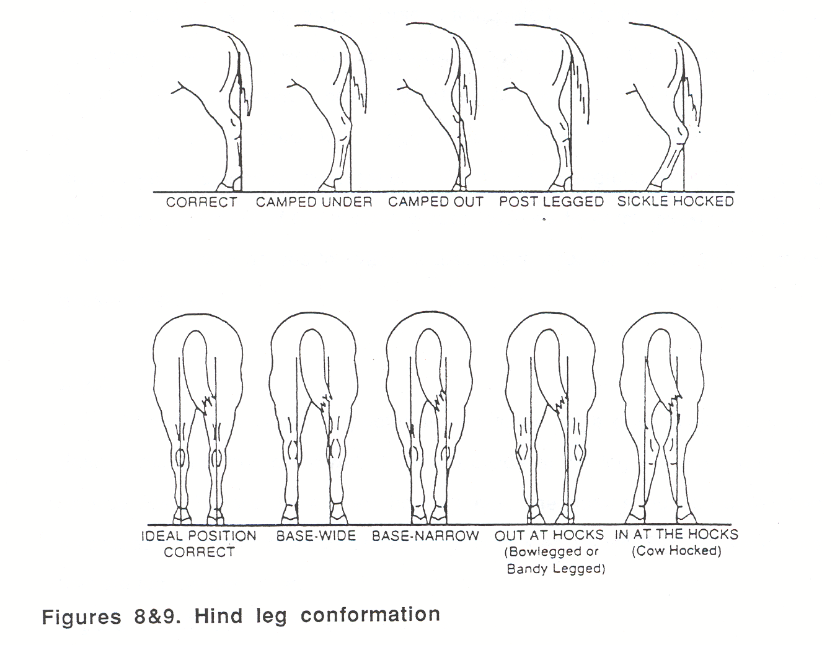

Slide 40
Blemishes and Unsoundnesses

Slide 41
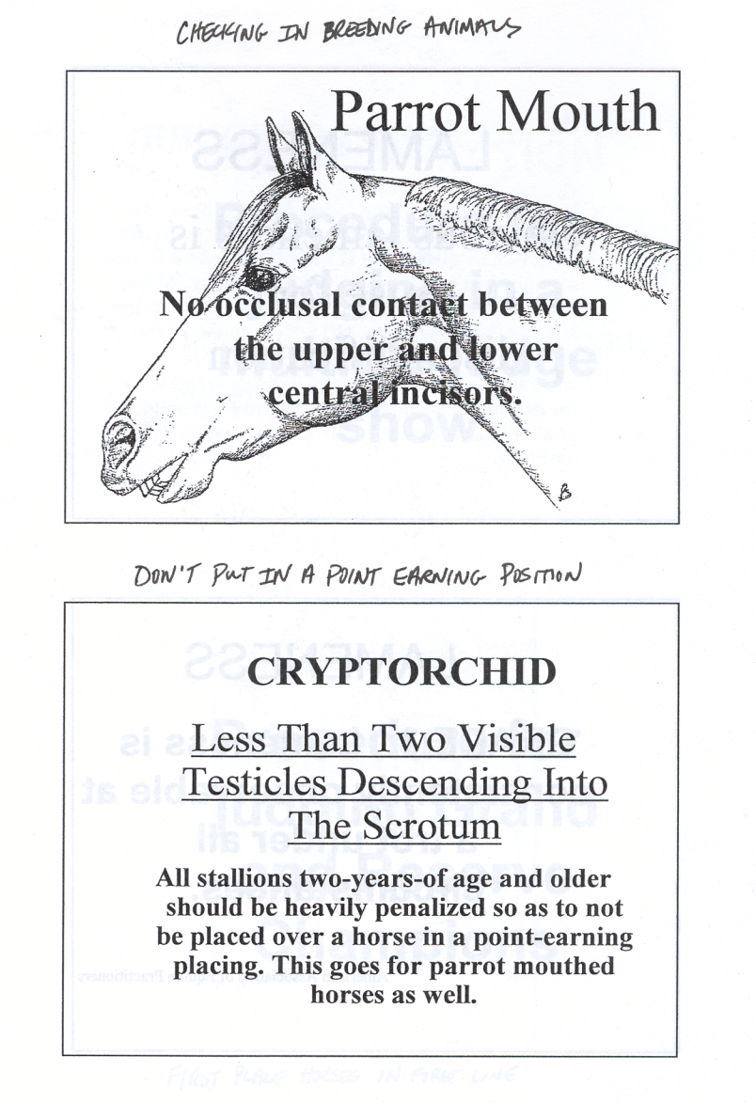
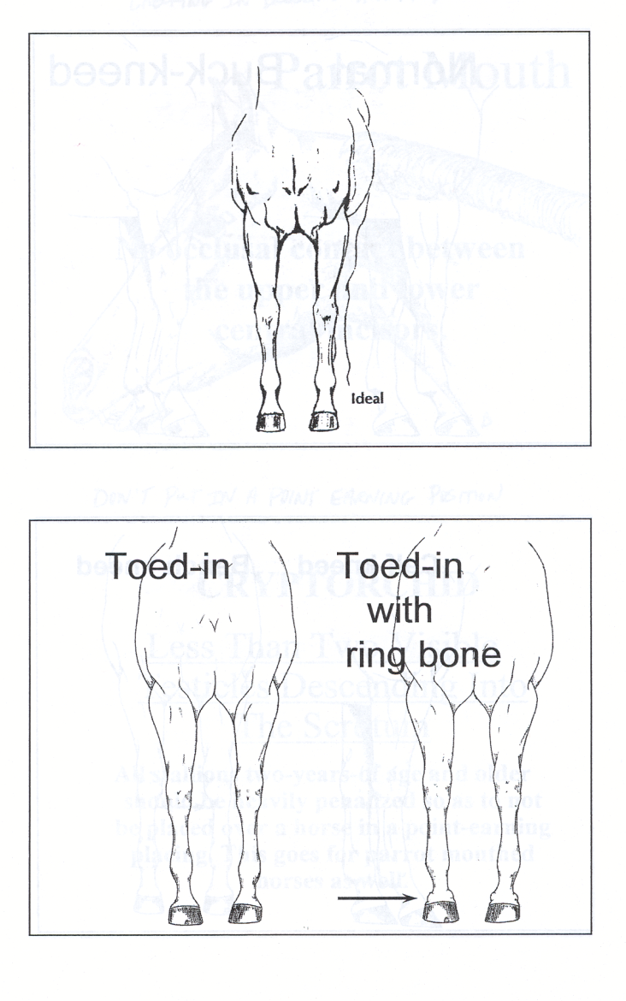
Blemishes

Slide 42
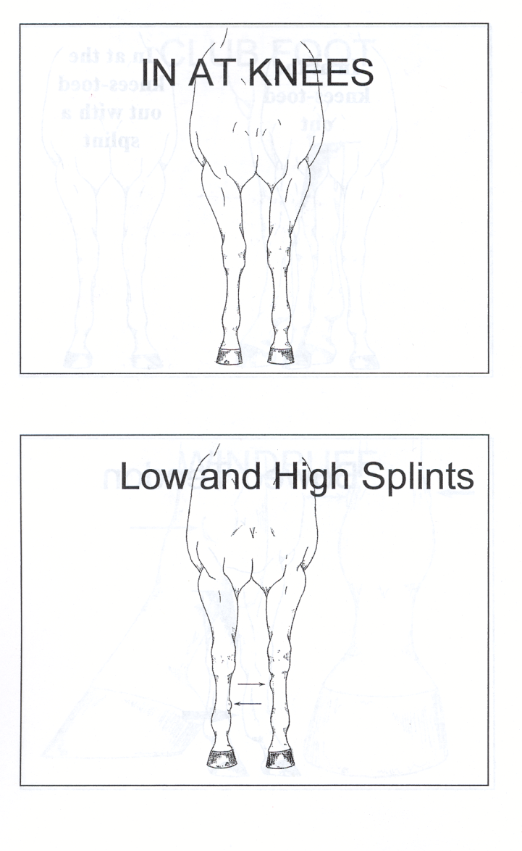
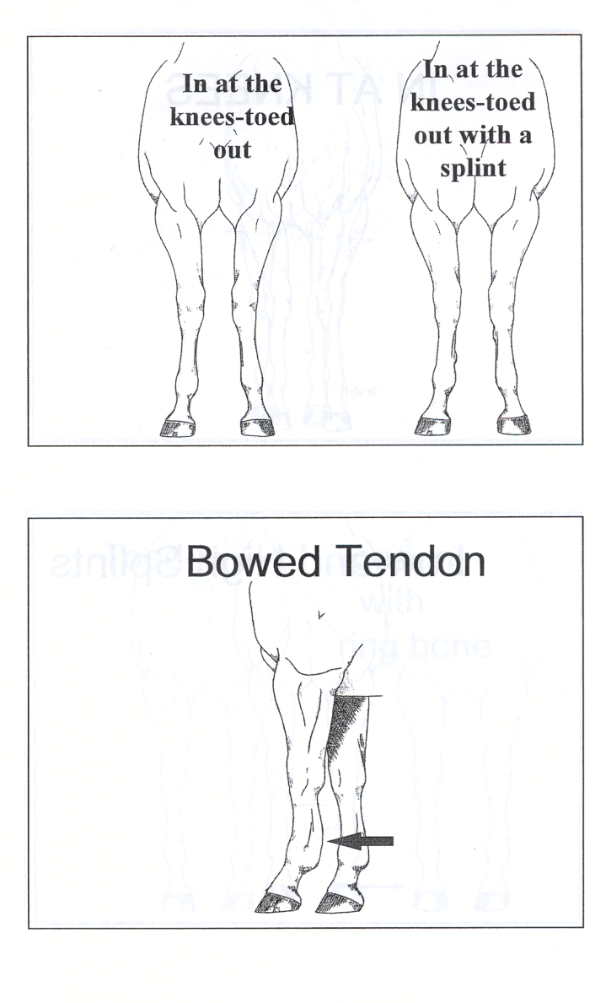
Blemishes

Slide 43
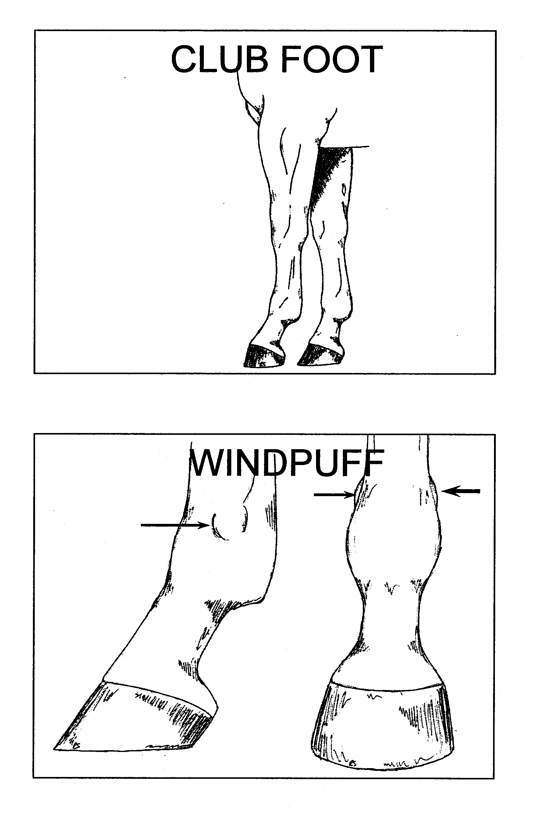
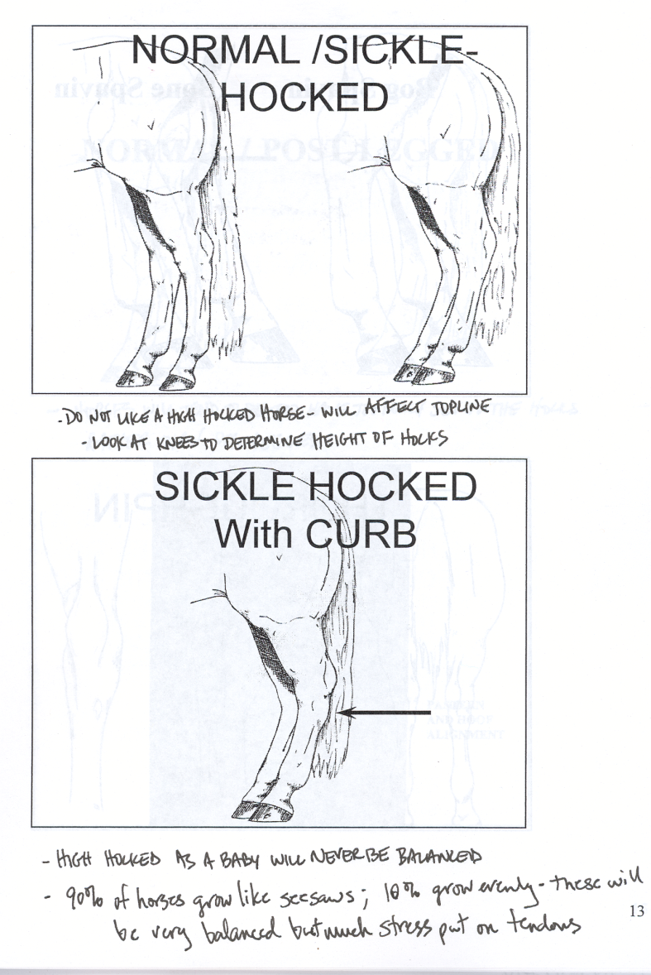
Blemishes

Slide 44
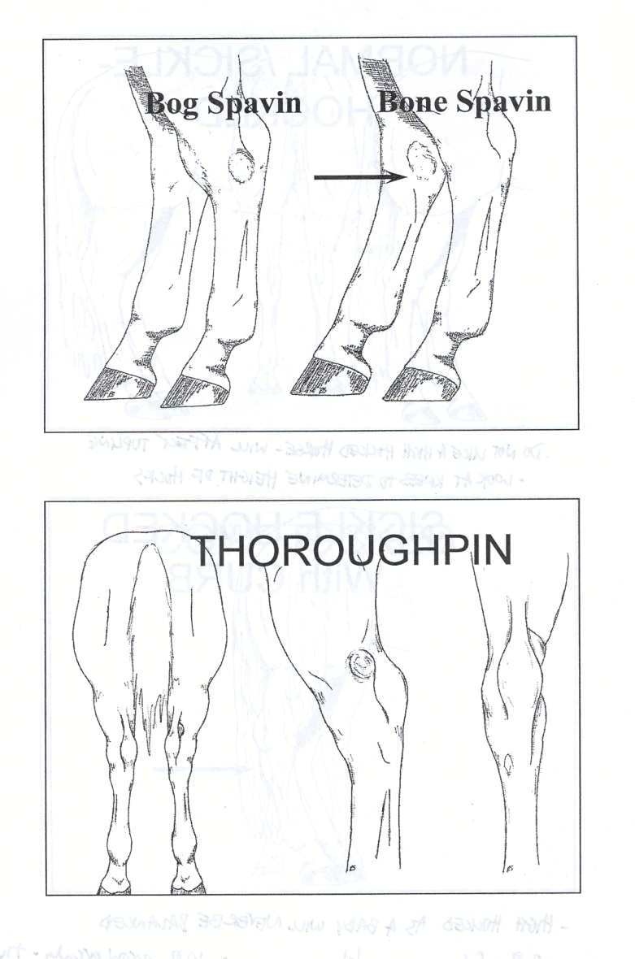
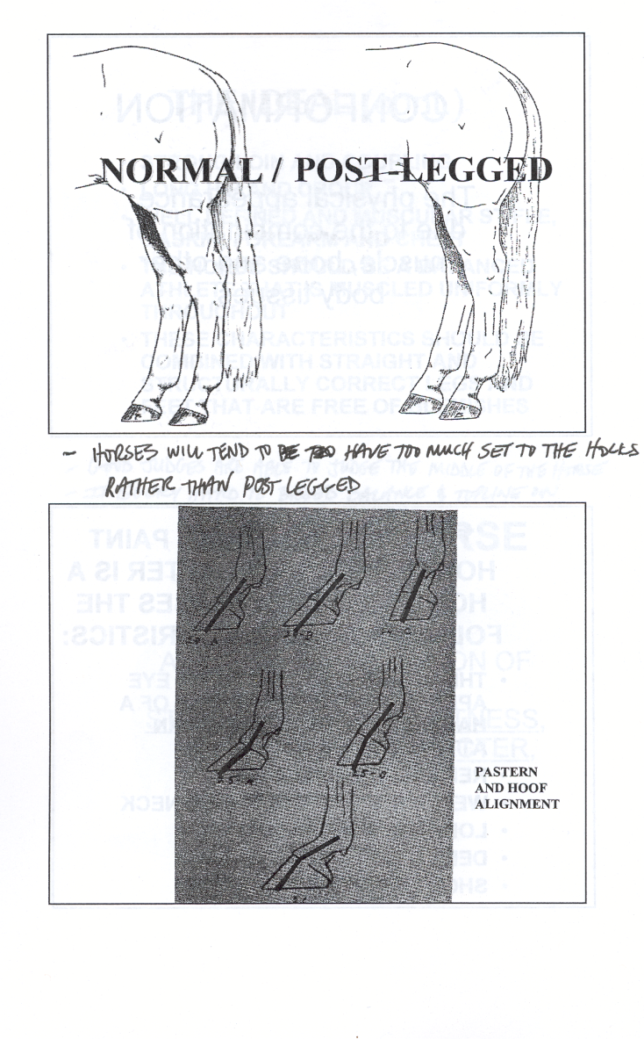
Blemishes

Slide 45
Characteristics of a Successful Judge
Clear mental picture of the ideal or type
Ability to recognize undesirable traits
Ability to employ deductive reasoning
Incorporate practical decisions in a positive manner
Mental and physical stamina necessary to
Make logical decisions under pressure
Ability to effectively defend the placing of a class

Slide 46
POSITIVE EVALUATION
vs.
ELIMINATION

Slide 47
Mr Yella Fella 2005, 2006, 2007, 2008 Leading AQHA Halter Sire

Slide 48
Sock Broker 1997, 1998, 1999 APHA Leading Sire of Halter Horses

Slide 49
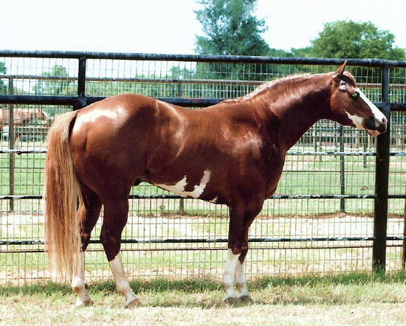
Mighty Awesome All Time Leading APHA Halter Sire

Slide 50
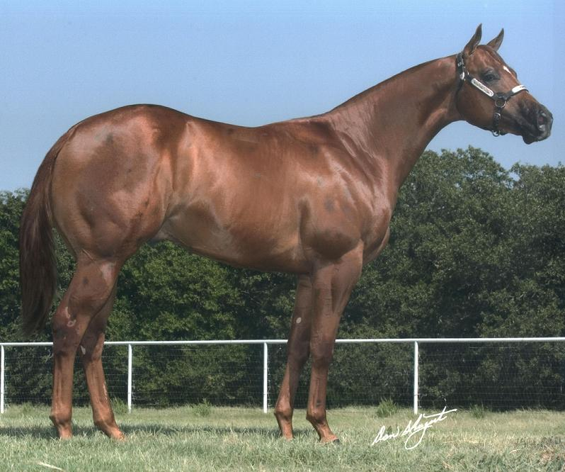
Intoxicate 2003 Sorrel Stallion

Slide 51
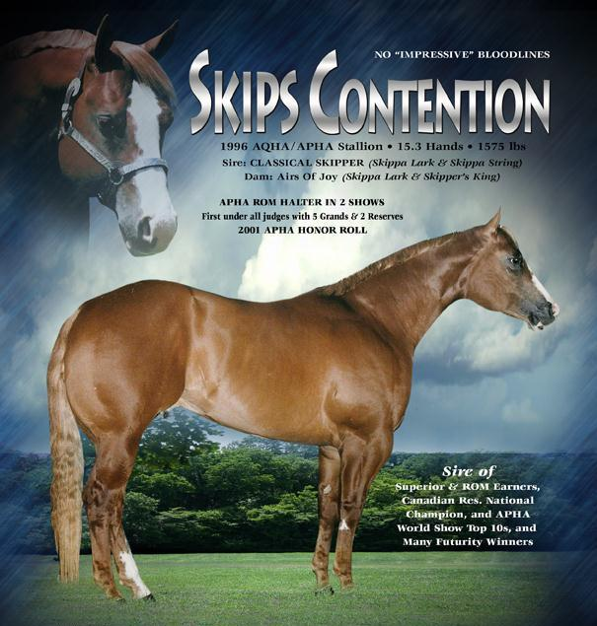

Slide 52
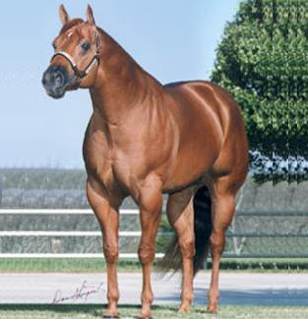
Perpetualism 1993 Stallion 16 Hands, 1450 lbs. Three Time World Champion

Slide 53
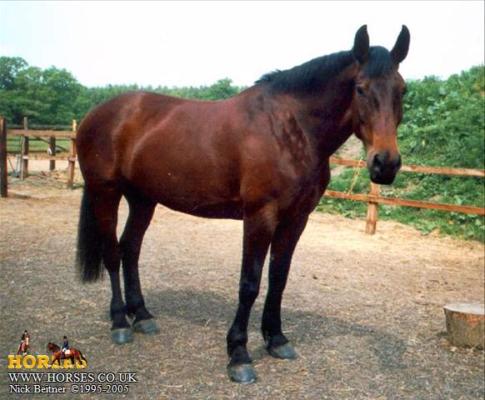
Lucky

Slide 54
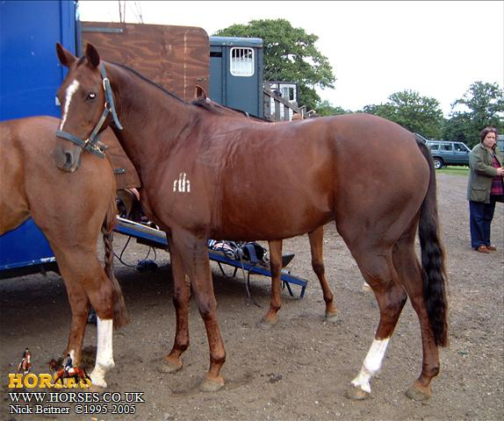

Slide 55
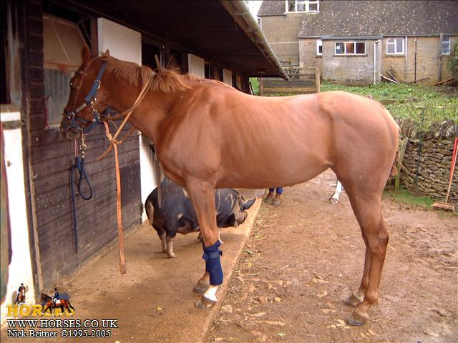

Slide 56
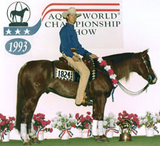
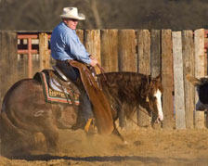
Smart Chic Olena $8,000,000.00 Sire (NCHA, NRHA, NRCHA)

