Slide 1
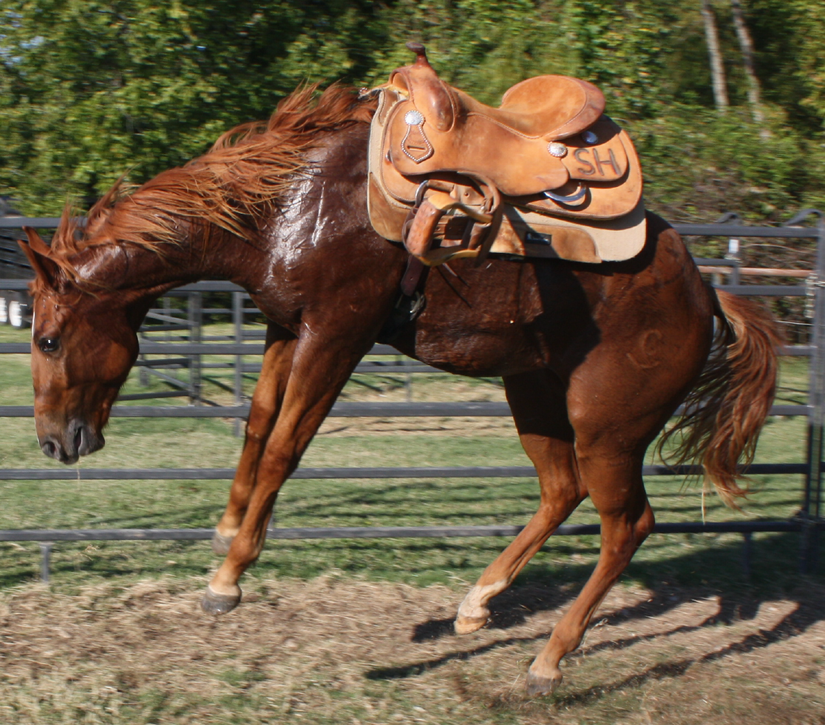
Equine Behavior

Slide 2
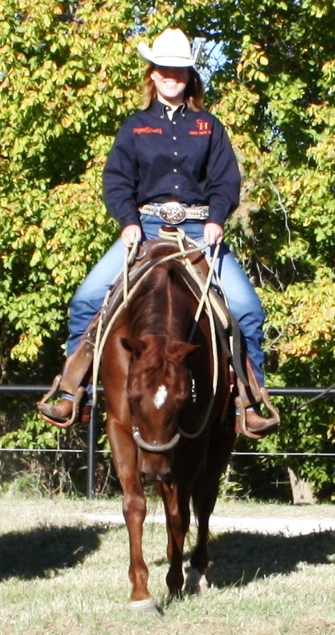
Equine Behavior
Why is it important to understand?
So communication can take place
So safety can be maintained
So training can occur

Slide 3
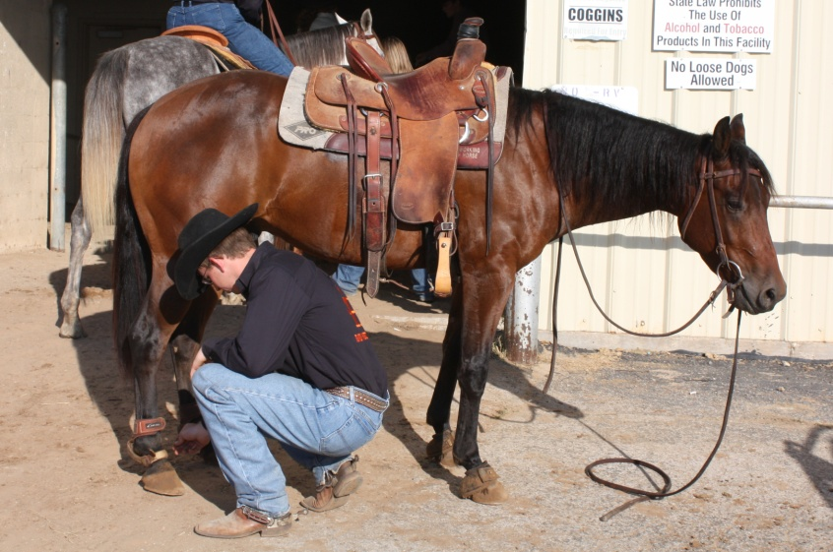
Equine Behavior
What types of behaviors do horses typically display?
Fight or Flight?
Creatures of Habit?
Creatures of Laziness?
Would it be beneficial to understand these behaviors when attempting to train?

Slide 4
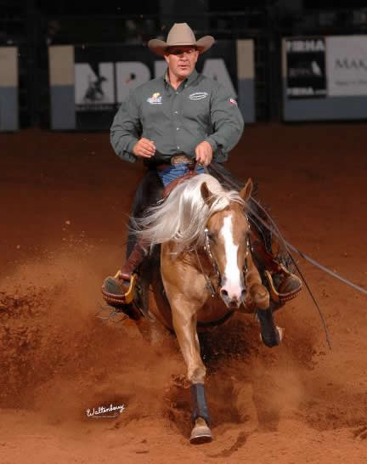
Equine Behavior
What is a horseman?
What is horsemanship?
The ability to effectively communicate with your horse according to the work at which you desire to achieve
When does horsemanship start?
When does it end?

Slide 5
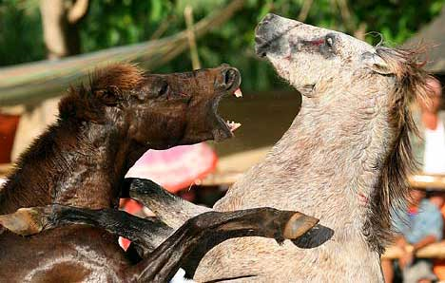
Normal Behavior
Agonistic Behavior (Includes All):
Aggressive and conflict-related actions
Fighting
Submission
Escape attempts
Dominance hierarchy
Stallions do not normally
submit to dominance easily
May fight to the death if in small pastures

Slide 6
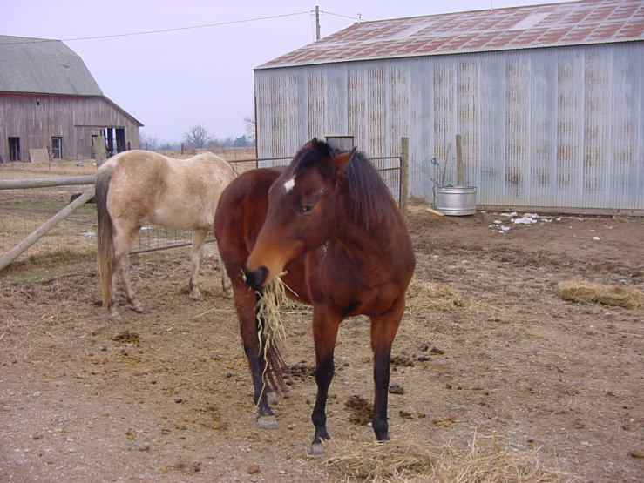
Normal Behavior
Agonistic Behavior:
One must manage horses according to:
Dominance
Submission in the herd
Many horses are dominant, but not aggressive
Rule by means of
Pinned ears
Threatening gestures
Intimidating charges

Slide 7
Agonistic Behavior

Slide 8
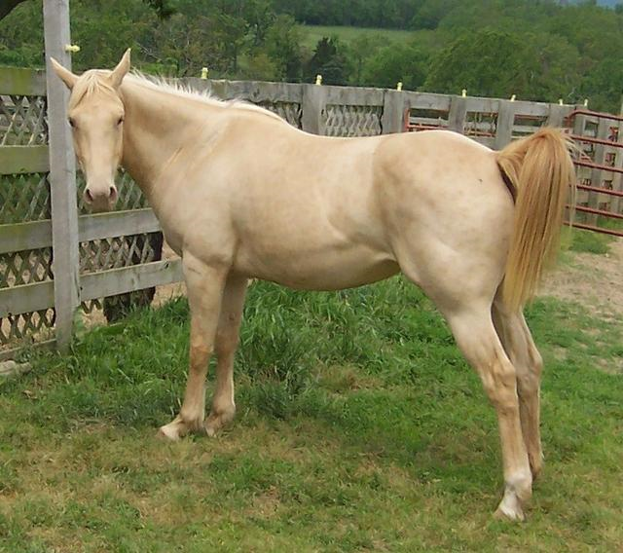
Normal Behavior
Sexual Behavior:
Fillies reach puberty when?
~20 months of age
Estrus:
Frequent urination in the
presence of a stallion,
squatting, standing, squealing
Di-estrus:
Unwilling to stand for male, possibly aggressive towards male

Slide 9
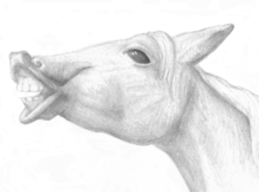
Normal Behavior
Sexual Behavior:
Intact males reach puberty much younger than fillies (Upon puberty):
Become more aggressive
May paw ground, kick, squeal
Display Flehman response
Geldings are typically not
sexually aggressive,
but some may be

Slide 10
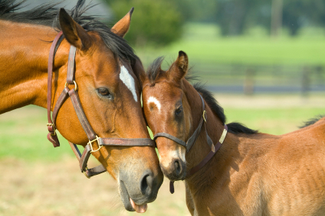
Normal Behavior
Epimeletic Behavior:
The concern of one animal for another animal’s needs
Examples:
Mares care for their foals and will fight other horses to protect them
Horses that do not associate much may stand head to tail during fly season
Stallions seldom exhibit epimeletic behavior

Slide 11
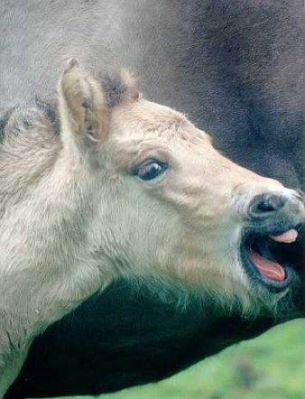
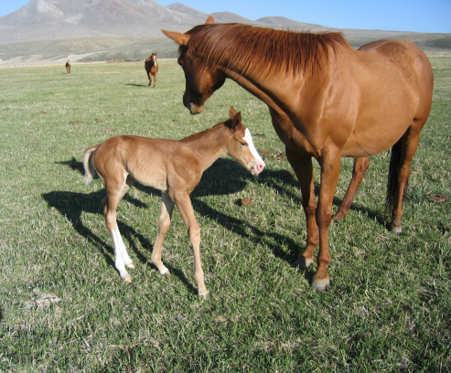
Normal Behavior
Et-Epimeletic Behavior:
Involves signaling for care and attention
Examples:
Weanlings call for their dams when separated
Recognize a pickup truck that feeds them and will meet it regularly at an appointed time
Pair Bonding: when separated they may call each other

Slide 12
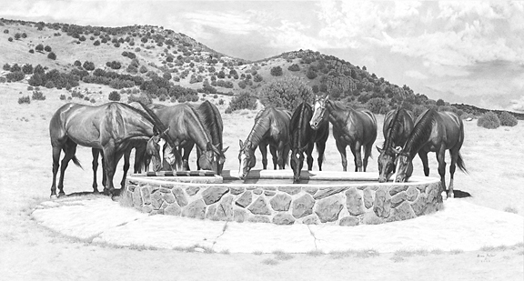
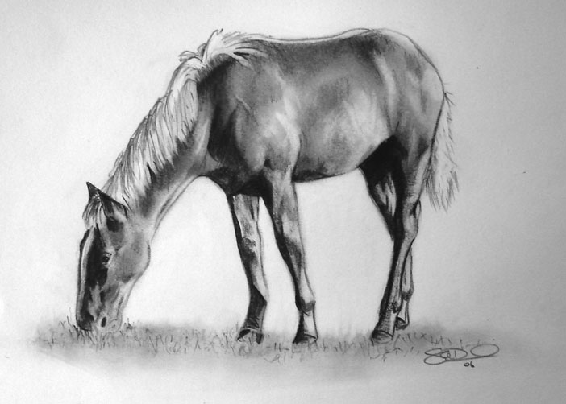
Normal Behavior
Ingestive Behavior:
The stomach of a horse is small
Therefore they prefer to eat often and in small amounts
Like to cover ground while grazing

Slide 13
Normal Behavior
Eliminative Behavior:
Where and when they urinate and/or defecate
Horses many times will wait until they get back to their stalls to urinate. Why?
Habit?
Usually only opportunity at horse show
Raised in pasture

Slide 14
Normal Behavior
Eliminative Behavior:
Stallions will often defecate outside the stall in the same spot every day
Grazing mares and geldings on good size pastures will generally defecate and urinate at will
In crowded pastures two spots may be found
Maybe a form of natural parasite management

Slide 15
Eliminative Behavior

Slide 16
Normal Behavior
Investigative Behavior:
Curious and constantly investigating their surroundings
They frequently find an open bend, gate, or other things to meddle with
May also use the senses of touch, hearing, and smell to
Identify aspects of their surroundings their inadequate eyesight has not clarified

Slide 17
Abnormal Behavior
Any difficult maneuver that is required of a horse by a human is
“Abnormal” behavior from the horse’s point of view
Horses are asked to adapt
Level of willingness is attributed to
Their flexibility and to their trainers’ skills

Slide 18
Abnormal Behavior
Some are able to adapt and some are not
We attribute level of intelligence with?
Level of adaptability
When horses are faced with abnormal conditions, they are exposed to:
Conflict
Uncertainty
Restriction

Slide 19
Abnormal Behavior
Conflict:
Mental conflict result from two opposing urges, both of which are equally strong
Example:
Young horses being exposed to work they are unfamiliar with and expected to perform the task at a high level
This creates anxiousness to avoid the work and possibly creating difficult situations

Slide 20
Abnormal Behavior
Uncertainty:
Horses exhibit abnormal behavior when faced with problems beyond their power of resolution
Example:
Rider becomes angry and spurs the horse forward then jerks on the reins; may create buck or rear

Slide 21
Abnormal Behavior
Uncertainty:
A good trainer must not only know how to ask for the desired response
But must also be sensitive enough to know when a poor response is the result of confusion rather than resistance on the horse’s part
Too much uncertainty will result in what?
Timid, hostile horses

Slide 22
Abnormal Behavior
Restriction:
Horses build a mental defense for restrictive conditions and relieve anxiety or boredom by abnormal behavior
Example:
The unexercised confined horse develops stable vices that may continue when activities are increased or when boredom ceases

Slide 23
Abnormal Behavior
Restriction:
Examples?
Cribbing, weaving, stall-walking, kicking, pawing, and eating bedding is a few
Almost all of these are
Management-induced

Slide 24
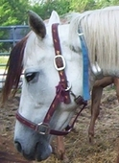
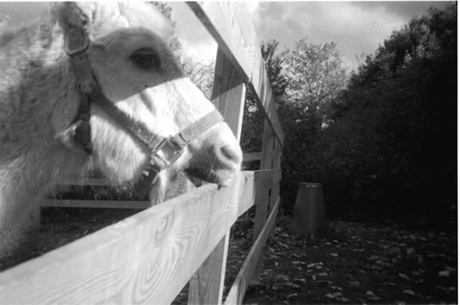
Cribbing

Slide 25
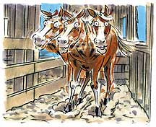
Weaving

Slide 26
Psychology and Training

Slide 27
Psychology of Training
The value of a horse is determined by what?
Largely by how much training has taken place
Horse training deals with what?
The modification of behavior
When training begins
Up to the trainer to decide the best method to achieve a specific goal

Slide 28
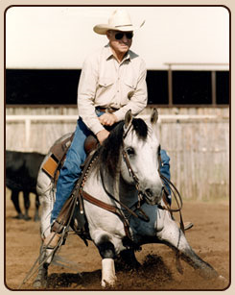
Psychology of Training
Does genetics play a role in training?
Suitability to purpose
Learning ability
Growth potential
Speed
Strength
Athleticism, etc.

Slide 29
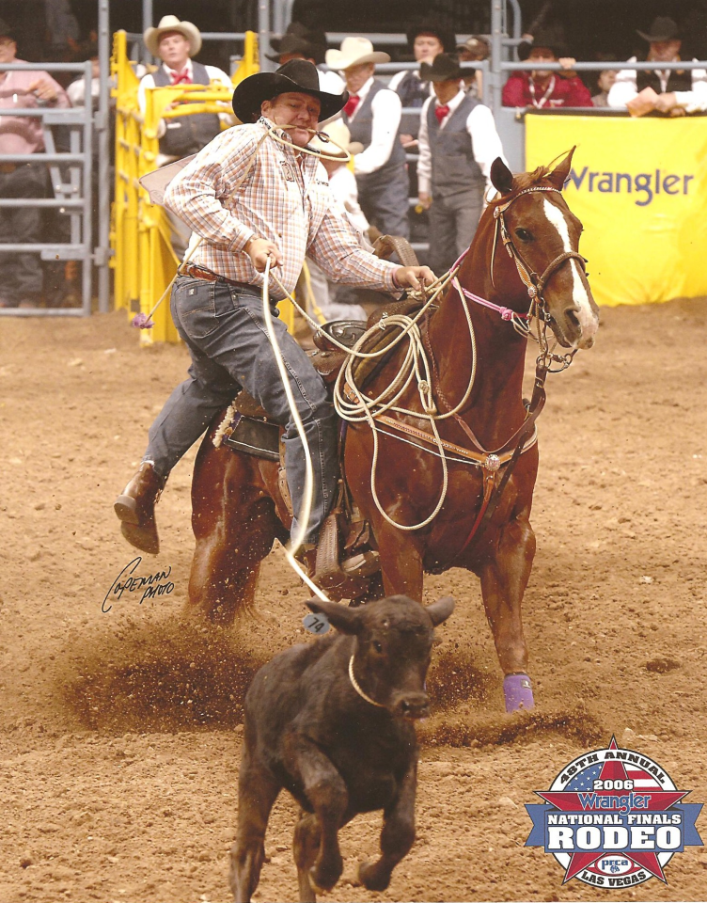
Psychology of Training
To modify behavior, the trainer has to manipulate the horses what?
Environment
The environment will be divided into:
Stimuli
Reinforcement
Will be used relative to the response he/she desires

Slide 30
Psychology of Training
What are the fundamentals to the psychology of training?
Responses
Stimuli
Reinforcement
The aspiring trainer must
Develop a clear understanding of each

Slide 31
Responses
Refers to the acts or movements which the horse makes
Training involves
Teaching the horse to make the desired response
Major responses such as
Stopping and jumping are the result of many minor responses

Slide 32
Stimuli
Divided into:
Conditioned and unconditioned categories
Depends on their natural effect on the horse
What is an unconditioned response?
A natural response with no practice
What is a conditioned response?
Learned through practice
Considered a conditioned stimulus
Known as cues

Slide 33
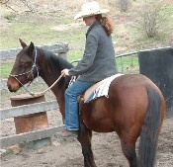
Basic Cues
Since cues must be learned, where does the trainer start?
With those basic cues that are the closest to being natural
Example: Direct rein pressure
If these obvious cues were all the horse ever acquired, would he be considered a very highly trained horse?

Slide 34
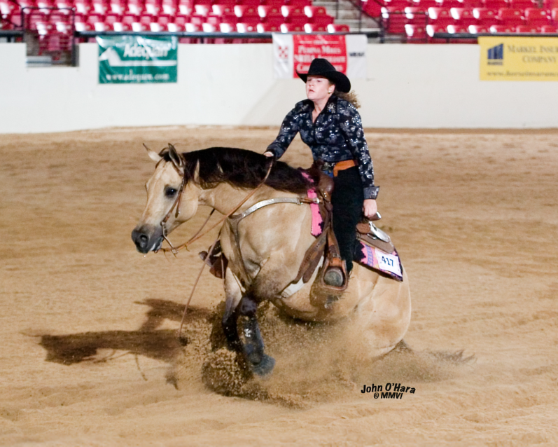
Presenting New Cues
Using the basic cues
Trainer will advance to more advanced cues
Pairing the new cue with the more basic in a daily training routine
New cue should always be presented first

Slide 35
Presenting Specific Cues
Best communication with horse seems to be through what?
Touch and Hearing
Common stimuli (cues) used in training are voice commands and pressures
Examples: nose, mouth, neck, ribs, etc.
Some research states that horses make greater use of hearing than touch or sight

Slide 36
Presenting Specific Cues
Indiscriminate presentation of cues only confuses the horse
Cues must be specific so that
Horse can identify them and separate them from outlying factors
Good horsemanship is a must!!!

Slide 37
Reinforcement
Certain events are capable of strengthening responses to certain stimuli
It is doubtful that any learning can be accomplished without
Reinforcement
Can be divided into
Primary and secondary

Slide 38
Reinforcement
Primary reinforcers have natural reinforcing properties
Examples:
Feed
Can be used as reward and can strengthen certain behavior

Slide 39
Reinforcement
Secondary reinforcers are
Acquired over a period of time
Can be said that they are learned
Learning that the training period will end if he performs well is
Secondary reinforcement for the horse

Slide 40
Stacy Westfall

