Slide 1
Green Buildings – Part 2
Agricultural Sustainable Energy Education Network
Renewable Energy Curriculum

Slide 2
Introduction
Geothermal Systems
Agricultural Applications
Economic Analysis

Slide 3
GEOTHERMAL SYSTEMS
Different Geothermal Energy Sources (1)
Hot Water Reservoirs: As the name implies these are reservoirs of hot underground water. There is a large amount of them in the US, but they are more suited for space heating than for electricity production.
Natural Stem Reservoirs: In this case a hole dug into the ground can cause steam to come to the surface. This type of resource is rare in the US.
Geopressured Reservoirs: In this type of reserve, brine completely saturated with natural gas in stored under pressure from the weight of overlying rock. This type of resource can be used for both heat and for natural gas.

Slide 4
Different Geothermal Energy Sources – Continued (1)
Normal Geothermal Gradient: At any place on the planet, there is a normal temperature gradient of +30⁰C per km dug into the earth. Therefore, if one digs 20,000 feet the temperature will be about 190⁰C above the surface temperature. This difference will be enough to produce electricity. However, no useful and economical technology has been developed to extracted this large source of energy.
Hot Dry Rock: This type of condition exists in 5% of the US. It is similar to Normal Geothermal Gradient, but the gradient is 40⁰C/km dug underground.
Molten Magma: No technology exists to tap into the heat reserves stored in magma. The best sources for this in the US are in Alaska and Hawaii.

Slide 5
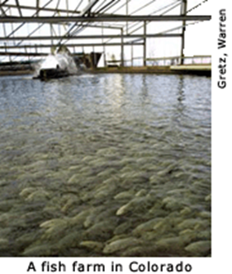
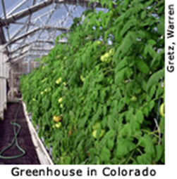
Geothermal energy is appropriate for sources below 150⁰C, which apply to typical residential and commercial opportunities. (1)
Residential/commercial space heating
Residential/commercial air conditioning
Industrial processes
Drying
Greenhouses
Aguaculture
Hot water (residential/commercial)
Resorts and pools
Melting snow

Slide 6
How Direct Use Works (2)
Direct Sources function by sending water or air down a well to be heated by the Earth’s warmth.
Then a heat pump is used to take the heat from the underground water to the substance that heats the house.
Then after the water it is cooled it is injected back into the Earth to be heated again.
Because the below surface temperature is constant it can be used for both heating and cooling depending on the time of year.

Slide 7
What are Geothermal systems ? (2)
Geothermal heating and cooling systems take advantage of the stable temperature underground using a piping system, commonly referred to as a “loop.”
Water circulates in the loop to exchange heat between your home, the ground source heat pump, and the earth, providing heating, cooling, and hot water at remarkably high efficiencies.
Geothermal heating and cooling systems can be 400-600% efficient and can cut your heating, cooling, and hot water costs by up to 80%.

Slide 8
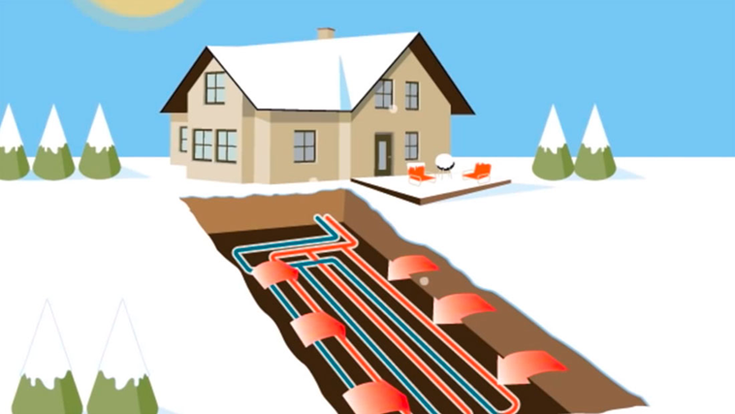
Geothermal Heating (2)
During the winter, geothermal heating and cooling systems absorb heat stored in the ground through the water that circulates in its underground loop.
This heat is carried to the ground source heat pumps where it’s concentrated and then sent as warm, comfortable air throughout your home.

Slide 9
When you need heating the most, the air outside is coldest.
As a result, a traditional air source heat pump works hard to extract the amount of heat from the cold air needed to properly heat your home.
In contrast, a geothermal system consumes less energy as it easily absorbs heat from the abundant supply stored below ground, making geothermal heating significantly more energy efficient.
Gas furnaces burn natural gas to provide heat for your home and are only 98% efficient, while geothermal systems use significantly less energy collecting heat from the earth, achieving 400-600% efficiencies.

Slide 10
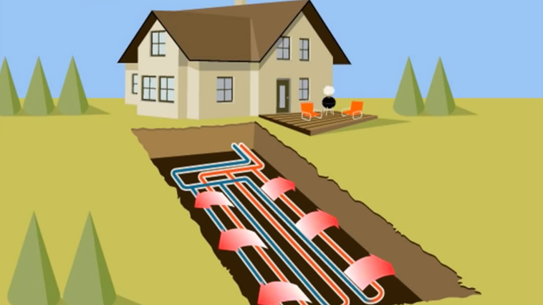
Geothermal Cooling (2)
During the summer, geothermal heating and cooling systems absorb heat from your home and transfers it to the underground loop where it is then absorbed by the cooler earth.
The geothermal heat pump uses the cool water returning from the earth to create cool, dehumidified air for your home.

Slide 11
When you need cooling the most, the outside air is hottest.
A traditional air source heat pump must work hard to force the heat from your home into the already heat saturated air.
In contrast, a geothermal heat pump consumes less energy as it easily rejects heat into the cool earth, making geothermal cooling significantly more energy efficient.

Slide 12
How Geothermal Systems Are Used (3)
A geothermal heat pump or ground source heat pump (GSHP) is a central heating and/or cooling system that transfers heat to or from the ground.
It uses the earth as a heat source (in the winter) or a heat sink (in the summer).
This design takes advantage of the moderate temperatures in the ground to boost efficiency and reduce the operational costs of heating and cooling systems, and may be combined with solar heating to form a geosolar system with even greater efficiency.

Slide 13
Ground source heat pumps are also known as "geothermal heat pumps" although, strictly, the heat does not come primarily from the center of the Earth, but from the Sun.
They are also known by other names, including geoexchange, earth-coupled, earth energy systems.
The engineering and scientific communities prefer the terms "geoexchange" or "ground source heat pumps" to avoid confusion with traditional geothermal power, which uses a high temperature heat source to generate electricity.
The temperature in the ground below 6 metres (20 ft) is roughly equal to the mean annual air temperature at that latitude at the surface.

Slide 14
Application of Ground Source Heat Pump Systems (3)
Ground source heat pumps employ a heat exchanger in contact with the ground or groundwater to extract or dissipate heat.
This component accounts for anywhere from a fifth to half of the total system cost, and would be the most cumbersome part to repair or replace.
Correctly sizing this component is necessary to assure long-term performance: the energy efficiency of the system improves with roughly 4% for every degree Celsius that is won through correct sizing, and the underground temperature balance must be maintained through proper design of the whole system.

Slide 15
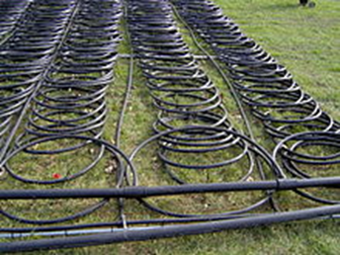
Direct Exchange (3)
The Direct Exchange Geothermal Heat Pump is the oldest type of geothermal heat pump technology.
The ground-coupling is achieved through a single loop, circulating refrigerant, in direct thermal contact with the ground (as opposed to a combination of a refrigerant loop and a water loop).
The refrigerant leaves the heat pump cabinet, circulates through a loop of copper tube buried underground, and exchanges heat with the ground before returning to the pump.
Loop Field For A 12-ton System

Slide 16
While they require more refrigerant and their tubing is more expensive per foot, a direct exchange earth loop is shorter than a closed water loop for a given capacity.
A direct exchange system requires only 15 to 30% of the length of tubing and half the diameter of drilled holes, and the drilling or excavation costs are therefore lower.
The U.S. Environmental Protection Agency conducted field monitoring of a direct geoexchange heat pump water heating system in a commercial application.
The EPA reported that the system saved 75% of the electrical energy that would have been required by an electrical resistance water heating unit.

Slide 17
Closed Loop (3)
Most installed Closed Loop Systems have two loops on the ground side: the primary refrigerant loop is contained in the appliance cabinet where it exchanges heat with a secondary water loop that is buried underground.
The secondary loop is typically made of High-density polyethylene pipe and contains a mixture of water and anti-freeze (propylene glycol, denatured alcohol or methanol).
Monopropylene glycol has the least damaging potential when it might leak into the ground, and is therefore the only allowed anti-freeze in ground sources in an increasing number of European countries.

Slide 18
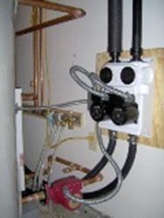
After leaving the internal heat exchanger, the water flows through the secondary loop outside the building to exchange heat with the ground before returning.
The secondary loop is placed below the frost line where the temperature is more stable, or preferably submerged in a body of water if available.
Systems in wet ground or in water are generally more efficient than drier ground loops since it is less work to move heat in and out of water than solids in sand or soil.
Interior Pump Pack for Closed Loop System

Slide 19
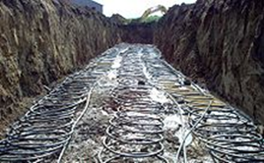
Closed loop tubing can be installed horizontally as a loop field in trenches or vertically as a series of long U-shapes in wells (3)
A Horizontal Closed Loop Field is composed of pipes that run horizontally in the ground.
A long horizontal trench, deeper than the frost line, is dug and U-shaped or slinky coils are placed horizontally inside the same trench.
Excavation for shallow horizontal loop fields is about half the cost of vertical drilling, so this is the most common layout used wherever there is adequate land available.

Slide 20
Through the late seventies, throughout the eighties, and into the early
nineties, much research was commissioned on energy efficient processes.
This research resulted in more effective solar panels, prefabricated efficient wall systems, water reclamations systems, modular construction units, and direct usage of light through windows in order to decrease day-time energy consumption.

Slide 21
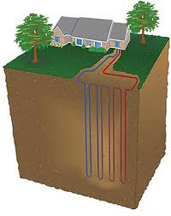
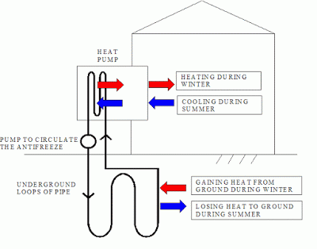
A Vertical Closed Loop Field is (3) composed of pipes that run vertically in the ground. A hole is bored in the ground, typically 50 to 400 feet (15–122 m) deep.
Pipe pairs in the hole are joined with a U-shaped cross connector at the bottom of the hole.
The borehole is commonly filled with a bentonite grout surrounding the pipe to provide a thermal connection to the surrounding soil or rock to improve the heat transfer.

Slide 22
Distribution System (3)
The heat pump is the central unit that becomes the heating and cooling plant for the building.
Some models may cover space heating, space cooling, (space heating via conditioned air, hydronic systems and / or radiant heating systems), domestic or pool water preheat (via the de-superheater function), demand hot water, and driveway ice melting all within one appliance with a variety of options with respect to controls, staging and zone control.
The heat may be carried to its end use by circulating water or forced air.
Almost all types of heat pumps are produced for commercial and residential applications.

Slide 23
Agricultural Applications (4)
What are the agricultural applications of Green Building?
USDA Leads the Way on Green Buildings, Use of Wood Products
WASHINGTON, March 30, 2011 -- Agriculture Secretary Tom Vilsack announced today USDA's strategy to promote the use of wood as a green building material. At an event this evening to launch the International Year of the Forest, Secretary Vilsack will lay out a three-part plan addressing the Forest Service's and USDA's current green building practices.

Slide 24
"Wood has a vital role to play in meeting the growing demand for green building materials. Forest Service studies show that wood compares favorably to competing materials," said Vilsack. "In keeping with the Obama Administration's America's Great Outdoors conservation agenda, USDA has made a strong commitment to conserving and restoring our forests to protect watersheds, recreation, and rural jobs.“
The strategy includes the following parts:
The U.S. Forest Service will preferentially select wood in new building construction while maintaining its commitment to certified green building standards.
The Secretary has asked the U.S. Forest Service to examine ways to increase its already strong commitment to green building.
The U.S.F.S. will actively look for opportunities to demonstrate the innovative use of wood as a green building material for all new structures of 10,000 square feet or more using recognized green building standards such as LEED, Green Globes or the National Green Building Standard.

Slide 25
As Green Building is applied to agricultural buildings we need to consider the follow: (5)
One of the challenges of efficient building is that there is no single solution that applies in every instance.
Depending on where a building is located, what its purpose is, and how long it will be needed, the most efficient design and materials for a particular situation may be very different from the best options for other circumstances.
An unheated storage building, a large barn, and a home all have different requirements for comfort, function, and efficiency.

Slide 26
So how do we apply Green Building techniques and guidelines to agricultural buildings? (5)
The most efficient and least costly long-term solution is to design a building that is responsive to the location it will occupy.
In some cases, this may require a sophisticated blending of local design wisdom with state-of-the art technology.
One of the first steps in building construction is site selection.
Savvy designers recommend careful study of potential sites, to identify how they are affected seasonally by water, wind, and sun

Slide 27
Once you identify a building site, it’s time to review your priorities for the building itself, to come up with the most efficient design for the
location and situation. (5)
• How big does the building need to be?
• How can the design work with the features of the site?
• Does the building need to be permanent, or will a temporary structure suit the purpose?
• Does the building need supplemental heating and cooling, or can natural processes maintain comfort?
• What materials are available locally?

Slide 28
The more energy a building can capture passively from natural forces, the less the owner has to pay to operate it and the more sustainable the structure. (5)
In temperate climates there may be little challenge in keeping a building comfortable for people or animals without supplementary energy.
In more extreme climates it takes careful planning to put nature’s energy to work heating or cooling your building.
What are the options:
Daylighting involves direct use of the sun to light the inside of a building. It may provide the sole light for a building that is used infrequently or only during the day. It can also be used in a self-adjusting or manually adjusted system that maintains a steady level of light by supplementing with artificial light when daylight is insufficient.

Slide 29
Natural Ventilation - Operable windows and/or skylights can aid in ventilation and provide cooling, especially in climates where the day and night temperatures differ significantly. (5)
One means of providing greater cooling for a building than simply opening the windows is a cooling tower that vents hot air out the top of the building and pulls in cooler air from the lowest level of the structure.
Another idea that can be adapted from desert architecture is the wind catcher. These air collectors face into the prevailing wind, and funnel moving air into occupied spaces to provide a cooling breeze.

Slide 30
Passive Solar - In many locations the sun is the cheapest and most reliable heat source. (5)
By siting and designing a building for the best capture of solar gain, the owner can reap maximum energy gain from a minimal investment.
For best passive solar performance, the highest concentration of windows should be on the building’s southern face, although generally the total window area should not exceed 15% of the building’s total floor area.
Southern windows provide the best opportunity for solar heat gain in winter.
Through careful placement and shading, these windows can capture the heat from a low-angle winter sun, while excluding much of the heat from the summer sun high in the sky.

Slide 31
In a structure with passive solar heat, capturing heat from the sun is only part of the battle.
Storing it to help moderate night-time temperature swings is also a key element in a passive solar design.
Storage capacity is provided by thermal mass within the structure.
There are many options for providing thermal mass, ranging from special interior walls containing barrels of water to dark-colored stone flooring.

Slide 32
Shading - Often in agricultural buildings there is less concern with capturing enough solar heat than with preventing overheating. (5)
In warm climates and seasonally used buildings, preventing heat gain may be the more important strategy, and shading is a key means of avoiding unwanted heat buildup.
Shade can be provided by vegetation, constructions, or a combination of the two.
Quick growing deciduous trees are often chosen because they can provide summer shade, yet when the leaves have fallen they allow the sun to reach the building, boosting solar gain.
Trellises can also provide window shading.
Awnings and slatted above-window shades are other means of protecting windows.

Slide 33
Earth Berms - Another natural force that can significantly contribute to reducing energy use in buildings is the temperature-moderating thermal mass of the earth itself. (5)
When a building is set into a slope or simply set deeper than usual into the ground of a level site, the surrounding earth helps shelter the structure from heat loss or gain.
The surrounding earth acts as a thermal reservoir, moderating the indoor temperature of the building as the outside air temperature changes.
There are two important considerations when earth berming buildings: 1) the structure must be designed to support the pressure of the surrounding earth, and 2) the building system must be protected from moisture in the soil.

Slide 34
Photovoltaics - Solar electric energy systems, or photovoltaics, can supply power for any number of remote agricultural applications, including pumping and electric fencing. (5)
Photovoltaics can also be used to generate electricity for lighting buildings or operating equipment and appliances.
There are several options for solar electric systems.
They can be designed to tie into the power grid as utilities allow, feeding any excess power back into the grid to run the meter backwards, and drawing power from the grid when they aren’t generating.
At remote sites, photovoltaics team with storage batteries to provide a reliable power supply at any time. The solar panels can be mounted on a building rooftop that provides the right aspect and angle, or mounted in a freestanding array.

Slide 35
Solar Water Heating - Solar water-heating systems range from the simple and homemade to the complex and expensive. (5)
Generally they serve to preheat water before it reaches a conventional water heater, minimizing the energy that the water heater then uses to boost the water to its final temperature.
For seasonally occupied or warm-climate agricultural buildings, even a simple solar hot-water system can offer energy savings at minimal cost.

Slide 36
Solar water heating systems are composed of three main elements: the solar collector, insulated piping, and a hot water storage tank. While there are many design variations, essentially the solar collector gathers the heat from the sun and transfers the heat to potable water. This heated water flows out of the collector to a hot water tank, and is used as necessary.
Other Alternative Energy Sources - In addition to the sun, many other renewable power sources exist, and a number of them may be particularly well-suited to rural sites. (5)
Small scale wind power, biomass generation, microhydro power, and methane digesters are all potential sources of renewable power for agricultural buildings.
Some of the alternative energy sources could be grown on site, increasing the sustainability of the energy.

Slide 37
Building Energy Effeciency (5)
Before investing in renewable energy generation systems for any building, it pays to make sure that the building is as energy efficient as possible. By applying the general principles of Green Building such as the LEED guidelines the agricultural buildings considered here will be more energy efficient and save the owner money.
Insulation is the first line of defense for heated or cooled buildings. Insulation increases the resistance of the building to heat flow, helping to keep heated or cooled air from escaping.
It’s relatively easy to add insulation to walls, roofs, and even floors, but when it comes to doors and windows, high prices often frighten consumers away from the most energy-efficient options. However, eliminating leaky, inefficient doors and windows can significantly improve a building’s energy performance and comfort.

Slide 38
Air Sealing - Once a building has efficient walls, roof, windows, and doors, what’s left to improve its energy performance? (5)
Studies show that most buildings have air leaks that provide escape routes for conditioned (heated and cooled) air.
Blocking air leaks with gaskets, caulk, or expanding foam can move a building’s energy performance up a notch.
The most common sources of air leaks include the sill plate; window and door openings; and wall, floor, and ceiling penetrations such as electrical boxes, plumbing lines, and recessed light fixtures

Slide 39
HVAC and other systems - Insulation, efficient windows and doors, and air sealing all contribute to making the building envelope energy efficient, but mechanical systems also have a role to play. (5)
Functions that aren’t furnished by the natural systems described above will need to be provided by mechanical and electrical systems and appliances.
Choosing efficient systems for heating, cooling, ventilation, and lighting helps to cut energy costs and minimize pollution, and can help support the use of renewable energy on site by cutting loads.
One standard is the Energy Star certification, which applies to a wide range of products.

Slide 40
Recycled Materials - Another approach to resource-efficient building is to use recycled materials. (5)
These are materials that have been removed from the waste stream and reprocessed to make another product.
Although recycled products are seldom less expensive than conventional materials, they do divert waste and conserve resources and energy in their manufacture.
Reused Materials - Unlike recycled products, which are reprocessed into a new form, reused products are salvaged and reapplied in the same form. (5)
Most farmers and ranchers are old hands at reusing building materials time and again, in one application after another, and in remodeling existing buildings to serve new uses.

Slide 41
Designing and constructing agricultural buildings with efficiency in mind saves money, energy, and resources. (5)
Employing strategies such as natural ventilation, passive solar heating, and daylighting are some of the ways that building owners can put natural systems to work for them.
By combining energy efficiency and renewable energy options, agricultural buildings can move toward energy independence.
And finally, agricultural buildings can be built from a range of resource-efficient materials geared to meet almost any need, whether that be for a temporary structure or a high-performance specialty building.

Slide 42
Economics of Green Building (6)
http://www.institutebe.com/clean-energy-finance/green-building-costs.aspx
As with all business decisions, the “build or not to build” decision depends on a cost-benefit analysis: a particular construction project or installation is executed if it is expected to generate monetary value that exceeds the price. If, on the other hand, perceived costs outweigh benefits, the project is shelved.
The same basic rule applies to construction of green buildings. However, there are important additional considerations that influence the green building costs versus benefits analysis—specifically, the price of going green and the value it will impart. But there is growing recognition that “green” should not be considered a discreet “add-on” feature—grafted on to an otherwise normal project and evaluated independently as to its relative financial burdens and benefits. Rather, it is becoming ever clearer that sustainable building requires changes of both paradigm and process that, when embraced and applied to the entire building process, can make green building an attractive option without being an expensive one.

Slide 43
Costs (6)
The traditional lens views green building features as add-ons. Through this lens, constructing a green building naturally costs more than a less sustainable alternative because it entails the use of premium materials, high-efficiency equipment, and additional layers of process workflow. The mindset that paying extra is an unavoidable element of greening a project is beginning to give way to more holistic designs and a lifecycle view of costs and benefits. Today, researchers, designers and owners are finding that a focus on sustainability at the beginning of the process can uncover techniques that will provide environmental and social benefits without necessitating incremental costs. To cite one example: simply orienting a building to optimize windows and passive solar heat gain may allow developers and architects to design for lower energy usage and increased sustainability as well as offer daylight, which can increase productivity for employees without adding any additional construction expenses.

Slide 44
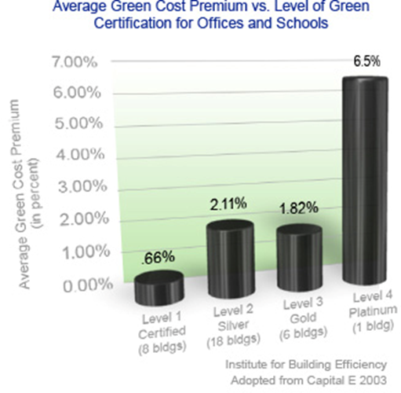
Green building can even help the owner avoid expenses at the outset. (6)
Selection of cooling equipment provides one example: if a green building design minimizes waste heat through efficient lighting equipment and includes an energy efficient building envelope, the building may require significantly less cooling capacity.
This may eliminate the need for an additional chiller and result in a significantly reduced project budget.

Slide 45
An analysis of 83 buildings seeking LEED certification compared to a control group of 138 non-green buildings and normalizing for building function and other major drivers of cost, found “no significant difference in average cost for green buildings as compared to non-green buildings.”
Benefits (6)
A green building may have little or no incremental cost, but it does not happen on its own. The change of process required to design and construct a building in an integrated way takes effort and must be perceived as sufficiently value-added before it will become widespread in the industry. Owners and developers seek reassurances not only that green building won’t cost more, but that it will, in addition, produce benefits substantial enough to justify the effort.

Slide 46
When properly designed to maximize efficiency and minimize the use of resources, a green building will experience lower utility costs. It is not unusual for energy bills to be up to 50 percent less than for a building constructed to minimum code requirements – even lower when onsite renewable energy generation is included in the project. Some of the findings: (6)
Green buildings sell at a higher price. McGraw Hill measured the price premium for the sale of Energy Star ®-labeled buildings to be 12%.³ Another study estimated the premium on LEED-certified buildings at 31%.
Green buildings command higher rent premiums. By comparing rental agreements involving Energy Star buildings with non-Energy Star leases, researchers at Maastricht University found that efficient buildings command 3.5% higher rents.
Green buildings are more attractive to tenants. The same study found a 6% higher occupancy rate for Energy Star certified buildings.

Slide 47
References:
http://www.physics.rutgers.edu/~kotliar/honors/honsem02/somalwar/HonSem02/Geothermal%20Energy.ppt
http://www.climatemaster.com/residential/how-geothermal-works/
http://en.wikipedia.org/wiki/Geothermal_heat_pump
http://www.usda.gov/wps/portal/usda/usdahome?contentid=2011/03/0143.xml
https://attra.ncat.org/Downloads/agbuildings.pdf
http://www.institutebe.com/clean-energy-finance/green-building-costs.aspx

