Slide 1
Lecture 5
Diseases

Slide 2
Common Foot Problems
Foot Disease may cause:
Severe Lameness
May be worse by owner neglect
Diseases may occur even under
Optimum conditions

Slide 3
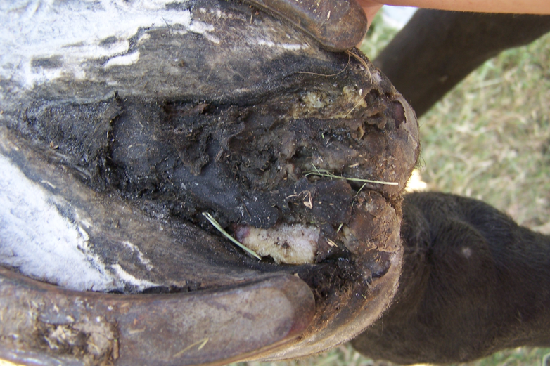
Common Foot Problems
Thrush:
Destruction of the frog by anaerobic bacteria
Usually black and strong smelling
Commonly found in the sulcus
If severe enough, could lead to an abscess

Slide 4
Common Foot Problems
Thrush:
Usually caused by:
Unclean, dirty conditions
Combined with long untrimmed hooves
Most infections are stopped by:
Removing affected tissue
Cleaning foot daily
Applying antiseptic drying agent

Slide 5
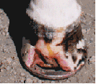
Common Foot Problems
White Line Disease:
A fungal infection of the hoof wall
Wall must be removed and treated with strong fungicide
Common in humid areas

Slide 6
Common Foot Problems
Sole Bruises:
Caused by concussion of the sole
Caused by rocks, gravel, and hard objects
Un-level horseshoe may also cause problem
Once bruised, pads may need to be applied

Slide 7
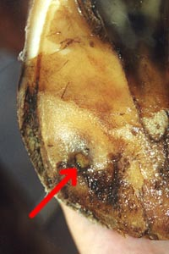
Common Foot Problems
Abscess:
Pus pocket or infection of sensitive structures
Most commonly occurs in sole or the white line area
Follows the path of least resistance until it breaks out and drains
May result from puncture wounds, thrush, sole bruises, or laminitis
Tetanus vaccinations are important

Slide 8
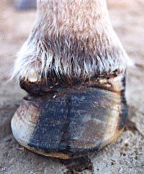
Common Foot Problems
Abscess:
Must be opened to allow to drain
Soaking in Epsom salt helps promote drainage
Germicide should be applied
Should also be packed to promote drainage
Pads applied
Can cause intense pain and severe lameness

Slide 9
Common Foot Problems
Sand Crack:
Often called a toe crack or quarter crack
May be superficial or deep and serious
May result from:
Uneven weight bearing
Irregular hoof growth
Wire Cuts
Excessive hoof length
Dry Conditions

Slide 10
Common Foot Problems
Navicular Disease:
Pain in the area of the Navicular Bone
May involve:
Inflamation of the Navicular bursa
Ligament Sprains
Cartilage or Tendon Destruction
Bone Changes
Pain may be mild or severe

Slide 11
Common Foot Problems
Navicular Bone Function:
Redirects the pull of the deep flexor tendon against the coffin bone as the horse moves forward
The navicular bursa is a fluid-filled sack that lubricates the tendon surface of the navicular bone

Slide 12
Common Foot Problems
Navicular Bone:
Held in place by two ligaments
Ligaments provide blood supply and nourishment
If injury occurs, blood supply may be affected and lameness may occur

Slide 13
Common Foot Problems
Signs of Navicular Disease:
Pointing of toe with heel off the ground
Short Steps
Contracted Heels
Treatment:
Bar shoes with heel support
Medication to improve circulation
Nerve operations (last resort)

Slide 14
Common Foot Problems
Laminitis or Founder:
Disturbance in the circulation of the laminae
Inflammation of laminae
Possible separation
Rotation of coffin bone

Slide 15
Common Foot Problems
Laminitis or Founder:
Disturbance in the circulation of the laminae
Inflammation of laminae
Possible separation
Rotation of coffin bone

Slide 16
Common Foot Problems
Laminitis or Founder:
Disturbance in the circulation of the laminae
Inflammation of laminae
Possible separation
Rotation of coffin bone

Slide 17
Common Foot Problems
Laminitis or Founder:
Disturbance in the circulation of the laminae
Inflammation of laminae
Possible separation
Rotation of coffin bone

Slide 18
Common Foot Problems
Laminitis or Founder:
Disturbance in the circulation of the laminae
Inflammation of laminae
Possible separation
Rotation of coffin bone

Slide 19
Common Foot Problems
Laminitis or Founder:
Disturbance in the circulation of the laminae
Inflammation of laminae
Possible separation
Rotation of coffin bone

Slide 20
Common Foot Problems
Laminitis or Founder:
Disturbance in the circulation of the laminae
Inflammation of laminae
Possible separation
Rotation of coffin bone

Slide 21
Common Foot Problems
Laminitis or Founder:
Disturbance in the circulation of the laminae
Inflammation of laminae
Possible separation
Rotation of coffin bone

