Slide 1
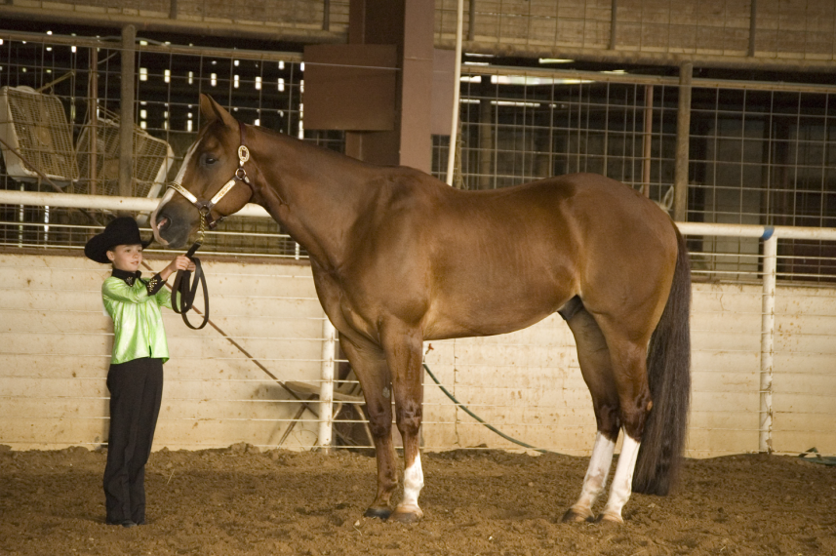
Equine Senses

Slide 2
Physical Parameters
How did horses survive over the years?
Hiding
Running away
Tools developed in the past are
Evident in the reactions of the horse today

Slide 3
Physical Parameters
What are these tools?
Sight and Skin Sensitivity
Hearing and Smell
Reflex for Flight
Memory and Gregarious Nature
Ability to feel ground vibrations

Slide 4
Sight
Eyes set wide on head
Monocular vs. Binocular Vision
Monocular Vision:
Why was this vision developed?
To protect from predators
Allowed to see danger from either side
Without turning its head

Slide 5
Sight
Binocular Vision:
Used to judge distances
Typically not as good as its monocular vision
Some horses have better binocular vision
Why?
Their eyes are set closer together

Slide 6
Sight
Some have to learn to develop binocular vision through training
Examples:
Rope horse following cattle at correct distance
Teaching a barrel horse to judge distance to the barrel
Teaching a jumper how to approach

Slide 7
Facts About Vision
Blind spots
Where?
Directly behind its hindquarters
Can’t see directly below its head
Must lower its head to
See far away

Slide 8
Facts About Vision
Must raise its head to see?
Close objects
If object is closer than __, can’t see with its binocular vision
4 feet
Takes time to adjust eyesight to
Dark spaces

Slide 9
Facts About Vision
A grazing horse can see?
Almost all the way around its body
Has a hard time focusing clearly on objects
Very good at detecting movement

Slide 11
Blind Spots

Slide 12
Touch
Do horses have a keen sense of touch?
Sense of touch is very important in riding
Rider’s hands through the touch of the bit
Rider’s legs on the ribs
Important that the rider remains soft

Slide 13
Touch
Where are the most sensitive areas?
Eyes, ears, and nose
Withers, ribs, flanks, and legs
Fearful of anything touching flanks

Slide 14
Hearing
Do horses have a good sense of hearing?
Excellent
Much better than sight
Eyes and ears are always working together
First ears will point toward the sound then
Horse will try to see what it is

Slide 15
Smell
Sense of smell?
Good
Stallions can identify mares in heat from great distances
Research trials have found
Horse can return home from up to five miles when hauled

Slide 16
Smell
Young horses may
Like to smell saddles
Smell may dictate grazing habits
Does this prevent consumption of poisonous plants?

Slide 17
Flight Reflex
Quick reflexes and panic
Characterized the prehistoric horse
Endowed with an extensive system of ligaments which permit them to what?
Sleep while standing
Will panic into flight without much consideration of such an action

Slide 18
Flight Reflex
Young horse especially will try to flee
As horses get older
Most tend to become desensitized
Careful management and good horsemanship skills should be used

Slide 19
Memory
Considered to have memories
Second only to elephants
In wild, if an attack came at a certain place
The herd avoided that spot in the future
Horses are creatures of habit
Creatures of laziness?

Slide 20
Memory
Memory and temperament are linked to?
Breeding
Well-trained horse never forgets its training
Neither does a poorly trained one
Bad habits should be
Corrected before they become fixed

Slide 21
Memory
Performance on intelligence tests have
Not been outstanding
However, able to complete complex things routinely when trained
What can they not associate with?
Overeating

Slide 22
Gregarious Nature
Gregarious by nature
Banding together
Wild horses were safer from attack
Still seen in zebras in Africa
Can be used to the benefit of trainers

