Slide 1
Electricity from Solar Energy
Agricultural Sustainable Energy Education Network
Renewable Energy Curriculum

Slide 2
Introduction
According to the Office of Energy Projects – Energy Infrastructure Update for December 2014:
Solar power represented 0.96% of OVERALL total installed (new and recurring) electrical generating capacity in the US
Solar power represented 20.4% of NEW installed electrical capacity cumulative over 2014
3,139 MW of new installed solar capacity was added throughout 2014
 | Installed Capacity (MW) in 2014 | Installed Capacity (MW) in 2013
Coal | 106 | 1,543
Natural Gas | 7,485 | 7,378
Nuclear | 71 | 0
Oil | 47 | 51
Water | 158 | 402
Wind | 4,080 | 1,690
Biomass | 254 | 858
Geothermal Steam | 32 | 59
Solar | 3,139 | 3,828
Waste Heat | 5 | 76
Other | 7 | 0
Total | 15,384 | 15,886
New U.S. Electricity Generation Capacity, 2014 vs. 2013 [1]

Slide 3
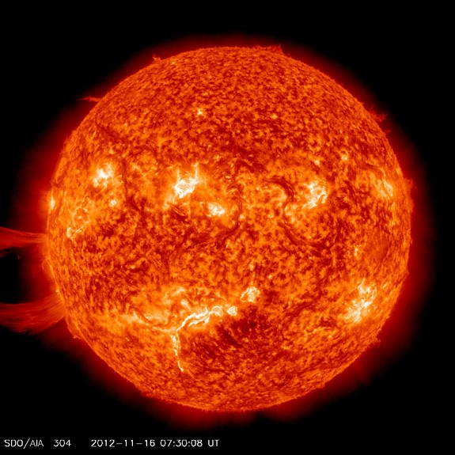
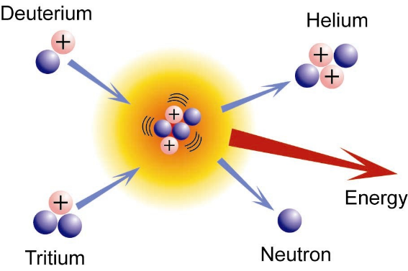
Production of Sunlight
The Sun is a 4.6 billion year old source of perpetual energy
Heat and light are produced by transforming Hydrogen gas into Helium gas through a thermonuclear fusion reaction: ²H + ³H → ⁴He + ¹n + energy
The Sun powers the wind, weather, ocean currents and is a source of energy for plants
⁴He
²H
³H
¹n
Source: [2]

Slide 4
Energy / Work / Power
Using measurement standards defined as SI units (Système International d’Unités), energy is reported in the unit of Joule (J)
Performing work is the act of transferring energy into or out of a system
work is also measured in Joules
Power is the rate of doing work
how fast energy is transferred
power is measured as Joule/second (J/s), which defines the Watt (W)
Energy consumption is commonly reported in kW-h
kW-h is another unit of energy
How does kW-h relates to Joules?
1 kW-h = 1000 W-h
= 1000 J/s x 1 h
= 1000 J/s x 3600 s
=3,600,000 J
= 3.6 million J
Note: the prefix k
= kilo = 10³

Slide 5
Abundance of Solar Energy
Solar energy is most abundant
About 1,000 W of solar power per 1 m² reach the Earth’s surface at noon on a cloudless day [3]
On the right side of the figure are the total recoverable reserves of energy from coal, uranium, petroleum, and natural gas reported in units of TWy (Terawatt-years)
To the left are the amounts of energy potentially recoverable per year (TWy/year) for each source of renewable energy
Technical challenges:
Improving detection efficiency of solar cells: currently (2015) solar cells convert only 5-24% of sunlight into electricity [5]
Improving battery capacity and integrating into existing energy grids [6]
1 TWy = 5.3 x 10¹⁴ kW-h = 1.9 x 10²¹ J
Source: [4]

Slide 6
Brief History of the Beginnings of Solar Energy
1767 - The Solar Collector (Swiss Physicist Horace de Saussure)
An insulated box covered with three layers of glass to absorb heat energy
Saussure’s box is the first known solar oven, reaching temperatures of 230 degrees F
1839 - Discovery of Photovoltaic Effect (French Physicist Edmond Becquerel)
The creation of voltage and electric current in a material when exposed to light
1860 to 1880 - The Solar Motor (French Engineer Auguste Mouchet)
The device converted solar radiation into mechanical steam power
1873 - Discovery of the photoconductivity properties of Selenium (English Engineer Willoughby Smith)
1905 – Albert Einstein explains the mechanism of the Photoelectric Effect (Nobel Prize)
1918 – Growth of Single-Crystal (Polish Chemist Jan Czochralski)
Source: [7]

Slide 7
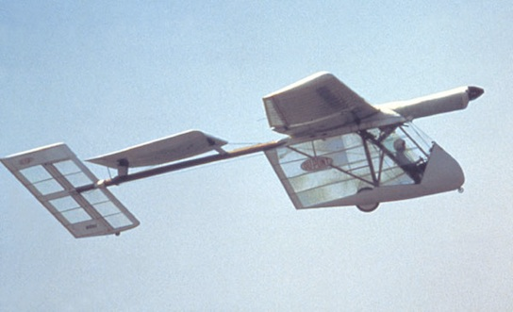
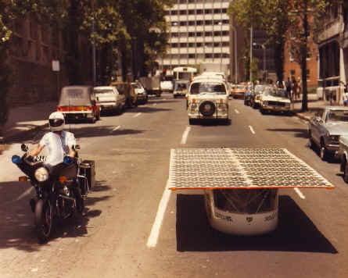
Brief History of the Beginnings of Solar Energy
1947 – Solar buildings are in demand as energy becomes scarce during World War II
1954 - The First (practical) Silicon Design of a Photovoltaic Cell (American scientists Daryl Chapin, Calvin Fuller and Gerald Pearson at Bell Laboratories)
1977 – The US government launches the Solar Energy Research Institute
1981 – First solar-powered aircraft: The Solar Challenger by AeroVironment flew 163 miles from France to England
1982 – First solar-powered vehicle: The Quiet Achiever drove 2,500 miles in under 20 days from Perth to Sydney, Australia
The Solar Challenger – Source: [8]
Source: [7]
The Quiet Achiever – Source: [9]

Slide 8
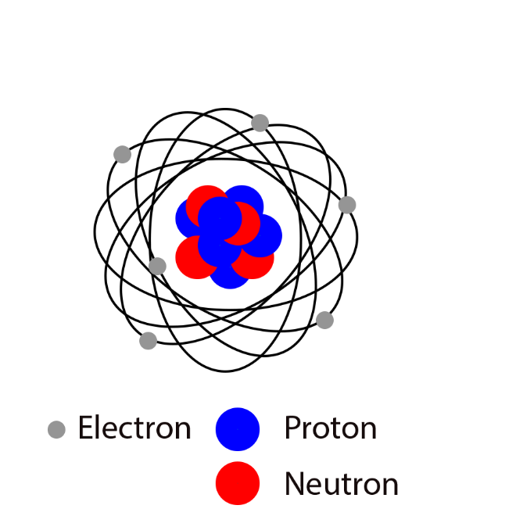
Science Fundamentals: Atoms
All matter is made of atoms
The Bohr Atomic Model
A simple system for representing the structure of atoms
Nucleus: consists of protons, each of positive charge +e, and neutrons (neutral)
Electrons, each of negative charge –e, orbit in discrete shells
Similar to mass, charge is an intrinsic property of protons and electrons
e is a specified amount of charge in Coulombs (C)
e = 1.60 x 10⁻¹⁹ C
Atoms are neutral
number of protons equals the number of electrons
The atomic number (Z) denotes the number of protons and determines the identity of a particular atom (element)
E.g. Hydrogen has one proton (Z = 1), Helium has two protons (Z = 2), etc

Slide 9
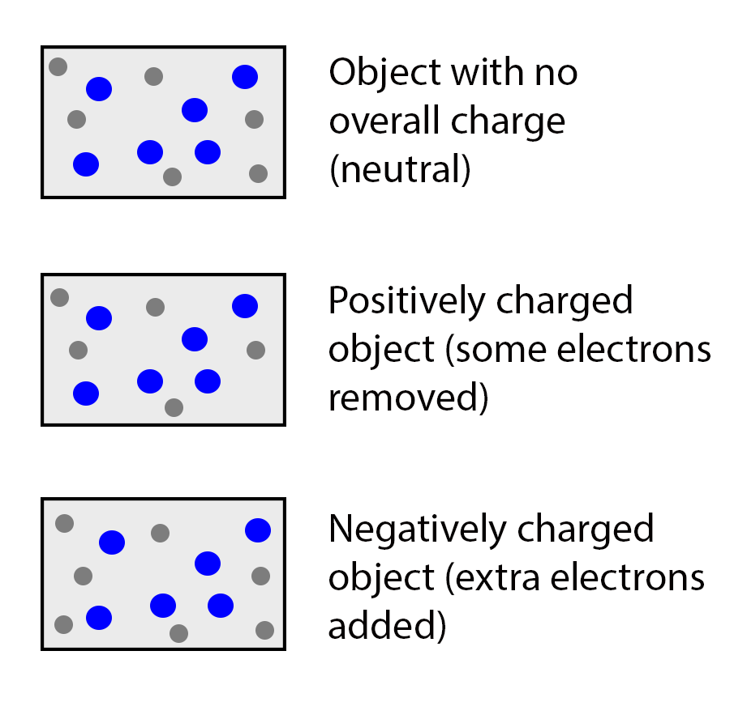
Science Fundamentals: Electrical Charge of an Object
Summary of facts:
Charge is an intrinsic property of protons and electrons
Atoms are overall neutral but yet contain protons and electrons
All objects are made of atoms
How can an object be charged?
For an object to be electrically charged, its atoms must undergo a transformation resulting in an excess or deficiency of electrons
Atoms can lose or gain electrons in a process called ionization, which leaves the atom in a state called a positive ion or negative ion

Slide 10
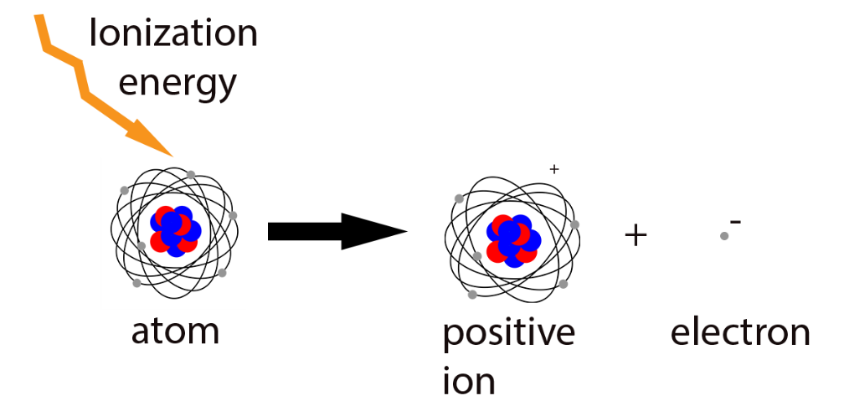
Science Fundamentals: Ionization through Radiation
Ionization: if an electron absorbs a photon (electromagnetic radiation) of sufficient energy, it escapes from the atom and becomes a free electron. The atom is left with more positive charge than negative charge and is now called a positive ion. An atom can lose several electrons at once, to produce a charge of +1e, +2e, …
An atom can also grab a free electron, which upsets its charge neutrality, yielding a negative ion. An atom can grab several free electrons at once, to produce a charge of -1e, -2e, …

Slide 11
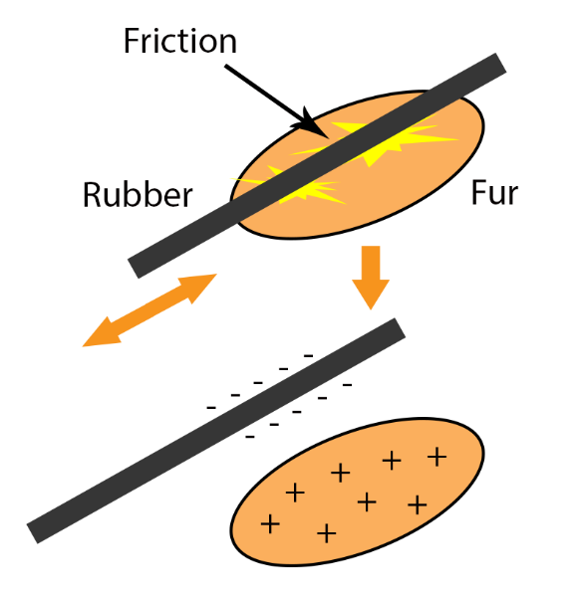
Science Fundamentals: Ionization through Friction
Ionization may also occur using energy from friction (heat)
Example 1: Rubbing a rod of rubber on fur
The frictional charging process results in a transfer of electrons between the two objects that are rubbed together
Rubber has a much greater attraction for electrons than fur. The atoms of rubber pull electrons from the atoms of fur leaving both objects with an imbalance of charge
The rubber rod has an excess of electrons and the fur has a shortage of electrons. Due to an excess of electrons, the rubber is charged negatively
Similarly, the shortage of electrons on the fur leaves it with a positive charge
Example 2: Static electricity from walking over carpet also relates to ionization

Slide 12
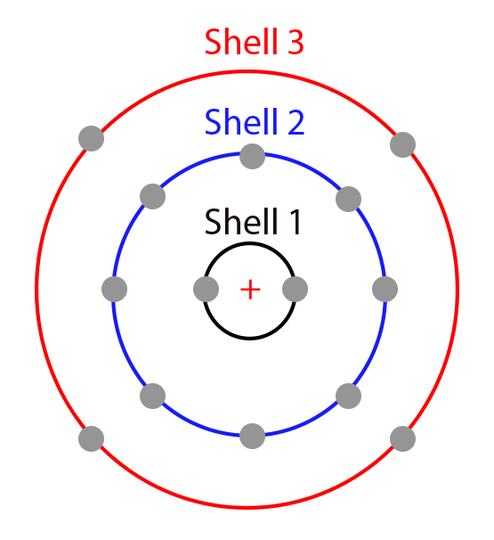
Science Fundamentals: The Valence Shell
The outer shell of an atom is called the valence shell. Electrons in this shell are involved in chemical reactions and are responsible for electrical and thermal conductivity in metals
A neutral Si atom is shown. There are 4 electrons in the valence shell.

Slide 13
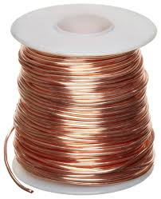
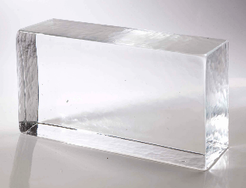
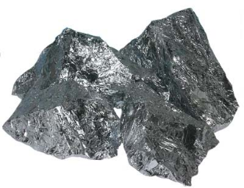
Science Fundamentals: Electric Conductivity of Materials
Conductors: materials through which current can flow. They have a large number of free electrons and one to three valence electrons. Silver is the best conductor (most expensive), and copper is the next best conductor.
Insulators: materials which are poor conductors of electric current. Insulators have no free electrons in their structure and their valence electrons are tightly bound. Ex: glass, porcelain and plastic
Semiconductors: materials with conducting properties in between conductors and insulators. Semiconductors have fewer free electrons than conductors do and four valence electrons in their structure. Semiconductors have unique properties exploited by electronic devices such as the diode, transistor, and integrated circuit. Ex: silicon and germanium
Copper wire
Glass
Silicon

Slide 14
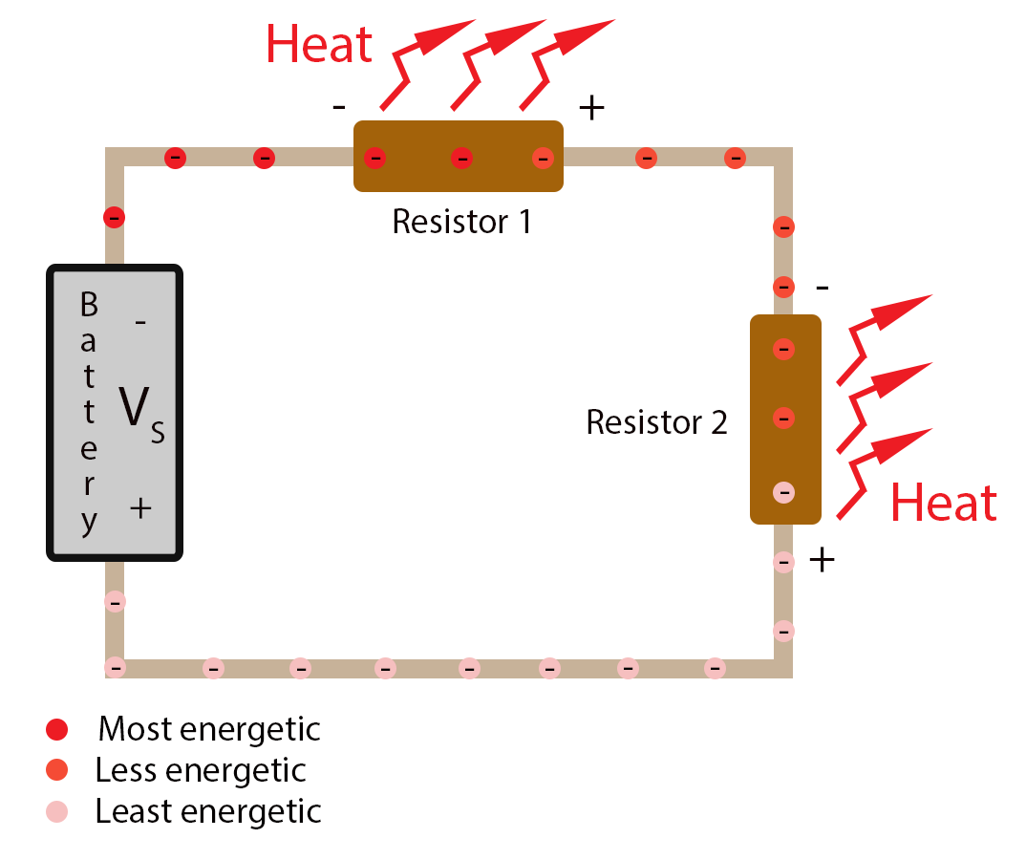
Science Fundamentals: Voltage and Voltage Difference
Voltage, V, is defined as energy per unit of charge:
W is energy in units of Joules (J) and Q is charge in Coulombs (C)
The electric potential difference (voltage difference) between two points in a closed circuit is similar to the pressure difference created by a pump causing water to flow through pipes in a closed water system
For electric circuits, a power supply provides an electric potential difference
Where the energy of the electrons is highest, the
voltage at that location is highest. Across either resistor,
R₁ or R₂, there is a voltage difference. The voltage source
reenergizes the electrons to maintain the current.

Slide 15
Science Fundamentals: No Voltage Difference Means No Current
In the absence of voltage difference between the two ends of a wire, free electrons move in a random direction. Thus, the net current is zero (for any cross-section, as many electrons move to the right as the left, on average).
When a potential difference is applied, free electrons move in unison toward the positive potential. Thus, a net current is induced.

Slide 16
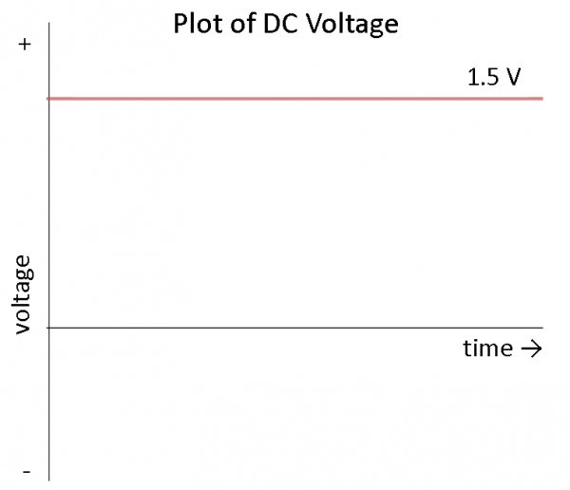
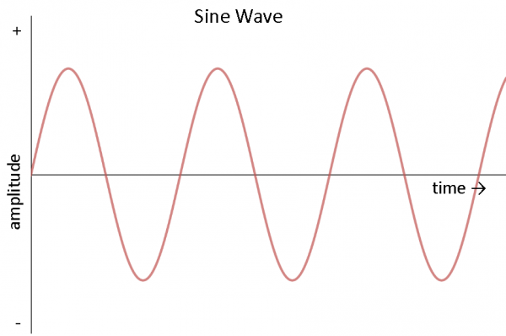
Power Systems: DC vs. AC
DC power systems provide a constant voltage/current
Devices that utilize a battery, plug into the wall through an AC adapter or utilize a USB cable for power operate on DC
Solar arrays produce DC voltage and current
AC power systems produce an alternating voltage/current
AC is produced using an alternator: a special type of electrical generator designed to produce alternating current
AC is the optimal method of delivering power over long distances and is used to deliver power to houses, buildings, etc via the grid

Slide 17
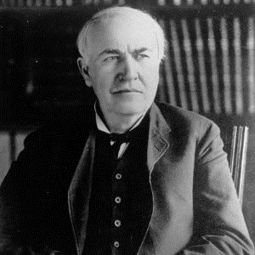
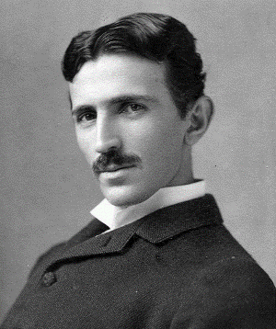
Brief History of DC and AC: The War of Currents (late 1800’s)
Thomas Edison
Pioneer of DC power
DC power plants needed to be within 1 mile of the end user or else all power was lost in transmission (dissipated as heat) due to resistance in transmission wires
Nikola Tesla
Pioneer of AC power
For AC power distribution, transformers provided an affordable method to step up AC voltage to thousands of volts and back down to usable levels
At higher voltages, the same power could be transmitted at much lower current, which meant less power lost as heat. Consequently, power plants could be located many miles away and service a greater number of houses and buildings
Thomas Edison
Source: [10][11]
Nikola Tesla

Slide 18
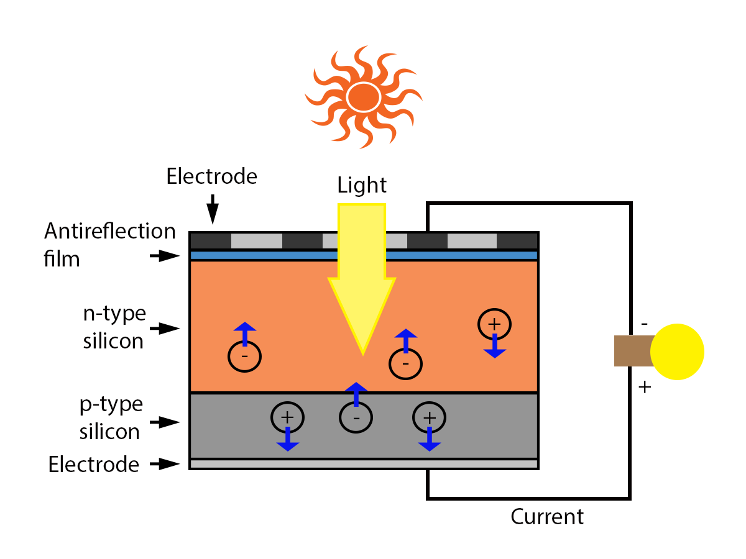
Photovoltaic Cells: How do they work?
Photovoltaic (PV) cells generate power by combining two semiconductor materials having different electrical characteristics
When exposed to sunlight, electrons inside the semiconductors obtain sufficient energy to break away from their parent atoms and cross the junction. Negative ions migrate to one side of the junction and positive ions to the other: producing a potential difference (i.e. a voltage)
When a load (device) is connected in a closed path to the PV cell, a current flows
Generating electricity with a Photovoltaic cell
Source: [12]

Slide 19
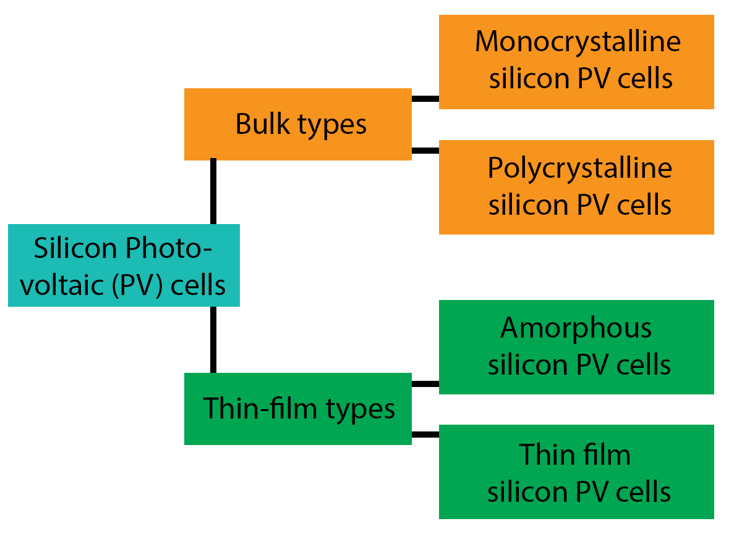
Types of Photovoltaic Cells
Monocrystalline Silicon
Oldest form of photovoltaic cells
Highest conversion efficiency among current commercial photovoltaic cells
Complex and relatively expensive
Polycrystalline Silicon
Lower heat conversion efficiency than monocrystalline cells
Affordable
Source: [13][14]

Slide 20
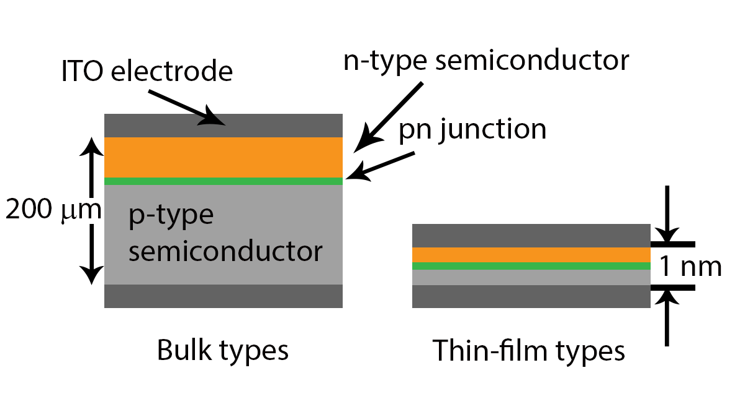
Types of Photovoltaic Cells
Thin-film Silicon
Photovoltaic cells produced by depositioning silicon film onto substrate glass
Uses less silicon therefore cheaper but conversion efficiency is less than crystalline types
Efficiency can be improved by layering several cells and generating power from each one
This layering technique can only be accomplished with thin-film types
Source: [15]

Slide 21
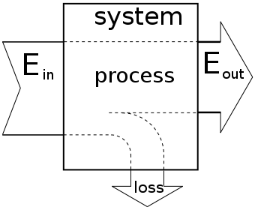
Converting Energy: What is Efficiency?
Energy conversion efficiency is the ratio between the useful output of an energy conversion machine and the input energy [16]
Constraint imposed by Nature through the Laws of Thermodynamics
A system cannot convert one form of energy into another, without giving up energy (e.g. energy is always lost to the environment as heat)
Current solar cells convert only 5-24% of energy in sunlight into electricity [5]
Source: [17]

Slide 22
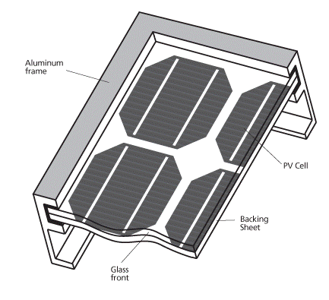
Typical Mono-crystalline PV Panel
To protect against damage from physical shock and weather, fragile PV cells are sandwiched between a backing sheet of tough plastic and transparent glass
The apparatus is enclosed within an aluminum frame, which provides structural support
Source: [18]

Slide 23
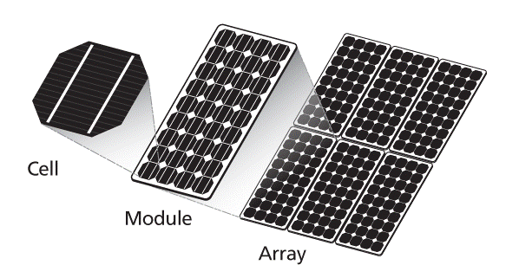
From PV Cell to PV Module & Array
To increase yield, multiple PV cells are interconnected in a sealed, weatherproof unit called a Panel or Module
12 V panel: 36 cells connected in series
24 V panel: 72 PV cells connected in series
(Panel)
Source: [18]

Slide 24
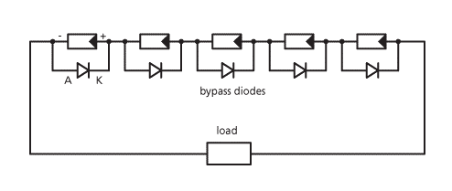
PV Cell Damage from Shading
The number of series cells determines the voltage of the panel/module
The number of parallel cells determines the current
If several cells are connected in series, shading of individual cells will stop the flow of charge and damage the shaded cells
As a preventive measure, bypass diodes are connected anti-parallel to the solar cells to give current an alternative path in the event of shading
In practice, it is sufficient to connect one bypass diode for every 15-20 cells
Even with bypass diodes, shading still results in reduced output voltage and power
Source: [18]

Slide 25
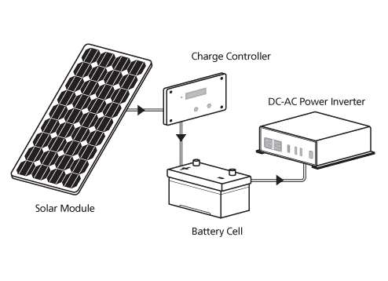
Non Grid-tied PV System
Components:
PV Panel
Charge Controller
Battery / batteries
Power Inverter
PV Panel converts solar light energy into DC electrical energy
Charge Controller regulates the DC electrical voltage and current produced by the PV Panel to charge a battery
Battery stores the DC electrical energy for when there is no solar energy available (e.g. night time, bad weather)
DC loads can be powered directly from the PV Panel or the battery
DC-AC Inverter converts the DC power produced by the PV Panel or stored in the battery into AC power to enable powering of AC loads
Source: [18]

Slide 26
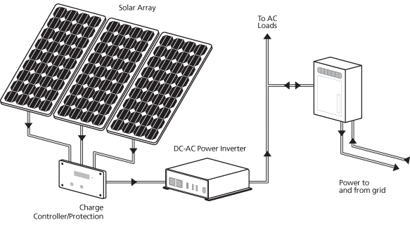
Grid-tied PV System
No batteries
PV Panels or Arrays directly feed to an inverter, which connects to an Electricity Transmission and Distribution System (i.e. the Electricity Grid)
The system draws electricity from the Grid when production is inadequate while feeding electricity back into the Grid during times of excess production
The following items are often needed to comply with the power provider’s grid-connection requirements and to safely transmit electricity to loads:
Power conditioning equipment
Safety equipment
Meters and instrumentation
Source: [18]

Slide 27
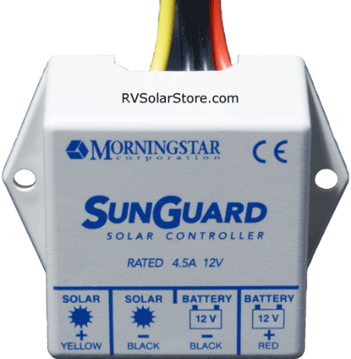
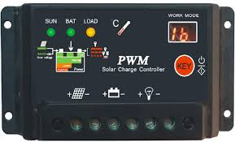
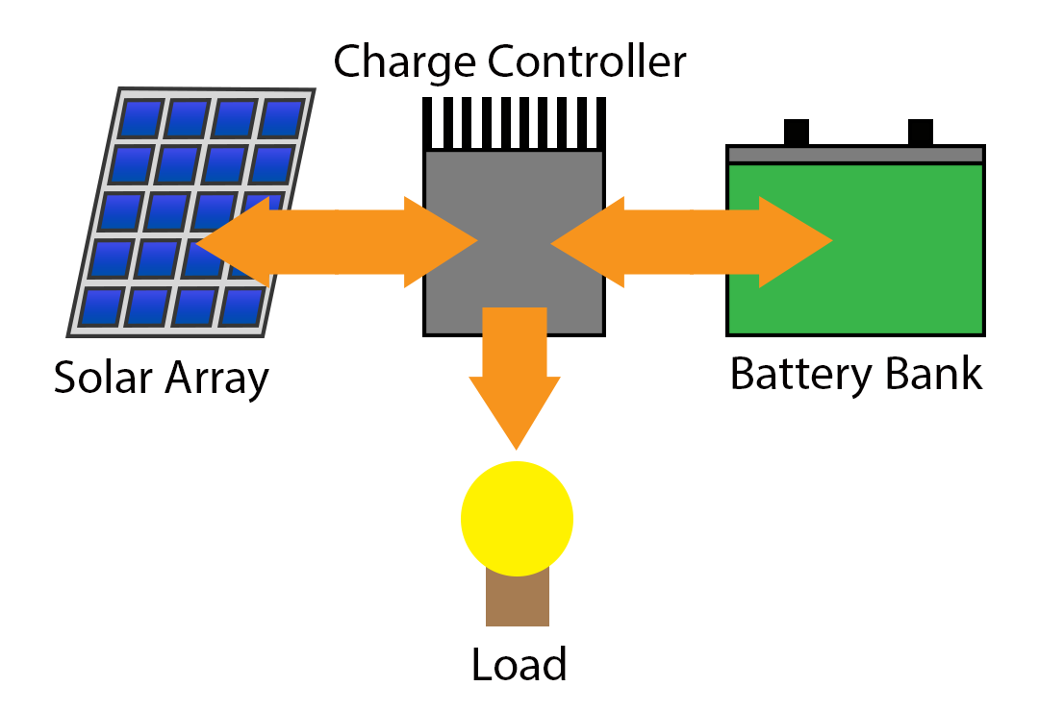
Charge Controllers
PV systems that use a battery most often require a charge controller
A charge controller regulates battery charge by controlling the charging voltage and/or current from a DC power source, such as a PV panel
Charge controllers protect the battery from overcharge and overdischarge
improving system performance
prolonging battery life
Source: [19]

Slide 28
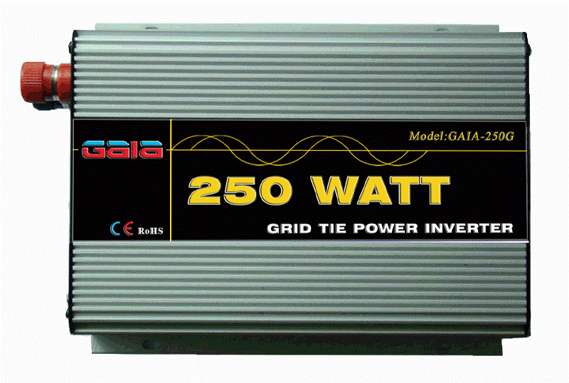
Power Inverters
A power inverter is an electronic device that converts direct current (DC) to alternating current (AC)
Required to operate any AC loads (devices) or to transfer AC power back to the grid
Source: [20]

Slide 29
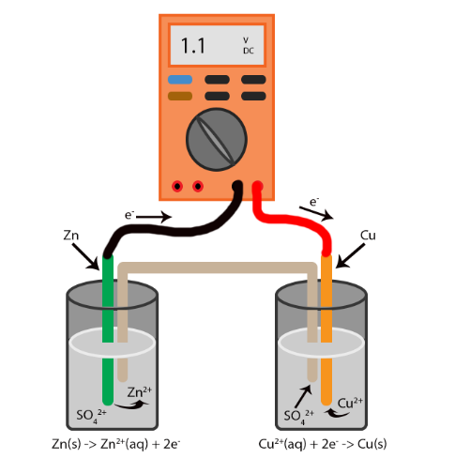
Single Cell Cu-Zn Battery
Principle of batteries
Chemical energy is transformed into electrical energy through an oxidation-reduction reaction
Electrons transfer from one reactant to another
Anode: terminal that supplies electrons
Cathode: terminal that receives electrons
Single cell Cu-Zn battery produces a fixed voltage of 1.1 V
The chemistry of the reactants (Cu and Zn in this case) determines the output voltage, shelf life, and discharge characteristics of a battery
The capacity of a battery (lifetime current measured in A-h) depends on the quantity of reactants in the cell
To produce a higher voltage, commercial batteries consist of a combination of multiple cells connected in series
Source: [21]
Single cell Cu-Zn battery

Slide 30
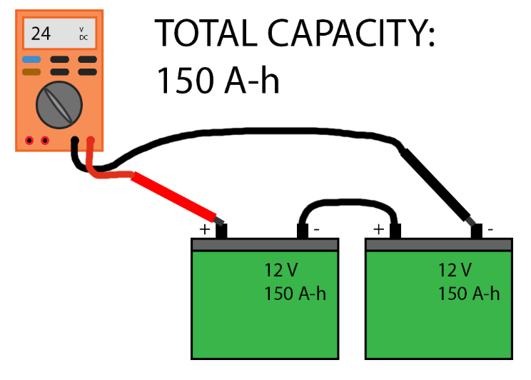
Connecting Batteries in Series
To connect batteries in series:
Connect the negative terminal of one battery to the positive terminal of the next battery, for as many batteries as are in the series string
Because there is only one path for the current to flow, the same current flows through all batteries
For batteries of similar capacity and voltage connected in series, the circuit voltage is the sum of the individual battery voltages, and the circuit capacity is the same as the capacity of the individual batteries
If batteries or cells with different capacities are connected in series, the capacity of the string is limited by the lowest-capacity battery
Two 12 V batteries of capacity 150 A-h connected
in series yield collectively 24 V and capacity 150 A-h
Source: [22]

Slide 31
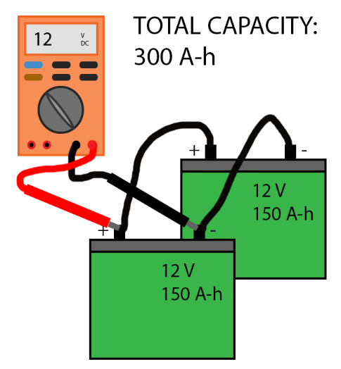
Connecting Batteries in Parallel
To connect batteries in parallel:
Connect all the positive terminals together and all the negative terminals together
Batteries connected in parallel provide more than one path for the current to flow, so currents add together at the common connections
The current of the parallel circuit is the sum of the currents from the individual batteries
The overall capacity is the sum of the capacities of each battery
The voltage across the circuit is the same as the voltage across the individual batteries
Two 12 V batteries of capacity 150 A-h connected
in parallel yield collectively 12 V and capacity 300 A-h
Source: [22]

Slide 32
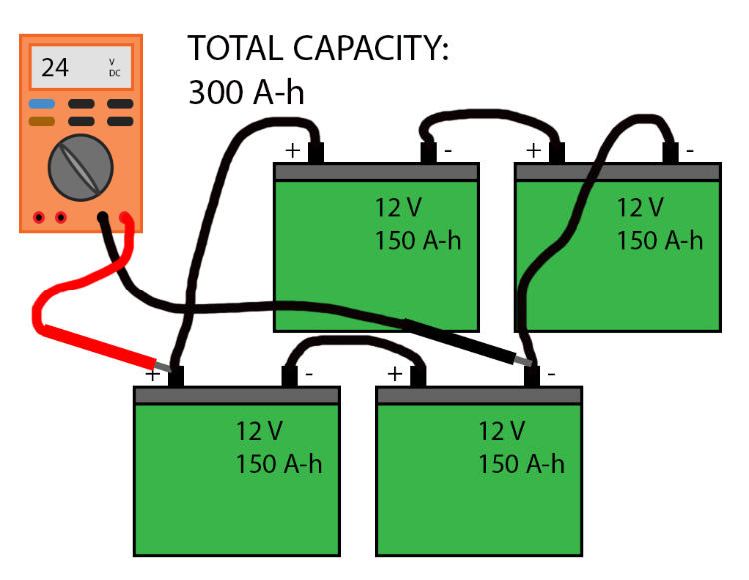
Connecting Batteries in Series and Parallel
Series and parallel connections can be combined to produce a desired system voltage level and capacity
The voltage across the shown battery bank is 24 V
You can equivalently replace each series combination of 12 V batteries with a 24 V battery and think of this system as two 24 V batteries connected in parallel
The battery bank’s overall capacity is 300 A-h
Source: [22]

Slide 33
Types of Batteries
Starting Battery
Use of multiple cells in the shape of thin plates to maximize surface area
Yields a high starting current but the plates are prone to warping if the battery is cycled
For applications requiring high cranking power, not deep cycling
Suited for back-up generators
Not recommended for storing energy in hybrid systems
Deep Cycle Battery
Uses thicker plates and the active material that holds the charge is denser to increase cycle life
Designed to have the majority of the capacity used before being recharged
Best suited for use with inverters
Dual Purpose Battery
Compromise between the two types of batteries, though it is better to use a battery as specific as possible to the application of interest
Source: [23]

Slide 34
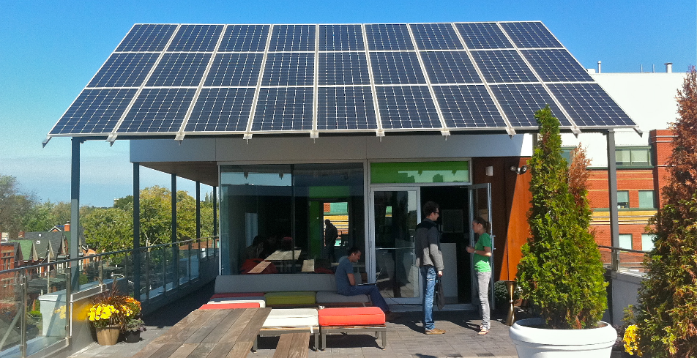
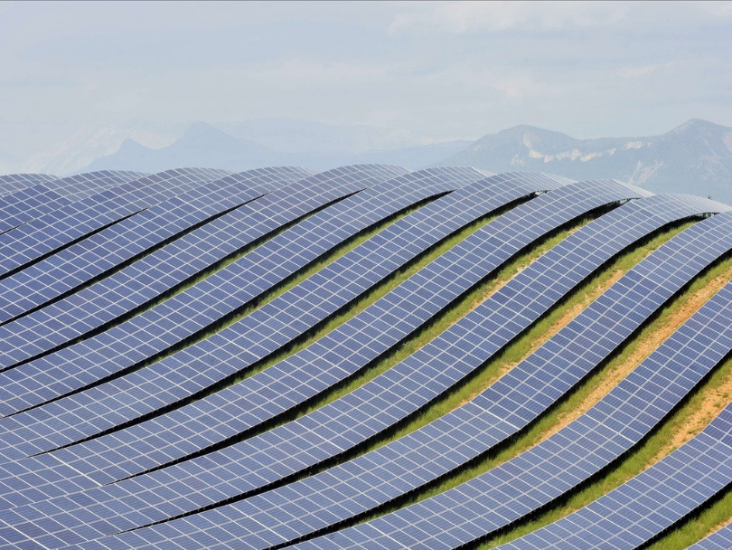
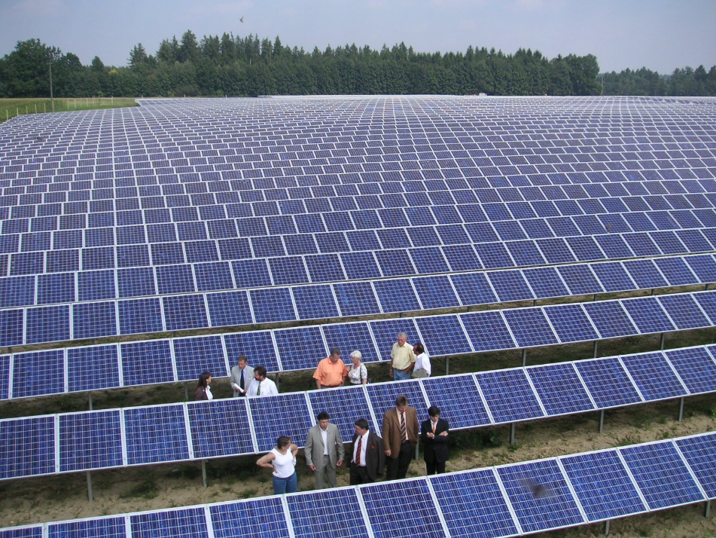
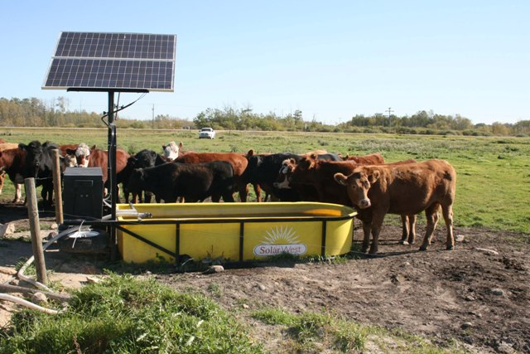
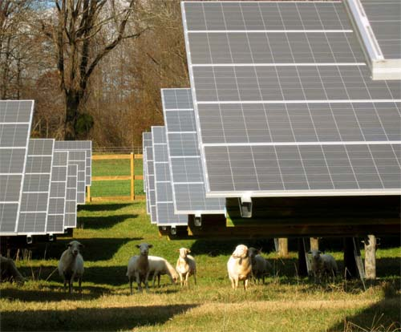
Examples of Solar Installations

Slide 35
Concentrating Solar Power Systems
Principle
Electricity generated with heat, not light
Use of mirrors and lenses to concentrate and focus sunlight onto a thermal receiver, which absorbs and converts sunlight into heat
Pressurized steam spins a turbine to produce electricity
Over 1,400 MW installed capacity in the US
Requirements
Exposure to high direct solar radiation
5 to 10 acres of land per MW of capacity
Access to water resources for cooling
Proximity to transmission grid
Types of designs
Parabolic Through System
Compact Linear Fresnel Reflector
Power Tower
Dish-Engine

Slide 36
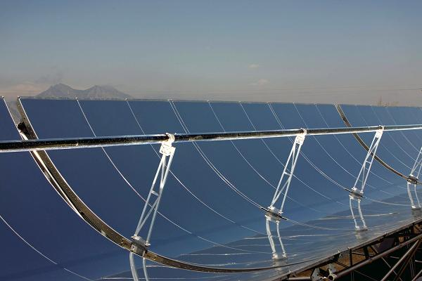
Parabolic Trough Systems
Curved mirrors focus sunlight onto a receiver tube that runs down the center of a trough
In the receiver tube, a high-temperature heat transfer fluid (such as a synthetic oil) absorbs the sun’s energy, reaching temperatures of 750°F or even higher, and passes through a heat exchanger to heat water
Steam turbine power system produces electricity
Modular and scalable design
Widely used since mid 1980’s
In the USA, more than 350 MW of parabolic through plants in operation
In Spain, over 1 GW capacity
Receiver tube
Source: [24][25]

Slide 37
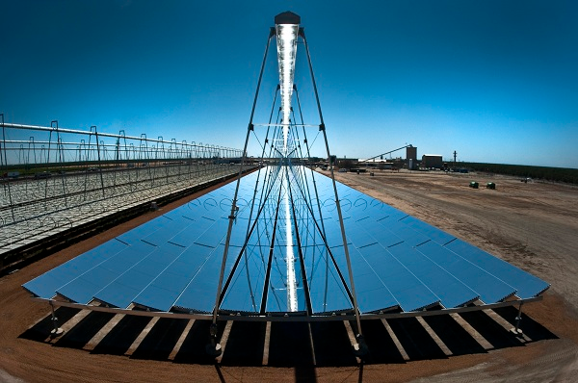
Compact Linear Fresnel Reflector
Receiver tube
Use of long parallel rows of flat mirrors to lower cost
Source: [24][26]

Slide 38
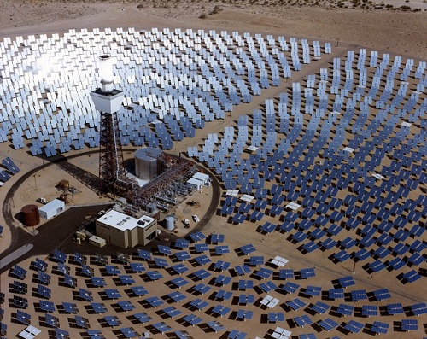
Power Tower
A central receiver system yields higher operating temperatures and greater efficiencies
Computer-controlled flat mirrors (heliostats) track the sun along two axes and focus solar energy on a receiver at the top of a high tower
The focused energy heats the transfer fluid around 800° F to 1,000° F
Receiver tube
Source: [24][27]

Slide 39
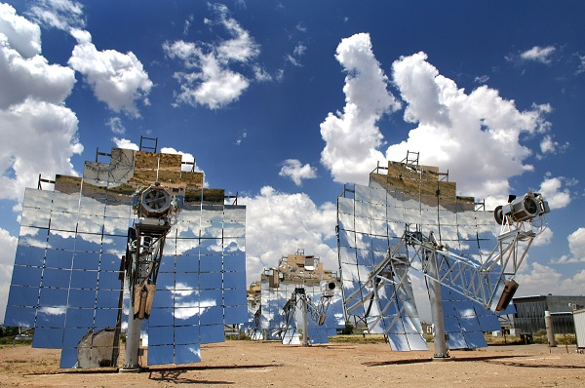
Dish-Engine
Mirrors are arranged over a parabolic dish surface to concentrate sunlight on a receiver fixed at the focal point
No use of steam
Heats up a working fluid such as hydrogen to 1,200° F in the receiver to drive a Stirling engine coupled to a generator
Each dish rotates along two axes to track the sun
Source: [24][27]

Slide 40
References
[1] https://www.ferc.gov/legal/staff-reports/2014/dec-infrastructure.pdf
[2] Photo courtesy of NASA
[3] http://www.eppleylab.com/solar.htm
[4] Perez & Perez. 2009. A fundamental look at energy reserves for the planet.
[5] http://sroeco.com/solar/table/
[6] http://scitation.aip.org/content/aip/journal/jrse/5/3/10.1063/1.4808264
[7] https://www1.eere.energy.gov/solar/pdfs/solar_timeline.pdf
[8] http://www.rafmuseum.org.uk
[9] http://www.snooksmotorsport.com.au/solartrek/Solar_Trek/Solar_Trek_The_Journey.htm
[10] http://www.biography.com/people/thomas-edison-9284349
[11] http://www.biography.com/people/nikola-tesla-9504443
[12] http://inventors.about.com/library/inventors/blsolar3.htm
[13] http://www.solar-facts-and-advice.com/monocrystalline.html
[14] http://www.solar-facts-and-advice.com/polycrystalline.html
[15] http://www.solar-facts-and-advice.com/thin-film.html

Slide 41
References
[16] https://www.teachengineering.org/view_lesson.php?url=collection/cla_/lessons/cla_lesson6_efficiency/cla_lesson6_efficiency.xml
[17] http://en.wikipedia.org/wiki/Energy_conversion_efficiency#/media/File:Efficiency_diagram_by_Zureks.svg
[18] http://www.samlexsolar.com/learning-center/solar-cell-module-array.aspx
[19] http://www.solar-electric.com/solar-charge-controller-basics.html
[20] http://www.powerinverters.org/
[21] http://chemwiki.ucdavis.edu/Analytical_Chemistry/Electrochemistry/Voltaic_Cells
[22] http://www.batteriesinaflash.com/wiring-your-battery-bank-in-series-parallel-and-series-parallel
[23] http://www.batterystuff.com/kb/articles/battery-articles/battery-basics.html#2
[24] http://www.seia.org/policy/solar-technology/concentrating-solar-power
[25] Photo courtesy of SkyFuel, Inc.
[26] Photo courtesy of AREVA Solar
[27] Photo courtesy of Sandia National Laboratories

