Slide 1
Parts, Colors, and Markings
Lecture 5

Slide 2
Parts of The Horse

Slide 3
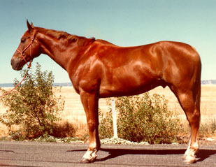
Sorrel
Body
Reddish or copper red
Mane and tail
Same
May be flaxen

Slide 4
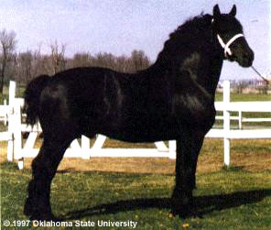
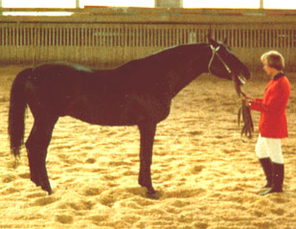
Black
Body color
True black without light areas
Mane and tail
Black

Slide 5
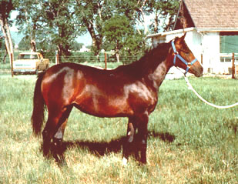
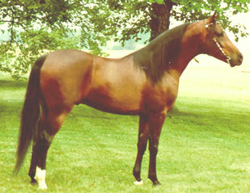
Bay
Body color
Tan / red / reddish-brown
Mane and tail
Black
Black on lower legs

Slide 6
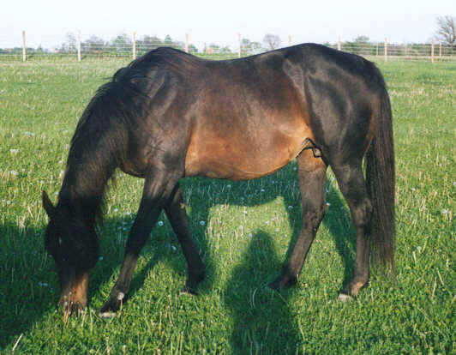
Brown
Body color
Brown or black
Light areas
Muzzle
Eyes
Flank
Inside upper legs
Mane and tail
Black or brown

Slide 7
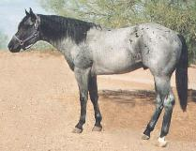
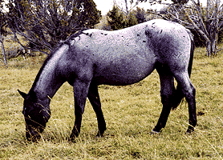
Blue Roan
Body
Uniform mixture of
white and black hairs
Dark Points

Slide 8
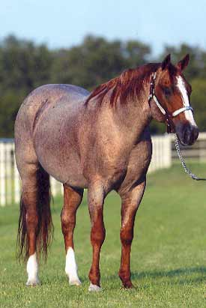
Red Roan
Body
Uniform mixture of white and red hairs
Red on head & lower legs
Red or flaxen mane & tail

Slide 9
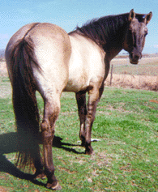
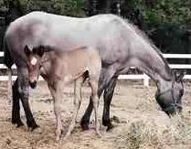
Grullo
Body
Smoky or mouse-colored
Not a mixture of black and white hairs
Each hair mouse colored
Mane and tail
Black
Black on lower legs
Usually has dorsal stripe

Slide 10
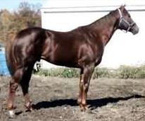
Chestnut or Liver Chestnut
Body
Dark red or brownish-red
Mane and tail
Usually dark red
Brownish red
May be flaxen
Lower legs red
May have dorsal stripe

Slide 11
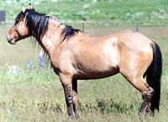
Dun
Body
Yellowish or gold
Mane and tail
Black or brown
Dorsal stripe
Zebra stripes on leg
Transverse stripe over withers

Slide 12
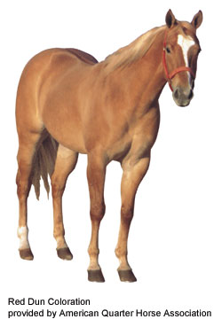
Red Dun
Body color
Form of dun
yellowish or flesh colored
Mane and tail
Red or reddish
Flaxen
Red dorsal stripe
Zebra stripes
Transverse stripe

Slide 13
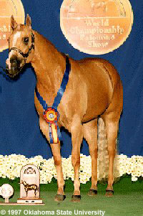
Palomino
Body
Golden yellow
Mane and tail
White
Typically no dorsal stripes

Slide 14
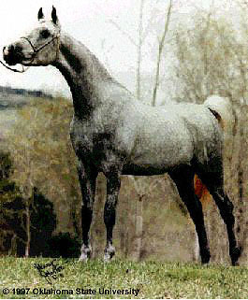
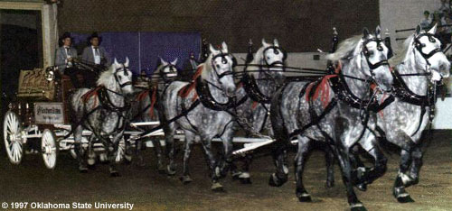
Gray
Body
Mixture of white with any other colored hairs
Often born solid
Lighter with age
May have dorsal stripe

Slide 15
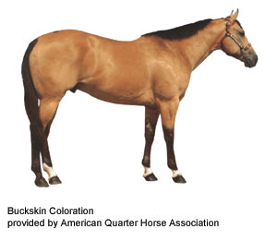
Buckskin
Body Color
Yellowish or gold
Mane and tail
Black
Usually black on lower legs
Typically do not have dorsal stripes

Slide 16
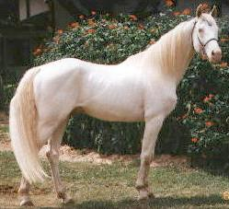
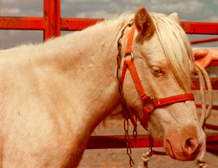
Cremello
Body color
White or light cream
Mane and tail
White
Pink or pinkish skin over entire body
Blue eyes

Slide 17
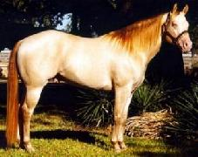
Perlino
Body color
White or light cream
Mane and tail
Usually have a darker tint
Pale copper or orange
Pink or pinkish skin over entire body
Blue eyes

Slide 18
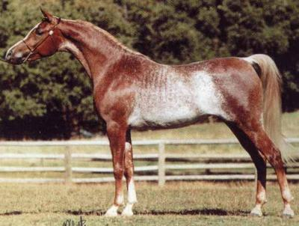
Rabicano
Body
Interspersed white hairs
Most dense from
Flank to tailhead
Not Roan

Slide 19
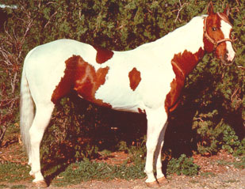
Tobiano
Dark color usually covers
One or both flanks
Generally
All four legs are white
At least below the hocks and knees
Spots
Regular and distinct appearance of a shield

Slide 20
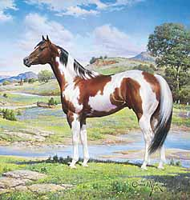
Tobiano
Head markings
Like solid-colored horse
May have blaze, strip, star or snip
May be either
Predominantly dark or white
Tail is often two colors

Slide 21
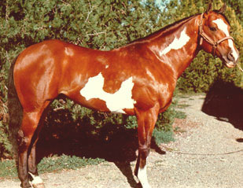
Overo
White
usually will not cross back
Between withers and tail
Generally
At least one and often all four legs dark
White irregular
Scattered or splashy

Slide 22
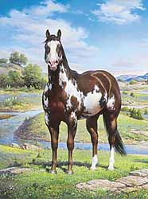
Overo
Head markings often
Bald-faced
May be either
predominantly dark or white
Tail usually one color

Slide 23
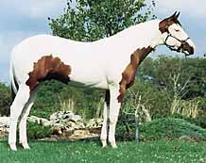
Tovero
Dark pigmentation around ears
May expand to cover
Forehead and/or eyes
One or both eyes blue
Dark pigmentation around
Mouth
May extend up sides of face and form spots

Slide 24
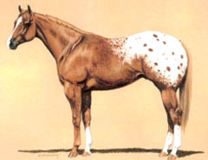
Blanket
Solid white area
Normally over
Hip area
Contrasting base color

Slide 25
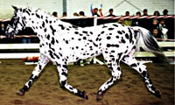
Leopard
Predominantly
White with spots of color over their body
Sometimes
Spots more concentrated head and leg areas
Spots may also occur
Direction hair grows
Most evident in the flank area

Slide 26
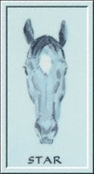
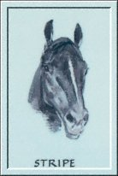
Head Markings
Star: white mark on forehead
Stripe: narrow white mark down the face

Slide 27
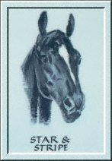
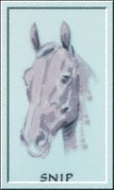
Head Markings
Star & Stripe: connected star and stripe
Snip: white mark between the nostrils

Slide 28
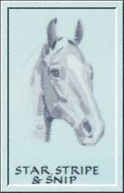
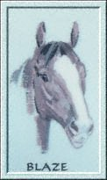
Head Markings
Star, stripe, snip: connected star, stripe, and snip
Blaze: broad white mark down the face, extending over nose

Slide 29
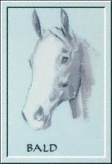
Head Markings
Bald: very wide blaze, covering most of the face extending down over the nostrils

Slide 30
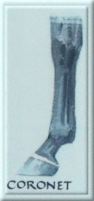
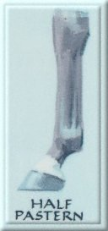
Leg Markings

Slide 31
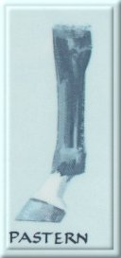
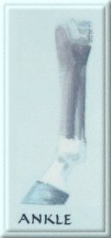
Leg Markings

Slide 32
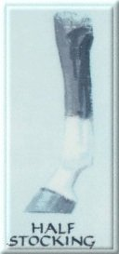
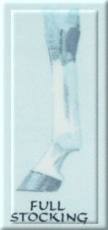
Leg Markings

Slide 33
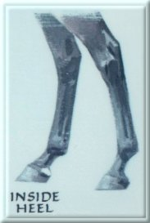
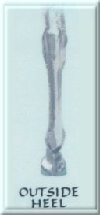
Leg Markings

