Slide 1
Wind Energy
ASEEN - Teacher Professional Development Workshop

Slide 2
Solar Energy
Solar energy is energy generated by the sun’s radiation The sun’s radiation is created by the intense pressure and heat at its core, which creates a nuclear reaction called fusion.
This energy, in the form of radiant light and heat, escapes from the surface of the sun, travels through space and strikes the surface of the Earth

Slide 3
Solar Energy
Solar energy is the most abundant source of energy on Earth.
The amount of energy striking the Earth’s atmosphere is approx. 1,366 watts per sq. meter.
Only 70%, or approx. 1,000 watts reaches the Earth’s surface.
The amount of solar energy striking the Earth in one hour is more than the world uses in an entire year.

Slide 4
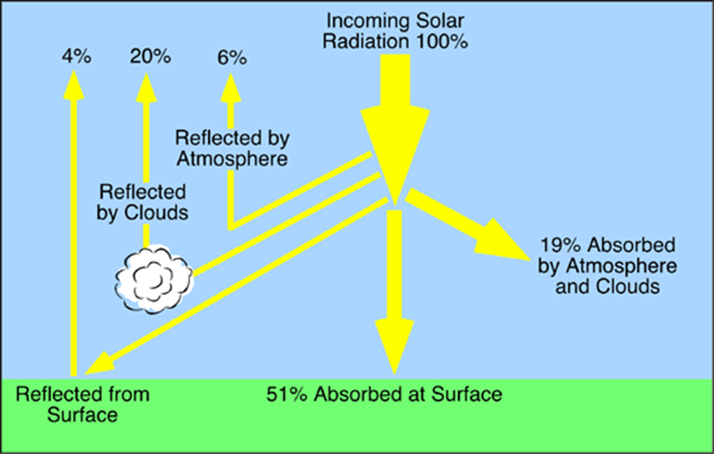

Slide 5
Wind Energy
Wind is the movement of air across the Earth due to changes in atmospheric pressure and temperature caused by the sun.
Wind power is generated by air movement or wind.
Devices such as windmills and wind turbines convert kinetic energy from the wind into mechanical or electrical power.

Slide 6
Wind Energy
Wind is a desirable energy source because it is renewable.
A renewable energy source is one that replenishes constantly.
Fossil fuels are the most used energy source.
Fossil fuels are considered a nonrenewable energy source.

Slide 7
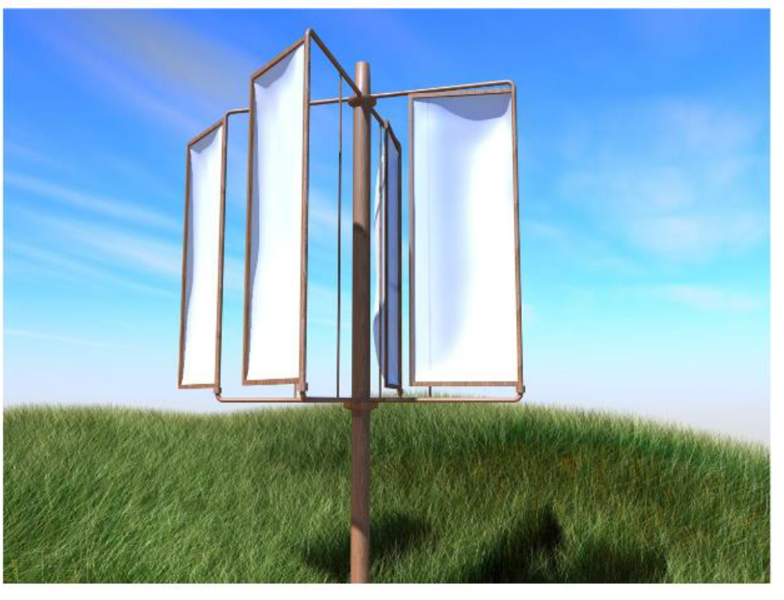
Wind Energy History
Notes:
10th Century. The first application of a windmill was grinding grains. The first known windmills were invented by the Persians and called Panemones. The blades were vertical sails connected to a horizontal shaft that rotated on a vertical axis.

Slide 8
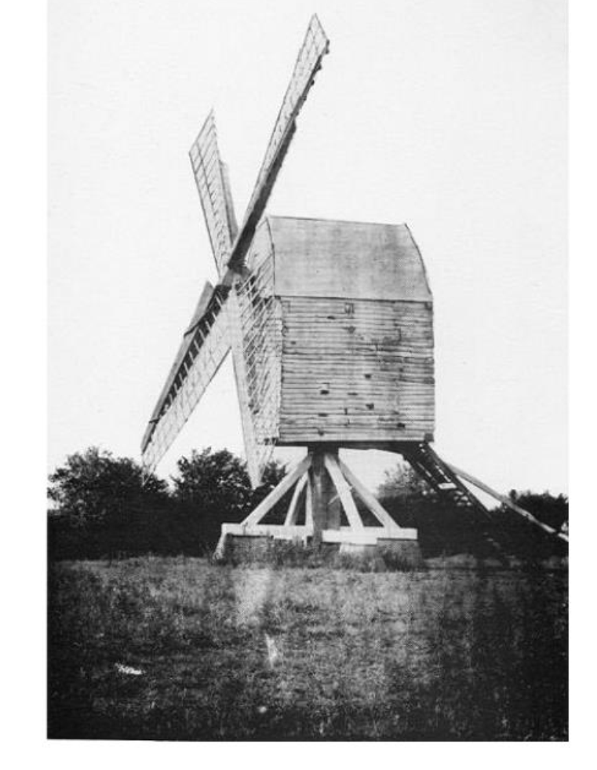
12th Century Wind Energy
Notes:
12th Century. The Europeans used windmills before the industrial revolution for several mechanical applications, such as grinding grain, cutting wood, and pumping water. The 13th century Europeans designed their windmills to rotate on a horizontal axis mounted on a central post, hence their name, post mill.

Slide 9
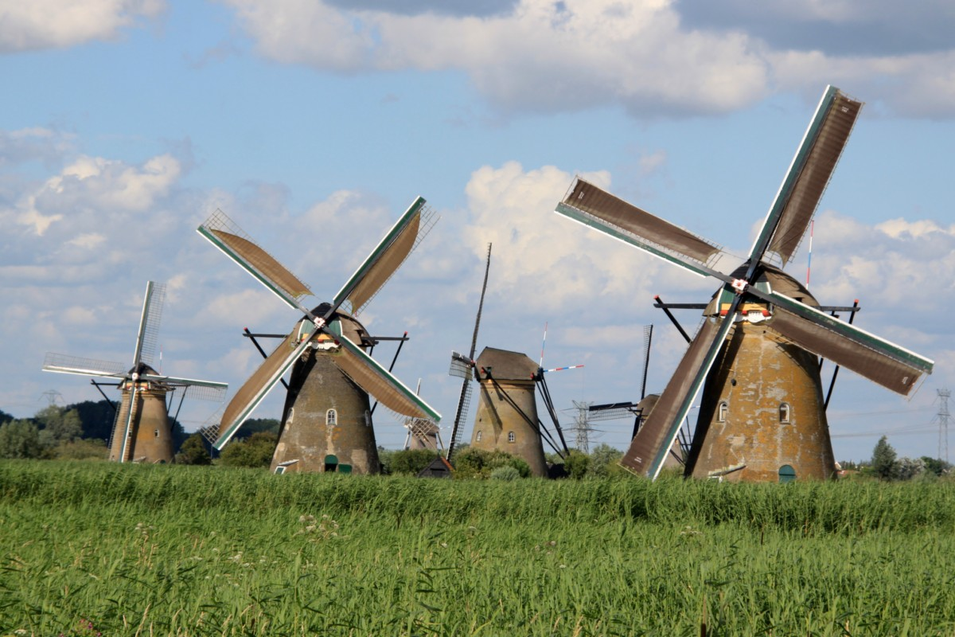
14th Century Wind Energy
Notes:
In the 14th century, the Dutch used towers that were several stories high to elevate the post mills where the wind speeds were greater. These windmills were mostly designed with four blades and a lever to manually orient the rotor. The use of these windmills diminished in the 19th century due to the popularity of steam turbines.

Slide 10
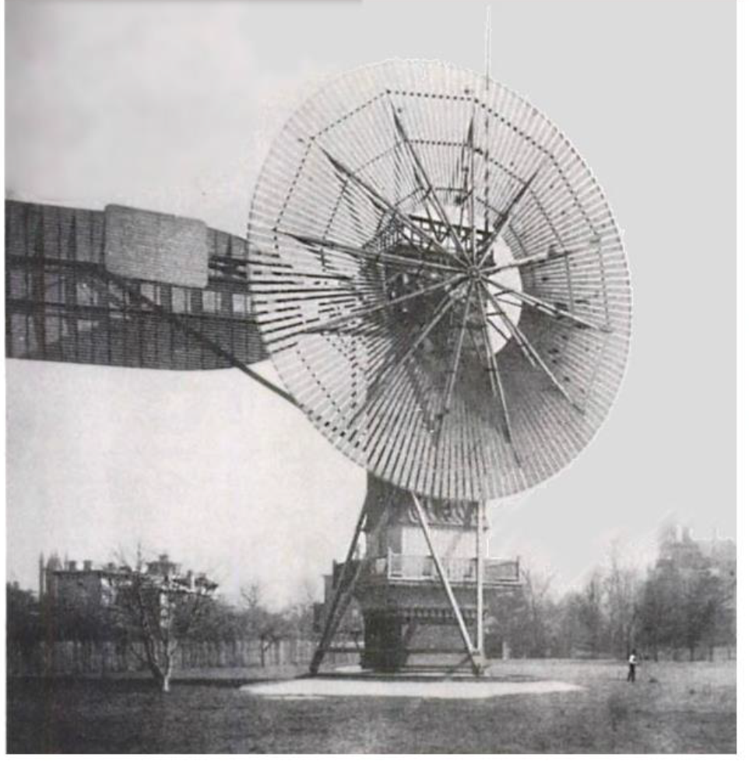
19th Century Wind Energy
Notes:
Charles F. Brush built the first windmill, or wind turbine, that generated electricity in 1888. It was a post mill designed with multiple blades and produced 17 kilowatts (kW). The Brush Mill became obsolete after 20 years due to the development of more efficient wind turbine designs. His company, Brush Electric in Cleveland, Ohio, was sold in 1889 and in 1892 it was merged with Edison General Electric Company under the name General Electric Company (GE).
Despite the size of the turbine, the generator was only a 12 kW model. This is due to the fact that slowly rotating wind turbines of the American wind rose type do not have a particularly high average efficiency. It was the Dane Poul la Cour, who later discovered that fast rotating wind turbines with few rotor blades are more efficient for electricity production than slow moving wind turbines.

Slide 11
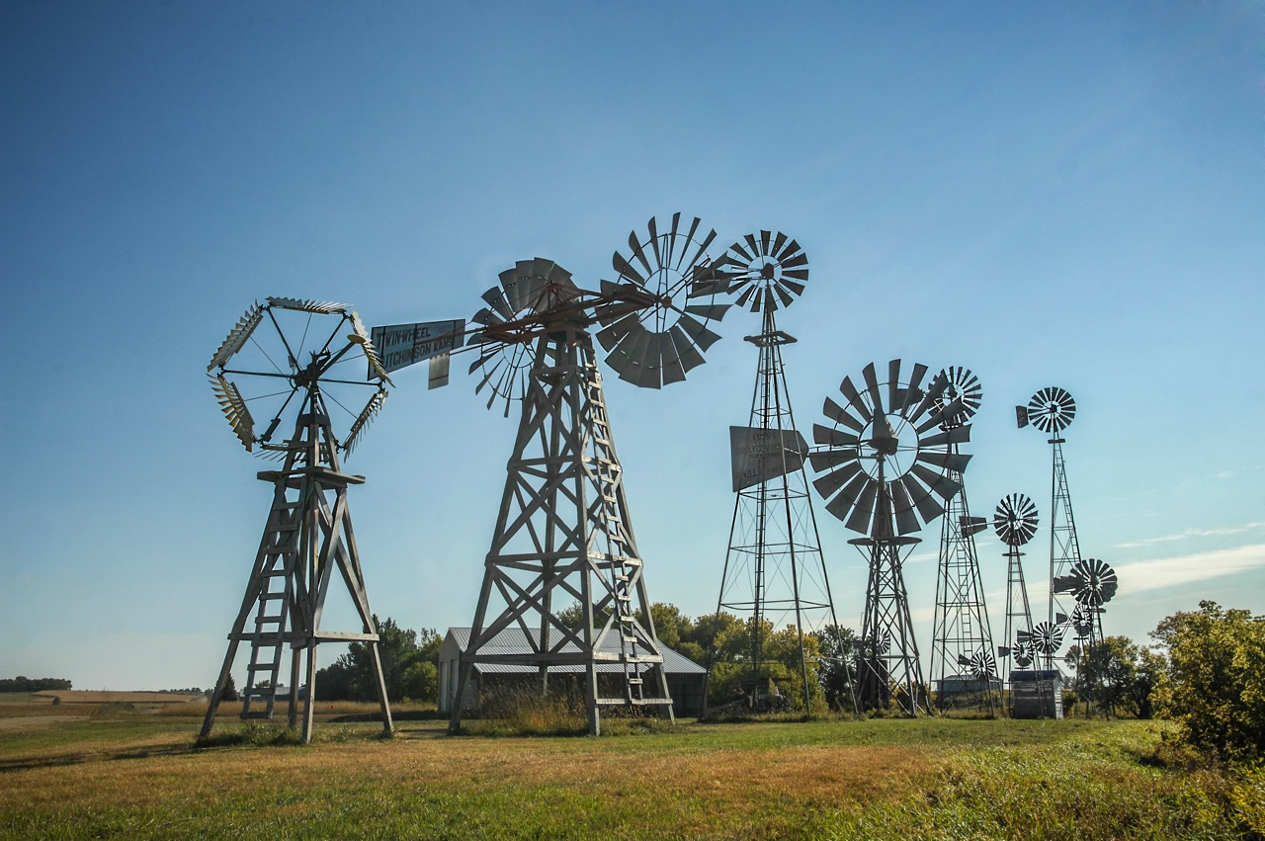
19th Century Wind energy
Notes:
Wind mills were used in America during the late 19th century primarily to pump water to farm houses and the railroad. Water was needed for the steam-powered locomotives, which were the main source of commercial transportation at the time.

Slide 12
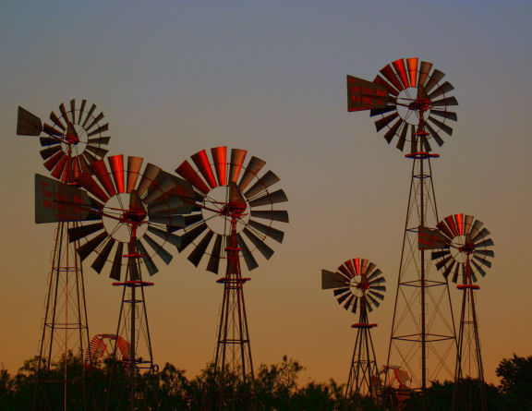
19th Century Wind energy

Slide 13
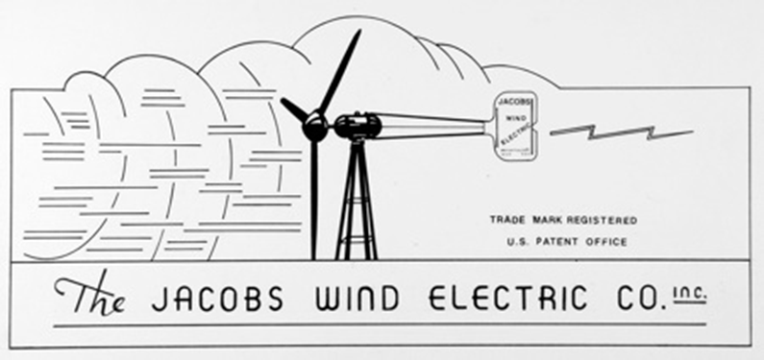
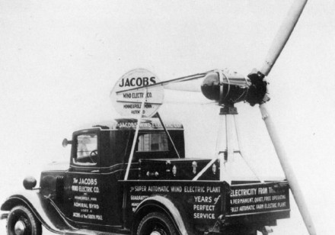
Marcellus Jacobs
Notes:
Smaller wind turbines made by Marcellus Jacobs gained popularity in the 1920s and 1930s, particularly in rural regions. The firm was started by Marcellus and Joseph Jacobs, after local interest in their wind electric system for their family’s Montana Ranch, built in 1922,^{[2]} brought them requests from neighbors to provide them with wind generated electric power as well. Jacobs and his brother built their first wind turbine generator on the family ranch near Wolf Point, Montana in 1922. They moved the Jacobs Company to Minneapolis in 1930 where they produced their famous 1.8 KW, 2.5 KW and 3.0 KW Jacobs wind generators. Those units were sold to thousands of farmers and ranchers in the US and around the world. The system had a three bladed, variable-pitched rotor with Sitka Spruce blades and a direct-drive generator.
Jacobs’ turbine had three blades attached to a rotor or hub.
The blades had a true airfoil design and closely resembled the blades used today.
The electricity generated by the windmill was stored in batteries.

Slide 14
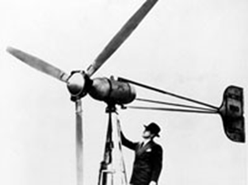
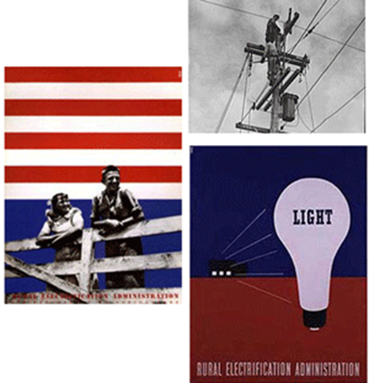
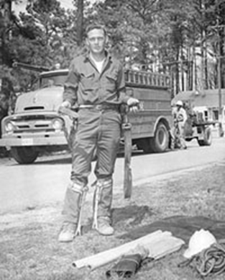
20th Century Wind Energy
Notes:
During the mid 1920’s, small scale wind turbines were used to light farms and supply electrical power to the Great Plains of the American Mid-West region. The use of small scale wind turbines decreased after the utility grid was expanded in the 1930s and 1940s to include these areas.
The Rural Electrification Act of 1935 provided federal loans for the installation of electrical distribution systems to serve rural areas of the United States. The Rural Electrification Act was also an attempt made by FDR's New Deal to deal with the crippling amount of unemployment. At the time the Rural Electrification Act was passed, electricity was commonplace in cities but largely unavailable in farms, ranches, and other rural places. In the 1930s, the provision of power to remote areas was not thought to be economically feasible. A 2300 volt distribution system was then used in cities. This relatively low voltage could only be carried about 4 miles before the voltage drop became unacceptable.
REA cooperatives used a 6900 volt distribution network, which could support much longer runs (up to about 40 miles). Despite requiring more expensive transformers at each home, the overall system cost was manageable.
REA crews travelled through the American countryside, bringing teams of electricians along with them. The electricians added wiring to houses and barns to utilize the newly available power provided by the line crews. By 1939 the REA had helped to establish 417 rural electric cooperatives, which served 288,000 households. The actions of the REA encouraged private utilities to electrify the countryside as well. By 1939 rural households with electricity had risen to 25 percent.

Slide 15
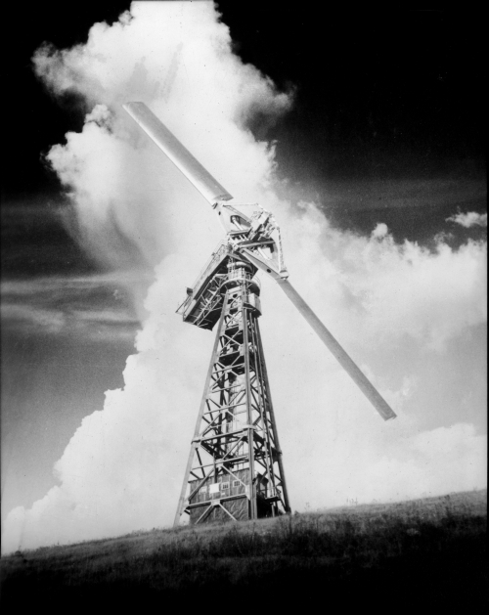
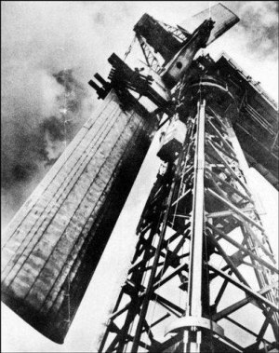
20th Century Wind energy
Notes:
On a hilltop in Rutland, Vermont, "Grandpa's Knob" wind generator supplied power to the local grid for several months during World War II. The Smith- Putnam machine was rated at 1.25 megawatts in winds of about 30 miles per hour. It was removed from service in 1945 because of design failure due to structural issues.

Slide 16
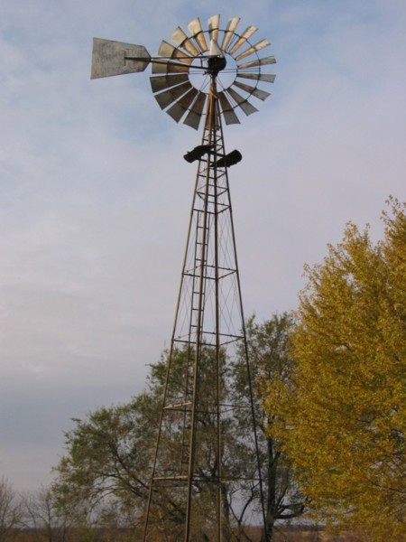
Windmills
Windmills convert wind power into mechanical energy to operate machinery.
The machinery may be used to pump water, run a grinding stone, cut lumber, or perform other mechanical applications
Notes:
In 1854, the first windmills were used in the United States and were mainly used to pump water for crops. Many of the water pumping windmills in the United States are still operable in this day and age. These windmills were typically smaller and did not take up as much space as their European counterparts as they were not used typically for milling, which requires a much larger unit. The blades on these early US windmills were made from wood and had a “tail” that would catch the wind so the need for a windsmith was not a factor. They could not house any one and were stand alone units. In 1870, the blades were changed from wooden to steel and this allowed for a more proficient means of turning the blades as they could be made into any shape and were much lighter. Many of the windmills had to be restructured because of the speed of the steel blades. It is interesting to note that in the United States alone; more than six million windmills were erected from the period of 1850 and 1970.

Slide 17
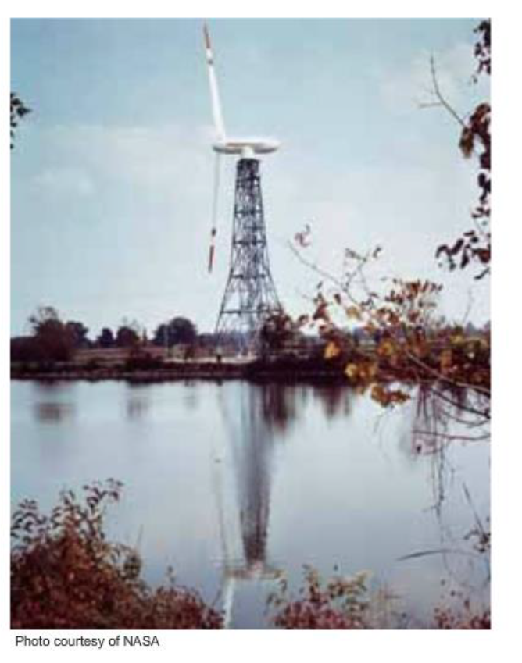
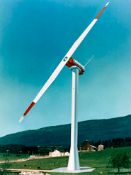

20th Century Wind Energy
Notes:
The US Department of Energy, due to an oil crisis, invested in the research and design of large scale wind turbines in 1973. NASA made several design attempts, but it’s designs co/.ntinued to be problematic, which led the Federal Government to remove much of the funding in 1981.
After 1981, several small private companies successfully installed and operated 15,000 medium sixed wind turbines on wind farms in California, where there were state and federal tax incentives. Unfortunately, these incentives were phased out in the late 1980s, which deterred progress on the wind industry in the United States.

Slide 18
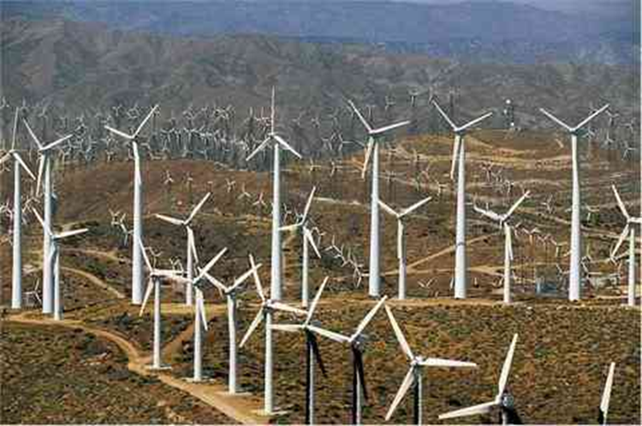
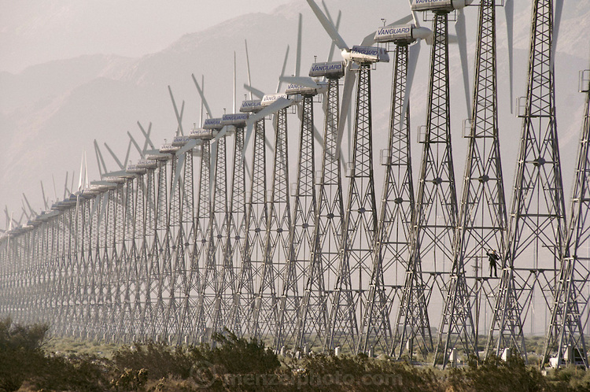
20th Century Wind Energy
Notes:
After 1981, several small private companies successfully installed and operated 15,000 medium sixed wind turbines on wind farms in California, where there were state and federal tax incentives. Unfortunately, these incentives were phased out in the late 1980s, which deterred progress on the wind industry in the United States.

Slide 19
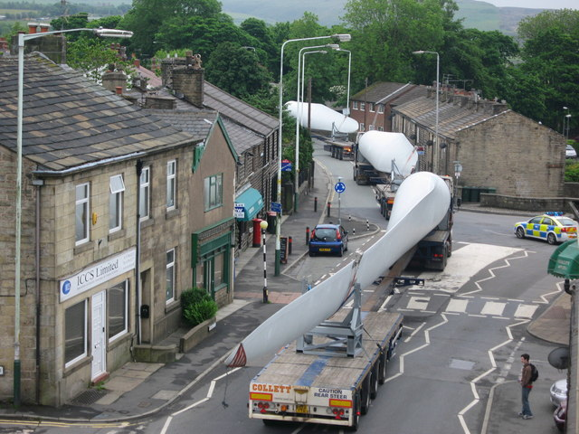
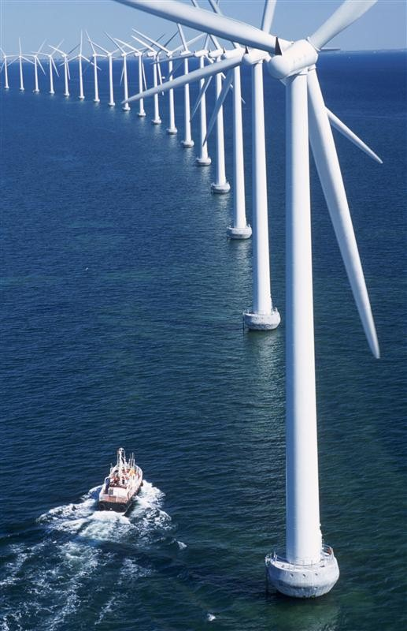
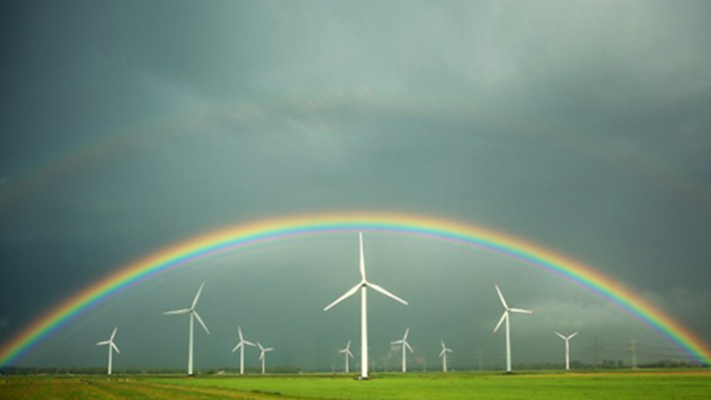
20th Century Wind Energy
Notes:
Wind industry development transitioned to Europe in the 1990s. High energy costs and increasing wind turbine efficiency resulted in drastic increase in installations of wind turbines throughout Europe.
The US and several other countries are currently driven by the need to reduce the demand on fossil fuels for energy. Therefore, they are installing several utility scale wind turbines where there are available wind resources. By the end of 2010, 200,ooo MW of global wind turbine capacity had been installed.

Slide 20
Break Time

Slide 21
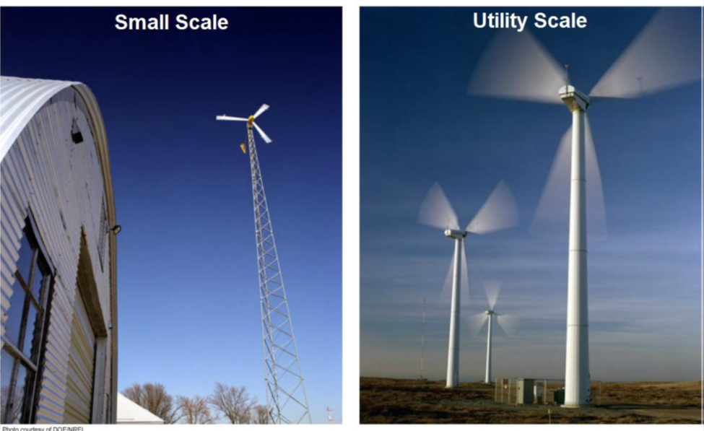
Wind turbine Categories

Slide 22
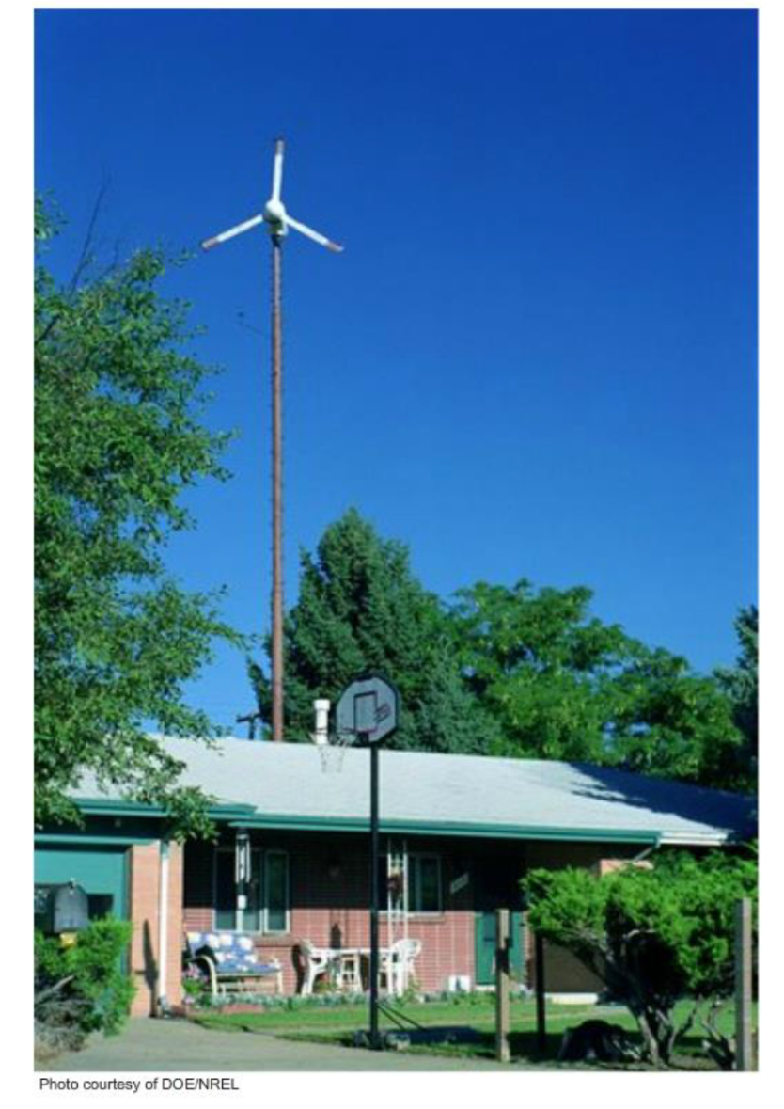
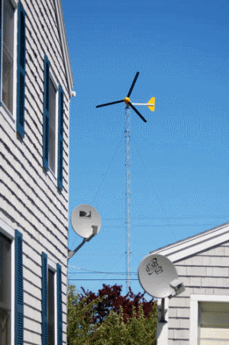
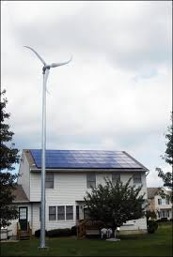
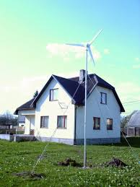
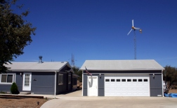
Small Wind
Notes:
By investing in a small wind system, you can reduce pollution and reduce your exposure to future fuel shortages and price increases. Deciding whether to purchase a wind system, however, is complicated; there are many factors to consider. But if you have the right set of circumstances, a well-designed wind energy system can provide you with many years of cost-effective, clean, and reliable electricity.
Small wind energy systems can be used in connection with an electricity transmission and distribution system (called grid-connected systems), or in stand-alone applications that are not connected to the utility grid. A grid-connected wind turbine can reduce your consumption of utility-supplied electricity for lighting, appliances, and electric heat. If the turbine cannot deliver the amount of energy you need, the utility makes up the difference. When the wind system produces more electricity than the household requires, the excess can be sold to the utility. With the interconnections available today, switching takes place automatically. Stand-alone wind energy systems can be appropriate for homes, farms, or even entire communities (a co-housing project, for example) that are far from the nearest utility lines. Either type of system can be practical if the following conditions exist.

Slide 23
Small wind
Notes:
The tail, if present, turns the rotor into the wind, which allows the wind to turn the rotor. The rotor turns a shaft that is geared to turn a generator, which generates electricity. The transmission cable carries the generated electricity to the load. The balance of the system components such as the inverter and batteries, regulate the power according to the type of wind power sysem.

Slide 24
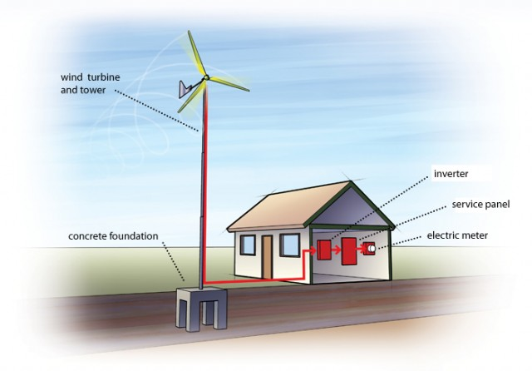
Small Wind
Notes:
Small scale wind turbines have power ratings up to 100 kW. The electricity generated from small scale wind turbines is typically transmitted directly to the end user. Any extra power is often stored in batteries or added to the utility grid.
On average, a typical American home would require a small turbine with a 5-kilowatt generating capacity to meet all its electricity needs. A machine of this size has a diameter of approximately 18 feet. The exact size needed to power a home, however, can range from 2 kW to 10 kW (12-25 ft. diameter) based on a home’s energy use, average wind speeds, and the turbine’s height above ground (which affects its productivity).
The average height of a small wind turbine (of any capacity) is about 80ft. (about twice the height of a neighborhood telephone pole), with a range of 30-140 ft. Generator size and tower height are not generally related; a 5-kW turbine could be on a tower anywhere from 30-140 ft. in height, for example. However, for good performance, experts recommend that small turbines be installed at a height of at least 30 feet above nearby obstructions such as trees.
The length of the payback period depends on the turbine, the quality of wind at the installation site, prevailing electricity rates, and available financing and incentives. Depending on these and other factors, the time it takes to fully recover the cost of a small wind turbine is 6 to 30 years.
The purchase and installation of a system large enough to power an entire home costs, on average, $30,000, but the price can range from $10,000 to $70,000 depending on system size, height, and installation expenses. The purchase and installation of very small (<1 kW) off-grid turbines generally cost $4,000 to $9,000, and a 100-kW turbine can cost $350,000. The federal government and many states have rebate or tax credit programs in place to encourage investment in small wind.
What happens when the wind does not blow?
For grid-connected systems,the user will not notice a difference when the wind is not blowing. The utility provides electricity when the wind does not blow, and any extra electricity the turbine generates is sent back to the utility system to be used by a neighbor. Off-grid turbines store power in batteries for on-demand use and are often complemented by solar electric panels to provide more consistent generation.
How much land and wind are required? Will my town let me install a turbine?
Installers recommend sites with average wind speeds of at least 12 mph, but specific land requirements vary from place to place. Zoning codes sometimes impose a minimum requirement on lot size or on the distance a turbine maybe placed from a property line, and may vary depending on the height of the proposed turbine. Also, it is essential to have a site with unobstructed access to winds, which most often requires higher towers, larger land lots, and non-urban locations. Currently, less than 1 percent of all small wind turbines are used in urban applications partly due to zoning restrictions, but mostly because wind quality is much poorer in densely built environments. Contact your turbine factory dealer for help navigating the permitting process.
Are batteries or other storage needed?
There are two types of systems: those connected to the electricity grid (“on-grid”) and those used off-grid (for battery charging) or backup power. Many systems sold today are off-grid, but demand is rising for on-grid systems which essentially use the grid as a "battery": when the wind blows, the owner uses electricity from the turbine; when winds are low and consumption is high, the owner uses electricity from the grid. The smallest wind turbines are often used in conjunction with solar photovoltaic technology.

Slide 25
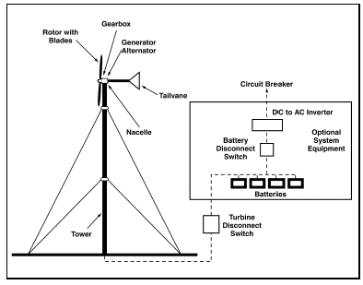
Stand Alone System

Slide 26
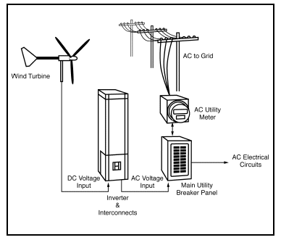
Grid – Tied System
Notes:
If your home or farm is connected to the power grid, on windier days you may be able to "sell" excess power generated by your wind turbine to your utility. Then, at other times when your turbine cannot generate all the power you need, you would buy power from the grid. This concept is called "net metering", or "net billing".

Slide 27
Hybrid power systems
Notes:
Hybrid systems incorporate two or more energy sources to provide continuous power. An example is a combination of a wind turbine and solar photovoltaic system. Typically there is also a battery bank to store extra energy from either source.
The system is designed to switch between energy sources based on source availability at different times. Power is generated mostly from the wind turbine in the winter when there is typically less sunlight and generated mostly from the PV modules in the summer when there is less wind. Also power is generated mostly from the PV modules in the day when there is more sunlight and from the wind turbine at night when there is generally more wind.
The power generated from the wind turbine and PV modules is balanced to meet the demands of the load and if possible, to charge the battery bank. The battery bank supplies power when neither the wind turbine nor the PV modules can meet the demands of the system.

Slide 28
Utility Scale Wind
Notes:
Utility scale wind turbines are designed to operate onshore or offshore. Onshore wind turbine power ratings range from 750kW to 3MW. A megawatt is I million watts. The rotor of a utility scale wind turbine ranges from 52 to 96 meters (or better), with tower heights ranging from 40 to 120 meters.
Off shore wind turbines have power ratings that range from 3 to 6 MW and typically are larger than onshore wind turbines. Wind turbine sizes and power ratings continue to grow as wind turbine technology develops because larger turbines tend to be more efficient. Think economy of scale.

Slide 29
VAWT and HAWT
Notes:
There are two types of wind turbines based on the orientation of the rotor.

Slide 30
Vertical Axis Wind Turbine
Notes:
The rotor of a vertical axis wind turbine spins on an axis that is perpendicular to the ground or vertical. The generator is below the rotor shaft near the base. VAWTs have to be mounted to a solid surface, such as the roof of a building.
The advantages of VAWTS are they can operate at low speeds and in any wind direction. VAWTS are rarely used due to several disadvantages.
VAWTS are less efficient than HAWTs. One reason is VAWTs are often low to the ground, which means they are not in the path of higher wind speeds. Another reason is that the design of VAWTs exposes their blades to much higher stresses than HAWTs, which results in a shorter life span of a VAWT blade as compared to a similar HAWT blade.

Slide 31
Horizontal Axis Wind Turbine
Notes:
The rotor of a horizontal axis wind turbine spins around an axis that is parallel to the ground or horizontal. The rotor and generator sit on top of a tower. The electricity generated is transmitted down the tower through cables to transformers, typically located on the ground.
Most utility scale wind turbines are upwind horizontal axis wind turbines because they have several advanteges. One advantage is the tower elevates the HAWT so it in the path of higher winds speeds, which occur at higher altitudes.
Most HAWTs are designed so the rotor faces into the wind, or upwind.

Slide 32
Horizontal Axis Wind Turbine
Notes:
HAWTs als have several features which could be considered disadvantages. HAWTs cannot operate at low speeds. For example, a typical HAWT requires 4.5 meters per second wind speed to operate. The cut-in speed varies depending on the turbine design and manufacturer.
Another disadvantage is the challenge of transporting the HAWT parts. Modern HAWTs have very tall towers and large blades which can be difficult to transport. Typical blade avaerage approx. 61.5 meters but can be as long as 72 meters.

Slide 33
Wind Turbine components

Slide 34
Nacelle
Notes:
The nacelle is the housing and platform that is mounted at the top of the tower. It containes the generator, drive train, yaw system, hydraulic power unit, and turbine control unit. It protects the components from the effects of weather and technicians who perform maintenance and repair the turbine.

Slide 35
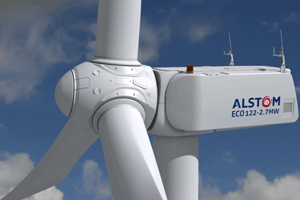
Rotor
Notes:
The rotor consists of the hub and blades. Most hubs have a pitch control unit that controls the pitch or angle of the blades. The blade pitch is controlled by hydraulic actuators or electric motors depending on the manufacturer.

Slide 36
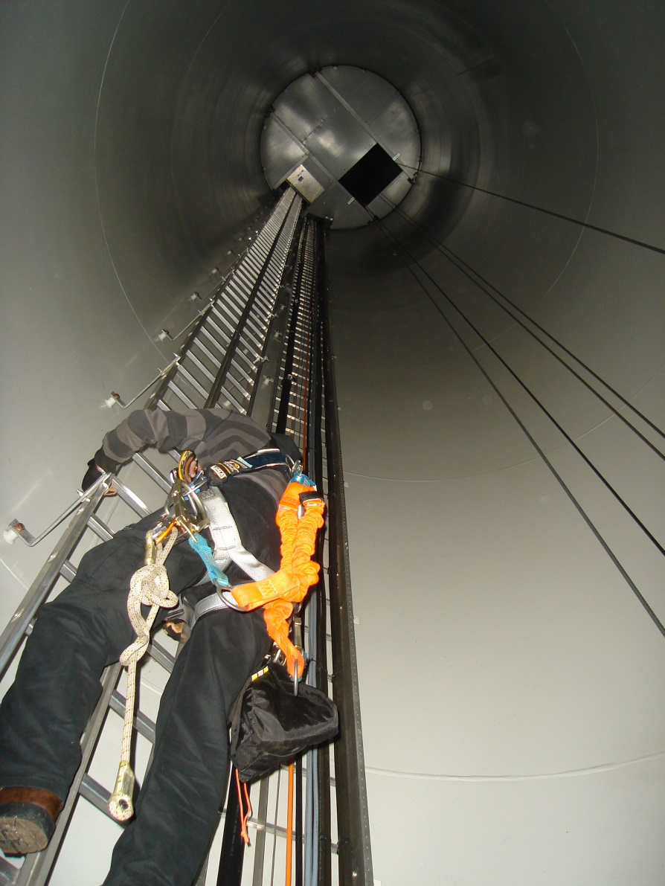
Tower
Notes:
The tower elevates the components of the turbine contained in the nacelle and hub. The tower is free standing and usually a tapered tubular design. It must be strong enough to withstand the dynamic and static forces of the turbine. The tower is equiped with a ladder to enable technicians to access the nacelle. As towers get taller, some are equipped with manlifts or climb-assist devices to make the climb easier.

Slide 37
Yaw system
Notes:
The yaw system rotates the nacelle so the rotor faces into the wind. Yaw is the movement of an object on a vertical axis.
The yaw system is located in the nacelle and typically uses an electric motor to drive a gearing system that rotates the nacelle. The gearing system is controlled by a brake system that holds the nacelle once it reaches the desired orientation.

Slide 38
Drive train
Notes:
The drive train is a gear shaft system that transfers the rotational energy from the rotor to the generator., which converts the energy to electricity. The drive train connects the rotor to the generator through a gearbox, which creates a higher shaft speed that drives the generator more efficiently. The drive train is located in the nacelle between the rotor and the generator.

Slide 39
Generator
Notes:
The generator converts the mechanical power from the drive train into electrical power.

Slide 40
Turbine control unit
Notes:
The TCU is the heart and brains of the utility scale wind turbine. The TCU is a computer control system that monitors and controls all aspects of turbine operation. The TCU operates by gathering all input data from sensors located throughout the turbine subsystems. It then uses that information and its programmed logic to command the turbine operations such as the Pitch Control Unit, Generator Control Unit and yaw system. The TCU is located in the nacelle.

Slide 41
Players in wind
Notes:
The wind power industry is comprised of companies, organizations and individuals working to ensure that the installed wind power systems operate correctly.
The wind power industry includes:

Slide 42
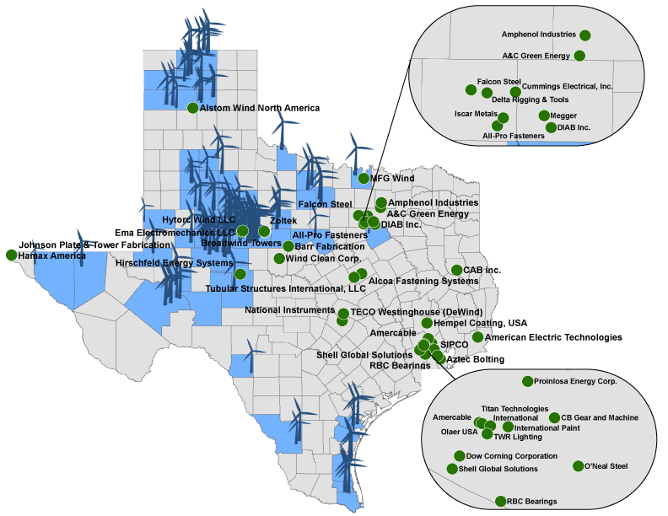
Wind industry in Texas

Slide 43
Landowners
Notes:
Typically in the utility scale wind market, private landowners lease land for wind farms to manufacturers, independent operators, and utility companies. In some cases, landowners will form landowners associations to negotiate with developers to facilitate the creation of large scale wind farms.

Slide 44
Associations
Notes:
Some associations work with governments to create national and state policy that works to stimulate the utility and small scale wind industry. An example is the American wind Energy /Association. They work with legislators to increase the public’s awareness of wind energy by sponsoring events to bring industry leaders together with media and the public.
Other institutions such as Texas State Technical College train people for wind industry careers.

Slide 45

Wind Energy Technology

Slide 46
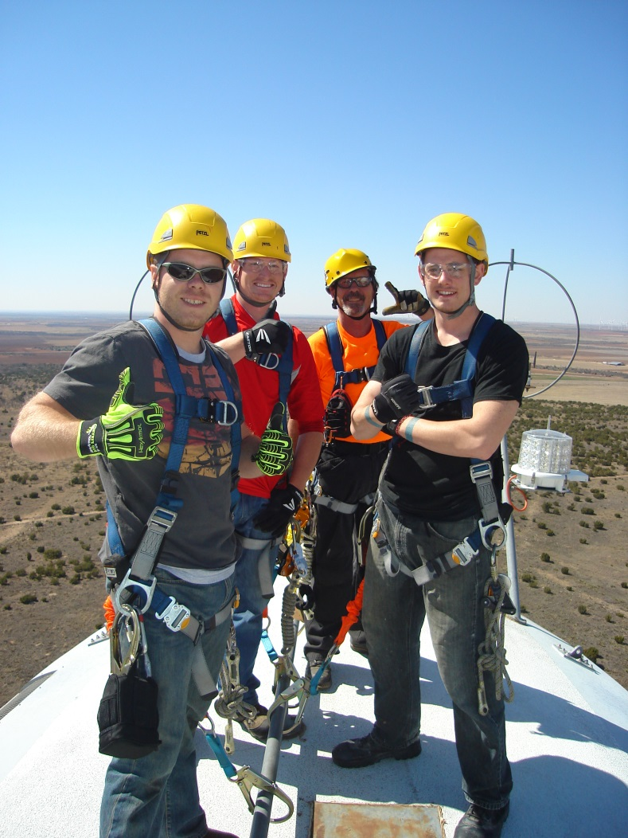
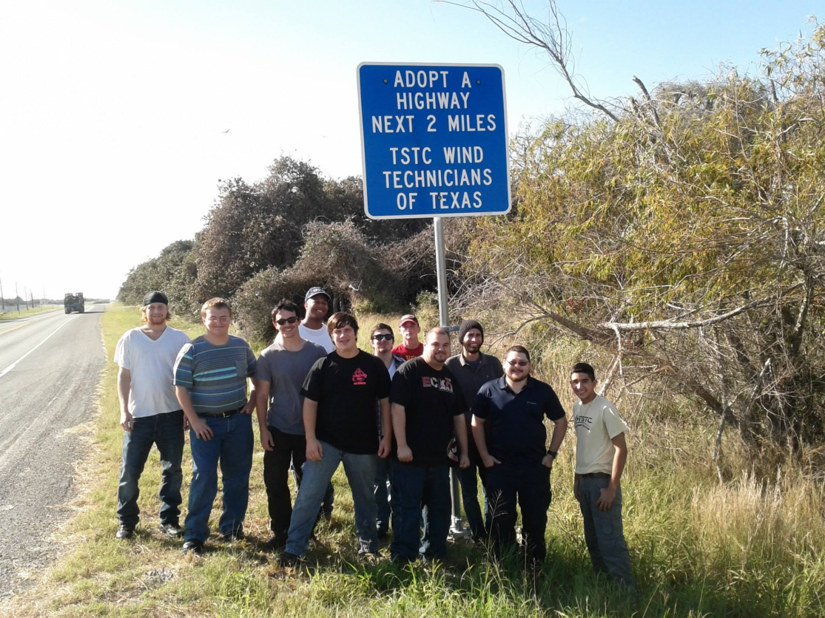
Tstc Wind energy technology

Slide 47
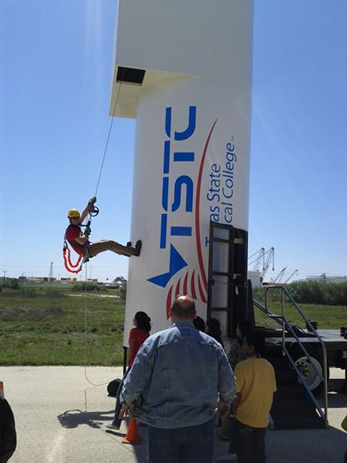
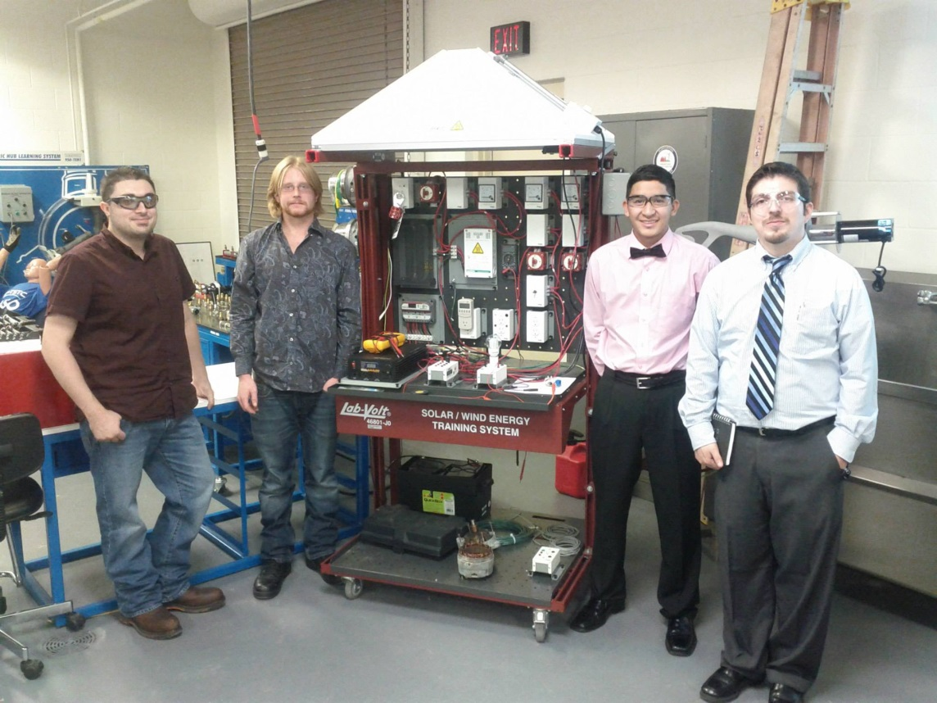
Tstc wind energy technology

Slide 48
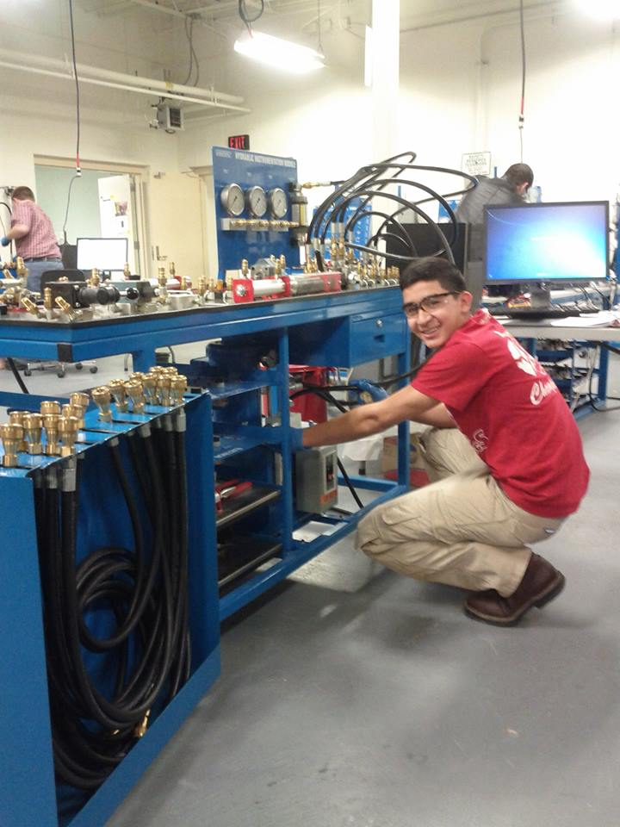
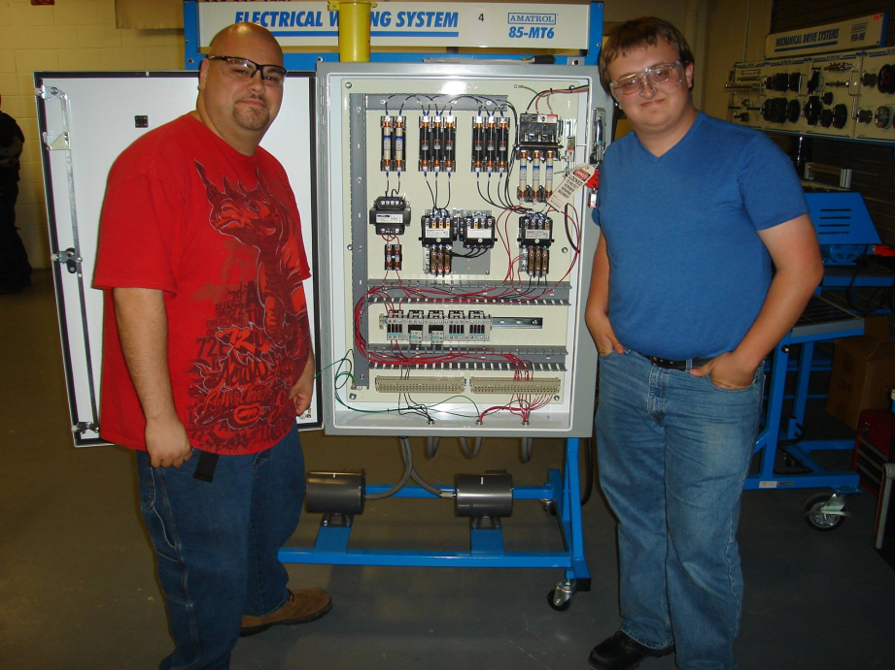
Tstc wind energy technology

Slide 49
Thank you

